Slide 1


Life in clean environment - a better future!
(Clean brownfields)
Kaunas City
PP No 5

Slide 2

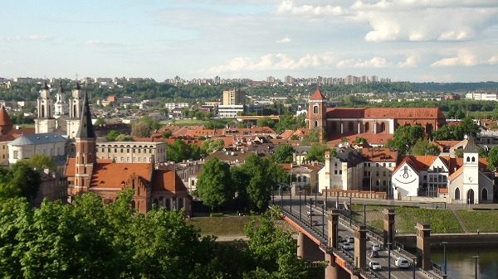
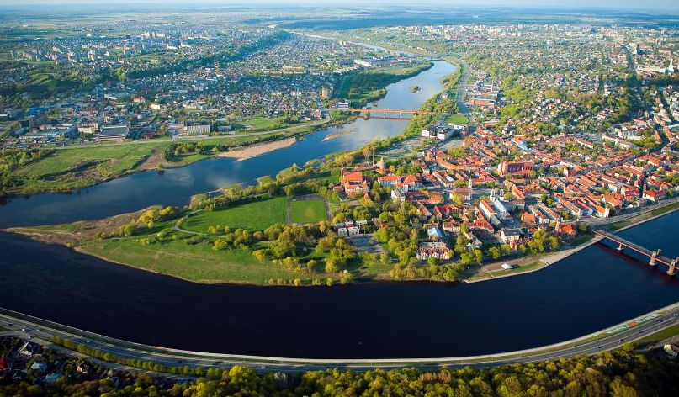

Clean Brownfields
KAUNAS CITY
Population ~ 300 000
Located in the centre of Lithuania
Historical City with large number of historical sites
Also neglected urban sites that require environmental regeneration

Slide 3
Clean Brownfields
Project partner No 5 - Kaunas City Municipal Administration is a local public authority
Long term experience implemeneting EU financed projects
Recently Kaunas has participated in similar themed EU projects: AT-FORT (Revitalised fortresses); REPAIR (Abandoned Military Sites); Baltic Fort Route (Trans-national Fortress Cooperation) and ReMiDo (Sustainable reintegration of post-soviet military areas)
Now implementing: Interreg V-A Latvia – Lithuania project „Cross-border Increase in Regional Cultural Heritage Tourism“ CIRCUIT
Most of above mentioned projects are related to Kaunas Fortress complex remains (constructed 1882 – 1915)

Slide 4
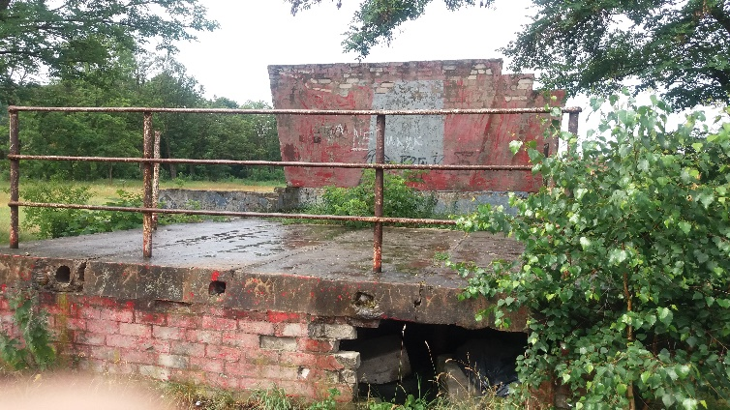
Clean Brownfields
Activities in the project
Regeneration of neglected object polluted with petrol products: stadium (10400 sq.m) in Kaunas Fortress artillery barracks area

Slide 5
Clean Brownfields
Expectations / outputs:
To strengthen our cross border activities and relationships through the production of relevant studies on urban regeneration growth
To gain experience in innovative and professional brownfield planning
To enhance our image as a safe and hospitable city through regeneration of public areas

Slide 6
Clean Brownfields
Thank you for your attention!

