Slide 1
Project activities in the Riga region
Challenges of the water tourism development in Riga region – central part of Latvia by the Gulf of Riga
Liesma Grīnberga
Riga planning region
Project coordinator
Sigulda, 17.04.2013.

Slide 2
Administration of Riga planning region
State institution – founded in 2006;
Legal form – derived public entity
Financial sources – state budget, local and international projects
Functions
Planning (monitoring of development planning, teritorrial planning, coordination of planning documents – local, regional, national);
Elaboration and implementation of development projects (local and international);
Culture coordination within region;
Public transport coordination;
EU Structural Funds Information centre;

Slide 3
Riga region
The driving force of development of Latvia,
competitive, European level region of metropolis,
with evenly high life standard in the whole territory
with attractive conditions for business & investments
with balanced and polycentric spatial structure
Target No.1
High quality human resources and their development
Target No.5
The increase of the role of Riga region locally and internationally
Target No.2
Convenient local and international reach of the region
Target No.4
High quality life standard
Target No.3
Competitive economy, varied and active business
Directions of action
1.1. Improvement of demographic situation
1.2. Development of healthcare, social, educational and cultural infrastructure and services
1.3. Improvement in provision with accommodations
1.4. Provision of preconditions favorable to employment
1.5. Development of information society
1.6. Development of civic society
Directions of action
5.1. Increase of the effectiveness of region administration
5.2. Expansion of collaboration on the state and international level
5.3. Promotion of uniform image of the region
Directions of action
4.1. Effective development of energy and environment infrastructure
4.2. Improvement of the quality of the city environment
4.3. Varied development of rural areas
4.4. Integrated development of the seacoast
Directions of action
2.1. Development of transport and transportation infrastructure
2.2. Development of communication infrastructure
Directions of action
3.1. Expansion of innovations in business and entrepreneurship
3.2. Increase of productivity
3.3. Increase of activities of entrepreneurship
3.4. Development and promotion of tourism

Slide 4
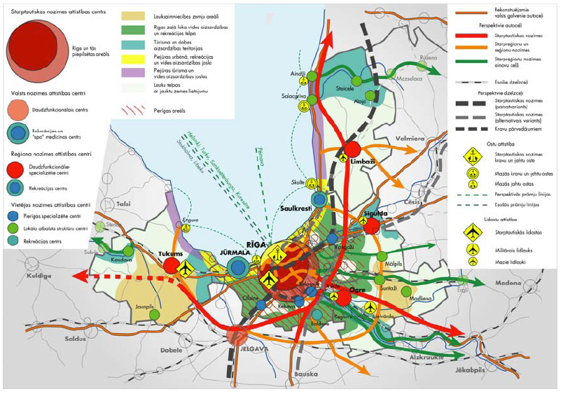
Cammon vision and main projects

Slide 5
Strenghts
Favourable geographical location
Geographical situation: The Gulf and coastline, the estuaries of the largest rivers, rich forest resources
Ecologically pure, not dense space of life of relative quality with a moderate climate
Comparatively high number of inhabitants. The main domestic market
The highest indices of economic development in the country. Varied national economy
Good communication systems. Developed transit business infrastructure. High level of IT employment
Riga port of international importance with the advantages of free port status. Rapidly growing airport
The centre of Latvia education, science and culture (architecture and art heritage, music and dance festivals, fairs, markets, traditions)
Notes:
5

Slide 6
Territory
Total territory 10 441,5 km²
The largest region in Baltic states with almost 1,1 million inhabitants
47% of population of Latvia.
Capital of Latvia – Riga is located in the center of the region
20 cities in Riga planning region
85% of population in Riga planning region live in cities
30 local municipalities
Ethnic structure - 52,3 % latvians - 33,5 % russians - 14,2 % other

Slide 7
Reference: Māris Bišofs / “My Latvia”

Slide 8
Territory by partners and river-beds
11 partners:
Aloja
Salacgrīva
Carnikava
Inčukalns
Sigulda
Ropaži
Ogre
Ikšķile
Salaspils
Ķekava
Jūrmala
Salaca
Gauja
Lielā Jugla,
Daugava, Ogre
Mazā Jugla
Lielupe
Abava, Svētupe, Virtupe.....

Slide 9
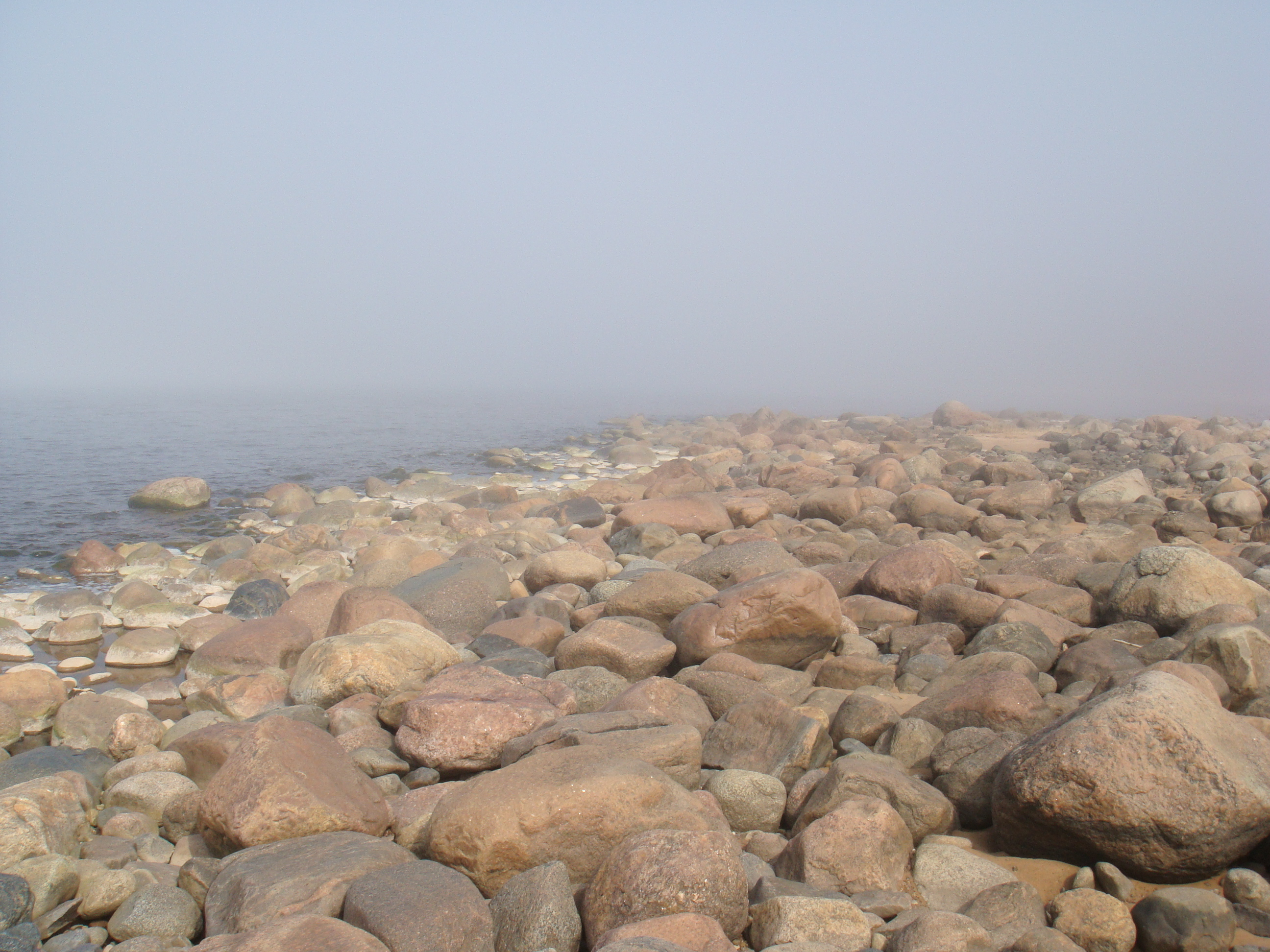
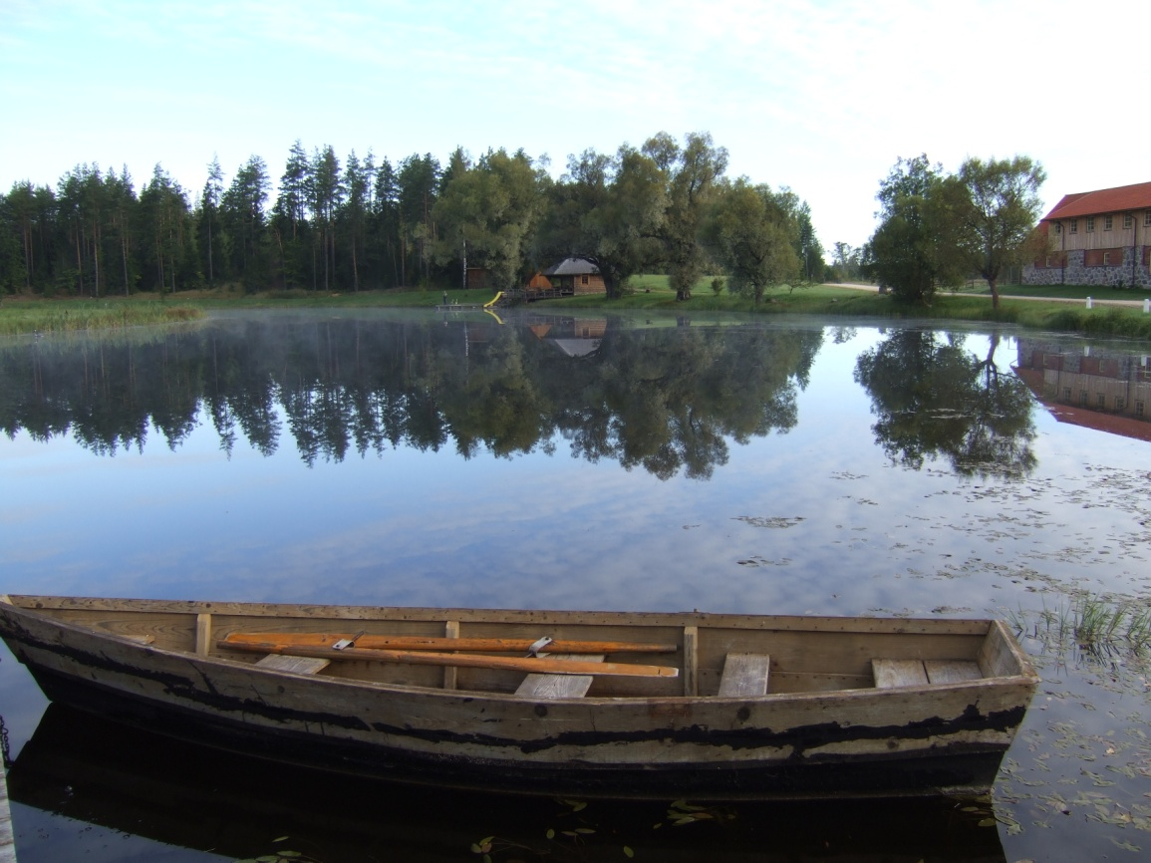
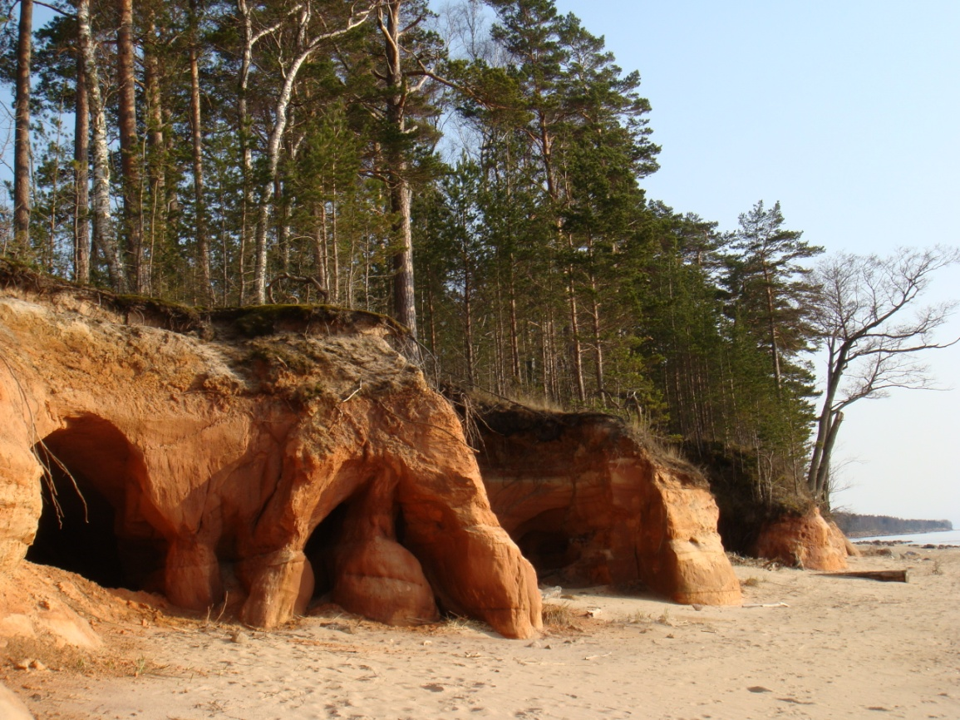
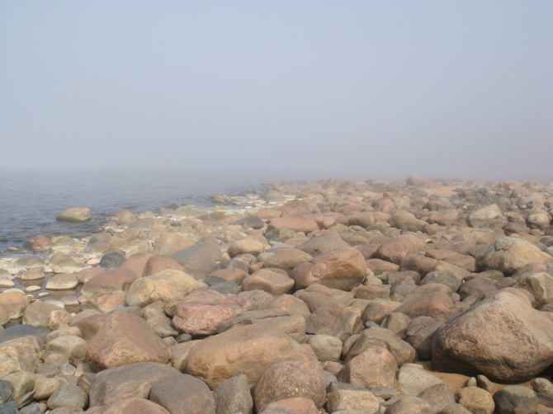
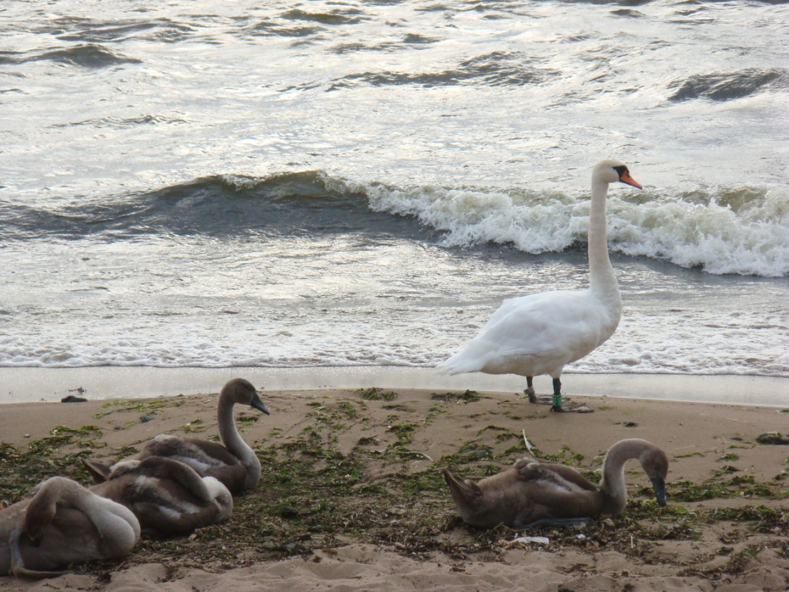
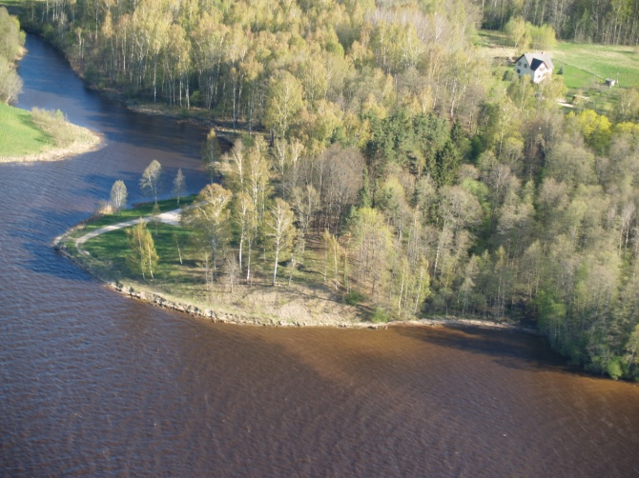
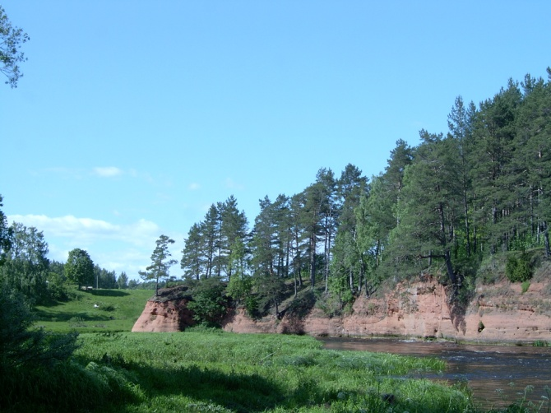
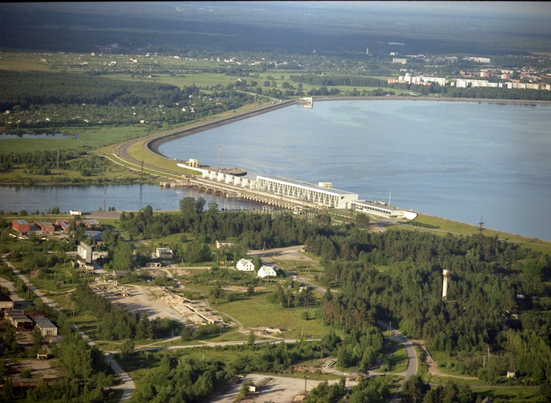

Slide 10
investments
PARTNERS | PP#18 | PP#19 | PP#20 | PP#21 | PP#22 | PP#23 | PP#24 | PP#25 | PP#26 | PP#27 | PP#28
ACTIVITY/ INVESTMENT: | Aloja local municipality | Carnikava local mun. | Ikšķile local mun. | Inčukalns local mun. | Jūrmala City Council | Ķekava local mun. | Ogre local mun. | Ropaži local mun. | Salacgrīva local mun. | Salaspils local mu mun.nicipality | Sigulda local mun. | Total:
River cleaning | Salaca | Gauja | Maza Jugla | Gauja | Lielupe | Daugava | Ranka, Ogre | Liela Jugla | Salaca | Daugava | Gauja | 4
Information stands | 1 | 2 | 2 | 2 | 2 | 2 | 1 | 2 | 1 | 2 | 2 | 19
Signs | 2 | 4 | 6 | 4 | 2 | 4 | - | 4 | 2 | 4 |  | 32
resting areas, incl. facilitated boating landing/ boat-stops | 1 | 2 | 2 | 2 | 1 | 2 | 2 | 2 | 1 | 2 | - | 17
Total infrastructure costs, EUR: | 14240,- | 20000,- | 20000,- | 20000,- | 20200,- | 20200,- | 20200,- | 19740,- | 8200,- | 18810,- | 8180,-

Slide 11
Other activities
Research
Visual identity, action plan and marketing plan for water tourism potentials
Experience exchange visit of water-nature tourism entrepreneurs and planners to Estonia, Finland, Lithuania
Development of Q-Latvia scheme for active and nature tourism.
Promotion
Water tourism map
Set of detailed brochures (guide of rivers;
detailed brochures for foreign target
markets with promotion packages; specific
brochure to promote coastal
water/active/nature tourism possibilities)
Image films
Electronic solutions for the project area
water tourism possibilities
Inserts in daily newspapers
Reference: Māris Bišofs / “My Latvia”

Slide 12
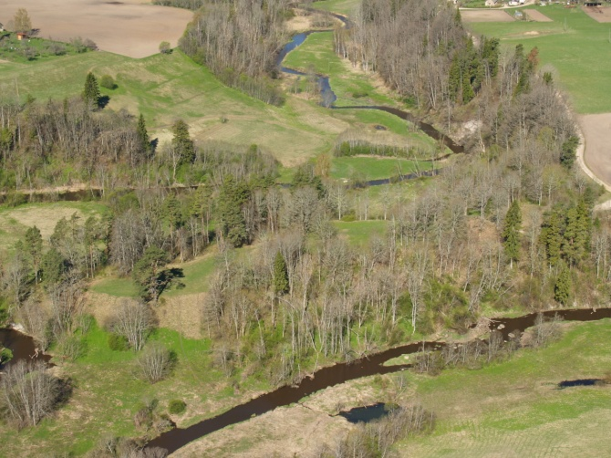
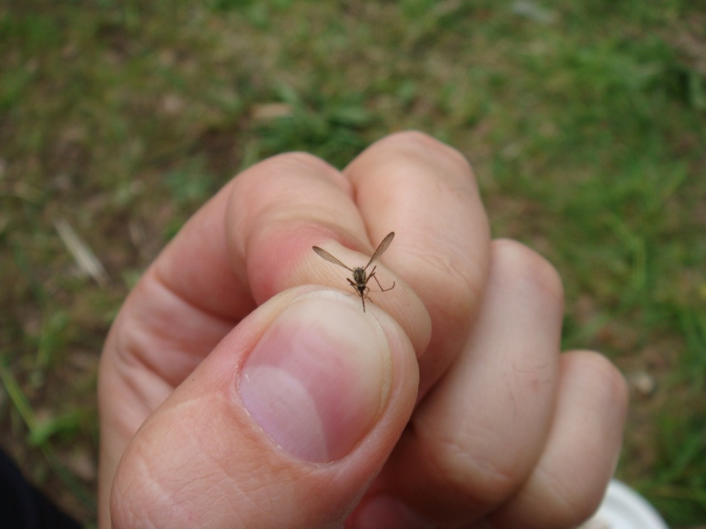
Challenges
Rivers over borders
Costal line
Cooperation
Nature
Waste management
Sustainability of investments
Sustainability of cooperation

Slide 13
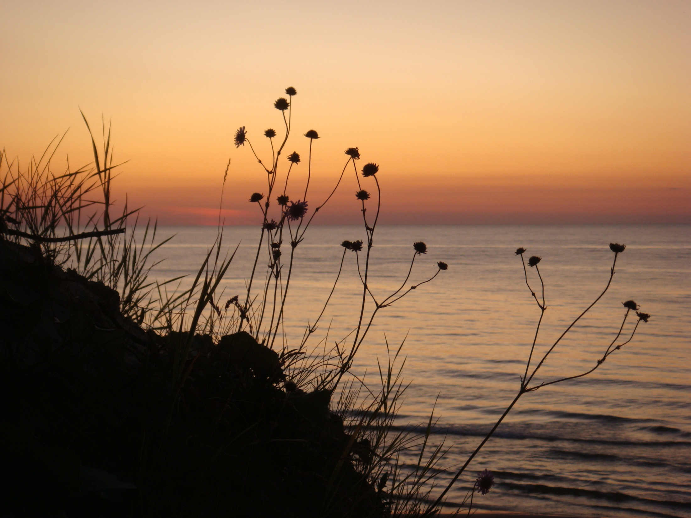
Thank you!
Liesma Grinberga
Project Manager (RPR section)
Phone: +371 67559826
E-mail: liesma.grinberga@rpr.gov.lv
www.rpr.gov.lv

