Slide 1
Role of Latvian tourism development agency in promotion of active and nature tourism
Armands Slokenbergs
Director,
Latvian Tourism Development Agency
Sigulda, 17.04.2013.

Slide 2
Basic principles of developing tourism products
Following an in-depth analysis of the market, draws up the marketing strategy and communication plan for each high-priority tourism market, based on:
Precisely defined segments of the target market;
The territory;
Tourism products offered to the respective market segment in the given territory.
Agency specifies themes and criteria for themed products and/or campaigns;
Agency markets the product part of the promotion campaigns of the national tourism products;

Slide 3
Nature areas of different type
Baltijas Sea and Riga Bay coast and the related biotopes and territories
Inland waters – rivers and lakes, and their banks
Bogs/marshes
Meadows
Wetlands

Slide 4
Foreign travelers in Latvia
Year 2012, stays in acommodations.
Avots: CSB, 2013

Slide 5
Leisure activities visits www.latvia.travel

Slide 6
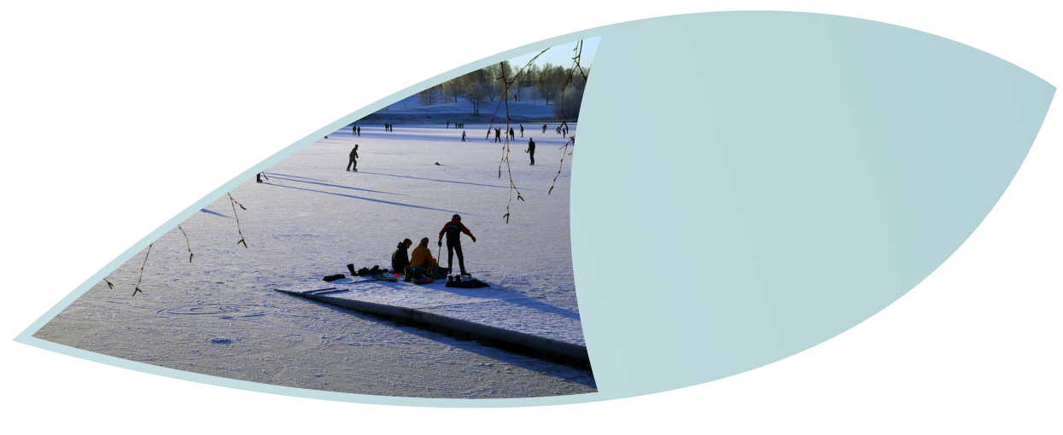
Cooperation with Tourism development agency

Slide 7
Cooperation on interactive environment
Associations, workshops;
Banner exchange;
Links;
Support in local tourism campaigns;
Support in social media pages;

Slide 8
Cooperation with marketing
Representation in international exhibitions in fares;
Cooperation with Associations; Participation in workshops, networking, journalists and tour operator visits;
Cooperation with distribution of information and print materials for tourists;
Present Latvia with Agency marketing materials

Slide 9
Tourism Marketing

Slide 10
Official tourism portal of Latvia www.latvia.travel

Slide 11
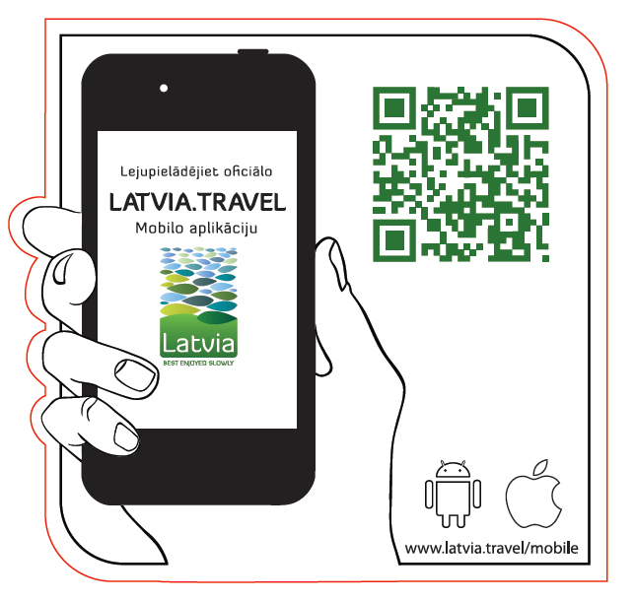
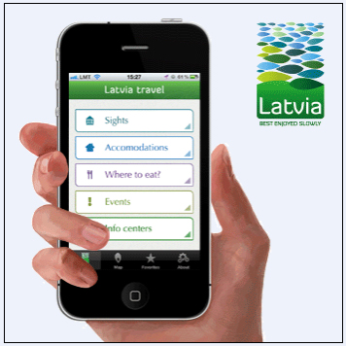
Latvia.travel mobile App
iPhone 750 users
Android 2500 users

Slide 12
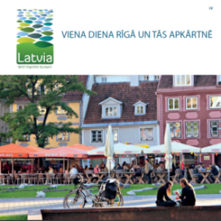
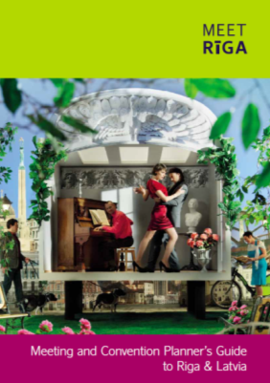
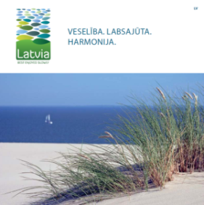
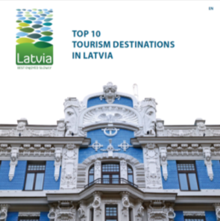
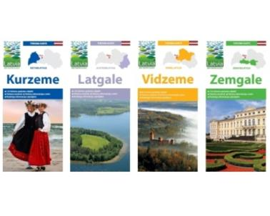
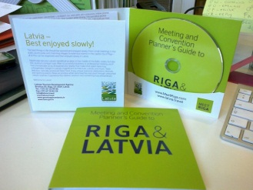
Printed materials
Region (Kurzeme, Vidzeme, Zemgale, Latgale) Tourism Maps
Latvia -Tourism Map
Baltic States - Tourism Map
Recration for families with childrens in Latvia – Tourism map
Nature Tourism in Latvia - Tourism map
Product Brochures:
Brochure "Latvia. Best enjoyed slowly"
Brochure "TOP 10 Tourism Destinations in Latvia"
Brochure "Top travel itineraries in Latvia"
Brochure "Riga, European Capital of Culture 2014«
Brochure «Nature Tourism Routs»
www.tava.gov.lv/lv/tava-izdotas-publikacijas

Slide 13
Local tourism campain
«Discover Latvia anew»
(«Atklāj Latviju no jauna!»)
13

Slide 14
Follow @
www.tava.gov.lv
www.latvia.travel and
Facebook

