Slide 1
Pp 6: Kaunas regional development agency
Project No LLI-303
„Life in Clean Environment – a Better Future“
Project partners‘ meeting, Telšiai, March 6, 2019

Slide 2
Activities implemented during period 1 (1)
Target groups reached: 23 (5 Kaunas city municipality, 5 Telšiai district municipality, 5 Klaipėda district municipality, 1 Kaišiadorys district municipality, 1 Prienai district municipality).
Work package M (Managmenet):
Day-to-day management, planning and coordination.
Communication with Lead Partner and Lithuanian partners.
Participation in Kick-off meeting in Kuldiga (presentation about planned project activities).
Report 0 and Report 1 prepared.

Slide 3
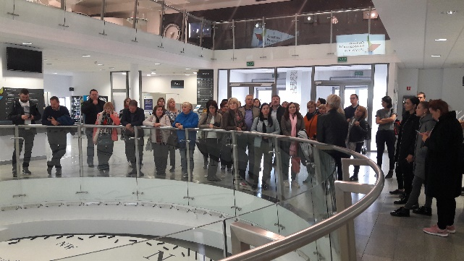
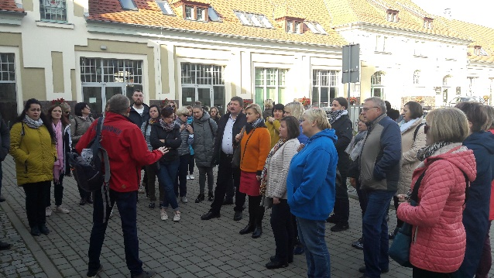
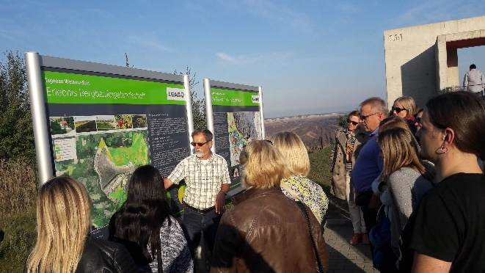
Activities implemented during period 1 (2)
Work package T1 (Implementation):
Study visit to Poland and Germany (October 8-12, 2018)
KRDA responsible for the programme, communication with sites, transport, accommodation and catering for LT participants.
19 participants from Lithuania, 20 participants from Latvia.
Best Polish and German experience on brownfields regeneration and adaptation to communicity needs.
4 places – 2 in Poland (Ostroda and Torun) and 2 in Germany (The Lusatian Lake District and Berlin).

Slide 4
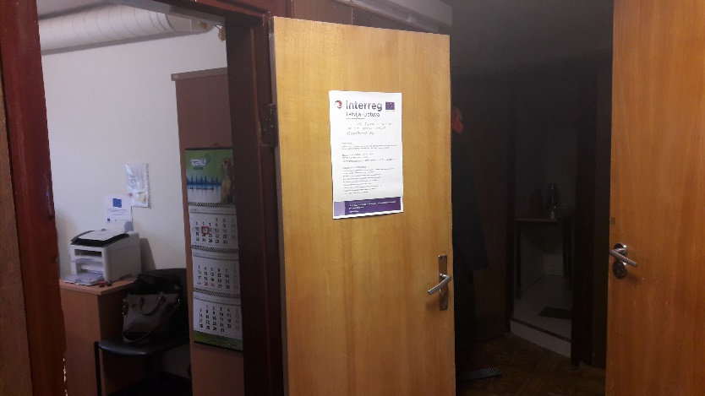
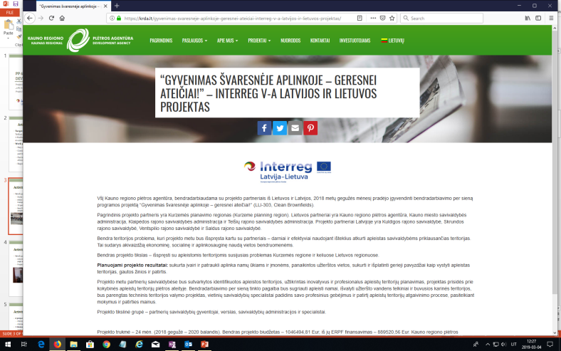
Activities implemented during period 1 (3)
Work package C (Communication)
Information about the project and first events published on KRDA web-page and Facebook profile.
Project poster is displayed in KRDA office and used during events.

Slide 5
Activities planned (1)
2 project management meetings (PMM):
PMM2 in Telšiai (Period 2), 2-3 persons from each partner. 1 day.
PMM4 in Kaunas (Period 4), 2-3 persons from each partner. 1 day.
1 thematic workshop:
Telšiai (Period 2), together with PMM2, 2-5 persons from each partner (all partners and municipal specialists), 1 day.

Slide 6
Activities planned (2)
3 roundtable discussions:
Telšiai (Period 1) – was moved to period 2 and implements on November 27, 2018
Gargždai (Period 2)
Kaunas (Period 3)
Participants – local stakeholders, Lithuanian partners.
Experience exchange visit to Latvia:
Period 4. 12 participants from Lithuania. 2 days (1 night).
KRDA is responsible for the development of content, rent of bus, accommodation and catering of Lithuanian participants.
Final conference:
Kaunas (Period 4), together with PMM4. 2-5 participants from each partner. 1,5 days event (1 night)

Slide 7
Thank you for your attention!
Elena Taločkaitė
Kaunas Regional Development Agency
Project Manager
elena@krda.lt, +370 616 56771

