Slide 1
Utilization of pollution in Kuldīga
LLI-303 Life in clean environment - a better future! Clean Brownfields
06.03.2019.
The project is co-financed by the Interreg V-A Latvia - Lithuania Cross Border Cooperation Programme 2014–2020 www.latlit.eu

Slide 2
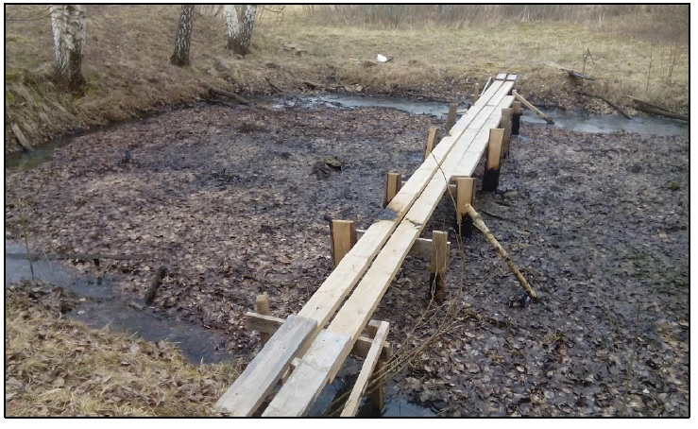
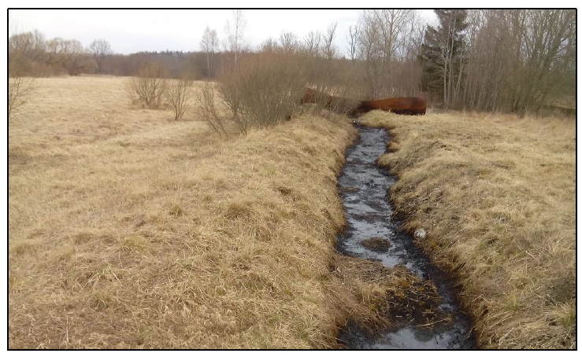
Utilization of pollution in Kuldīga
Kuldīga county municipality PP_2
Our goal in this project is to remove two objects from the national list of potential polluted territory:
Regenerate the ditch and pond polluted with oil products at Kuldiga
Total surface area of rehabilitated land - 0,02 ha

Slide 3
Utilization of pollution in Kuldīga
Done so far
Information about project in our webpage www.kuldiga.lv
28.09.2018. Opening of tender for Utilization of pollution in Kuldīga
08.10.2018.-12.10.2018. Study visit to Poland and Germany
14.02.2019. Procurement stage final report and submission

Slide 4
Utilization of pollution in Kuldīga
Next activities
Implementation of main activity:
Preparation of the technical documentation, planned time – 4 months;
Utilization of pollution, planned time – 6 months.

Slide 5
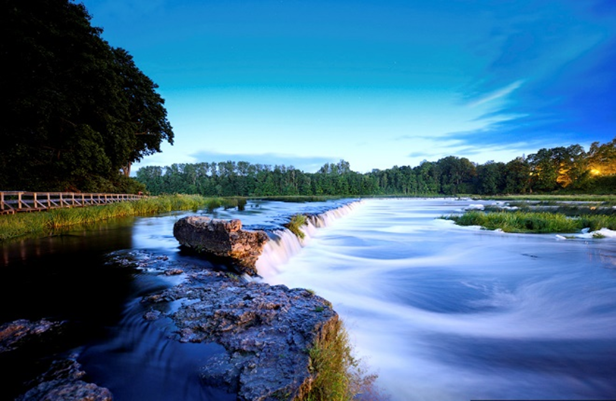
Utilization of pollution in Kuldīga
Kuldīga – a town with a soul!

