Slide 1
LLI – 303 «Life in Clean Environment – a Better Future !» (Clean Brownfields)
Overview of the Project implementation
Project Management Group Meeting 2
March 6, 2019, Telsiai

Slide 2
Overview of the Project
Project budget – actual performance vs planned
Project time plan
Project changes
Project reporting
Communication
Closest events
Proposal concerning study visits to Latvia and Lithuania
Any other changes or deviations proposed/expected ?

Slide 3
Project budget, actual performance vs planned
Project number Period Updated actual and expected reported amount (ERDF, 85%) Originally planned amount in Subsidy Contract, (ERDF, 85%)
LLI- 303 0 1339,99 1339,99
1 72526,66 398031,49
2 102614,30 263292,68
3 425795,78 145436,82
4 285792,73 81419,53
Total: 888069,46 889520,51

Slide 4
Project time plan
WP Management
Kick-off and two PMG meetings - according to the plan
FC contracted – deviations in time
Project partner reports – deviations in time
Project progress report for period 0 – according to the plan
WP Investment - Transforming through revitalization
Out of 6 brownfields – 2 according to the plan, 4 – deviations in time ( public procurement or changes in the technical documentation )
WP Training - Planning and competence for regeneration
Training and experience exchange events – according to the plan
Preparation of technical documentation – serious deviation in time
WP Communication
According to the plan

Slide 5
Project changes and deviations
Project minor changes were requested and approved:
For Kaunas City Administration – changes in the technical documentation for the sports stadium ( artificial football field lawn instead of the natural one )
For Kaunas Regional Development Agency – a technical mistake was corrected and 3 round-table discussions included in project activities according to the budget already planned,
For Klaipeda and Telsiai District Municipalities – project partner data were changed, the former project coordinators were replaced by new ones.
Joint Technical Secretariat was informed about deviations in time:
For Ventspils County Municipality – disassembly of the building extended to period 2(needed also for 3rd)
Klaipeda District Municipality preparation of technical documentation extended to period 4,
For Kurzeme Planning Region kinds and number of promotional materials was enlarged within the same budget.
Regarding project changes and deviations, please follow «Programme Manual» and «Quidance how to implement the project via the electronic monitoring system»

Slide 6
Project reporting, project periods
Period 1 May, 2018. – October, 2018
Period 2 November 2018 – April 2019
Period 3 May 2019 – October 2019
Period 4 November 2019 – April 2020

Slide 7
Project reporting
General project reporting rules:
Prepare and save the necessary documentation, including photos, in due time,
Use correct Programme logos where necessary, mark infrastructure objects, take photos
Carefully follow the project report form and fill in all the relevant information,
Follow programme «Manual» and «Quidance how to implement the project via the EMS»

Slide 8
Communication
Communication guidelines
Do not forget marking of infrastructure objects – see p. 7 of Guidelines!
Logos, Templates ( no necessary «innovations»! )
Electronic Monitoring system
Concise information on the project under «Supported projects», «Clean and sustainable environment»
Project Application form
Follow carefully your project activities in EMS, ensure at least the planned number of communication measures !

Slide 9
Closest events
Seminar 3, April 24, Liepaja, hotel «Amrita»
ESPON – an European Grouping on Territorial Cooperation, www.espon.eu
Liepaja Free Economic Zone
Liepaja example how to urge owners of neglected properties and derelict properties to put them in order
Seminar language – English
PMG meeting – September, 2019, Ventspils
Thematic workshop – September, 2019, Ventspils
Study visits to Latvia and Lithuania – move to period 3, that is, to the end of September, beginning of October, 2019, instead of period 4 ?

Slide 10
Project changes, minor changes
1. Contact data of the LP or project partners
2. Bank account of the LP
3. Work plan adjustment, e.g. a seminar is moved from the first period to the second period
4. Changes in costs within one budget line
Require prior consultation with JS. Reported via progress reports.

Slide 11
Project changes, major changes
1. Change of project partners
2. Reallocation between budget lines
3.Change in the project activities, e.g. increase/decrease of the activity/ new activity/output
4. Prolongation of the project duration
Require prior consultation with JS. Changes request. Prior approval by MA before changes are implemented.

Slide 12
Durability and ownership of project results
«Without prior consent of the MA, neither the LP nor project partners are allowed to transfer ownership, titles, industrial and intellectual property rights for outputs of the project related to investment in infrastructure and/or productive investment during the project duration and at least five years after the final
payment to the project has been made.»
Programme Manual, page 62

Slide 13
Durability of the project results
«The LP and project partners ( each for its part ) are at all times obliged to retain all files, documents and data about the project on standard data storage media in a safe and orderly manner for control and audit purposes at least for five years after the final payment has been made by the MA to the LP.»
Programme Manual, page 61

Slide 14
Project Revenue
Methodology on calculation of discounted net revenue and net revenue http://latlit.eu/wp-content/uploads/2017/03/Meth-on-calculation-net-revenue_070716.pdf
Namely, point 6 for project less than 1 000 000 EUR and point 7 for projects over 1 000 000 EUR.
Point 6 refers to The Article 65 of the General Regulation states that “the eligible expenditure of the operation to be co-financed from the ESI Funds shall be reduced by the net revenue not taken into account at the time of approval of the operation directly generated only during its implementation, not later than at the final payment claim submitted by the beneficiary”.
Point 7 refers to The Article 61 of the General Regulation states that „the eligible expenditure of the operation to be co-financed from the ESI Funds shall be reduced in advance taking into account the potential of the project to generate net revenue over a specific reference period that covers both implementation of the project and the period after its completion. The potential net revenue of the project shall be determined in advance by calculation of the discounted net revenue of the project.”

Slide 15
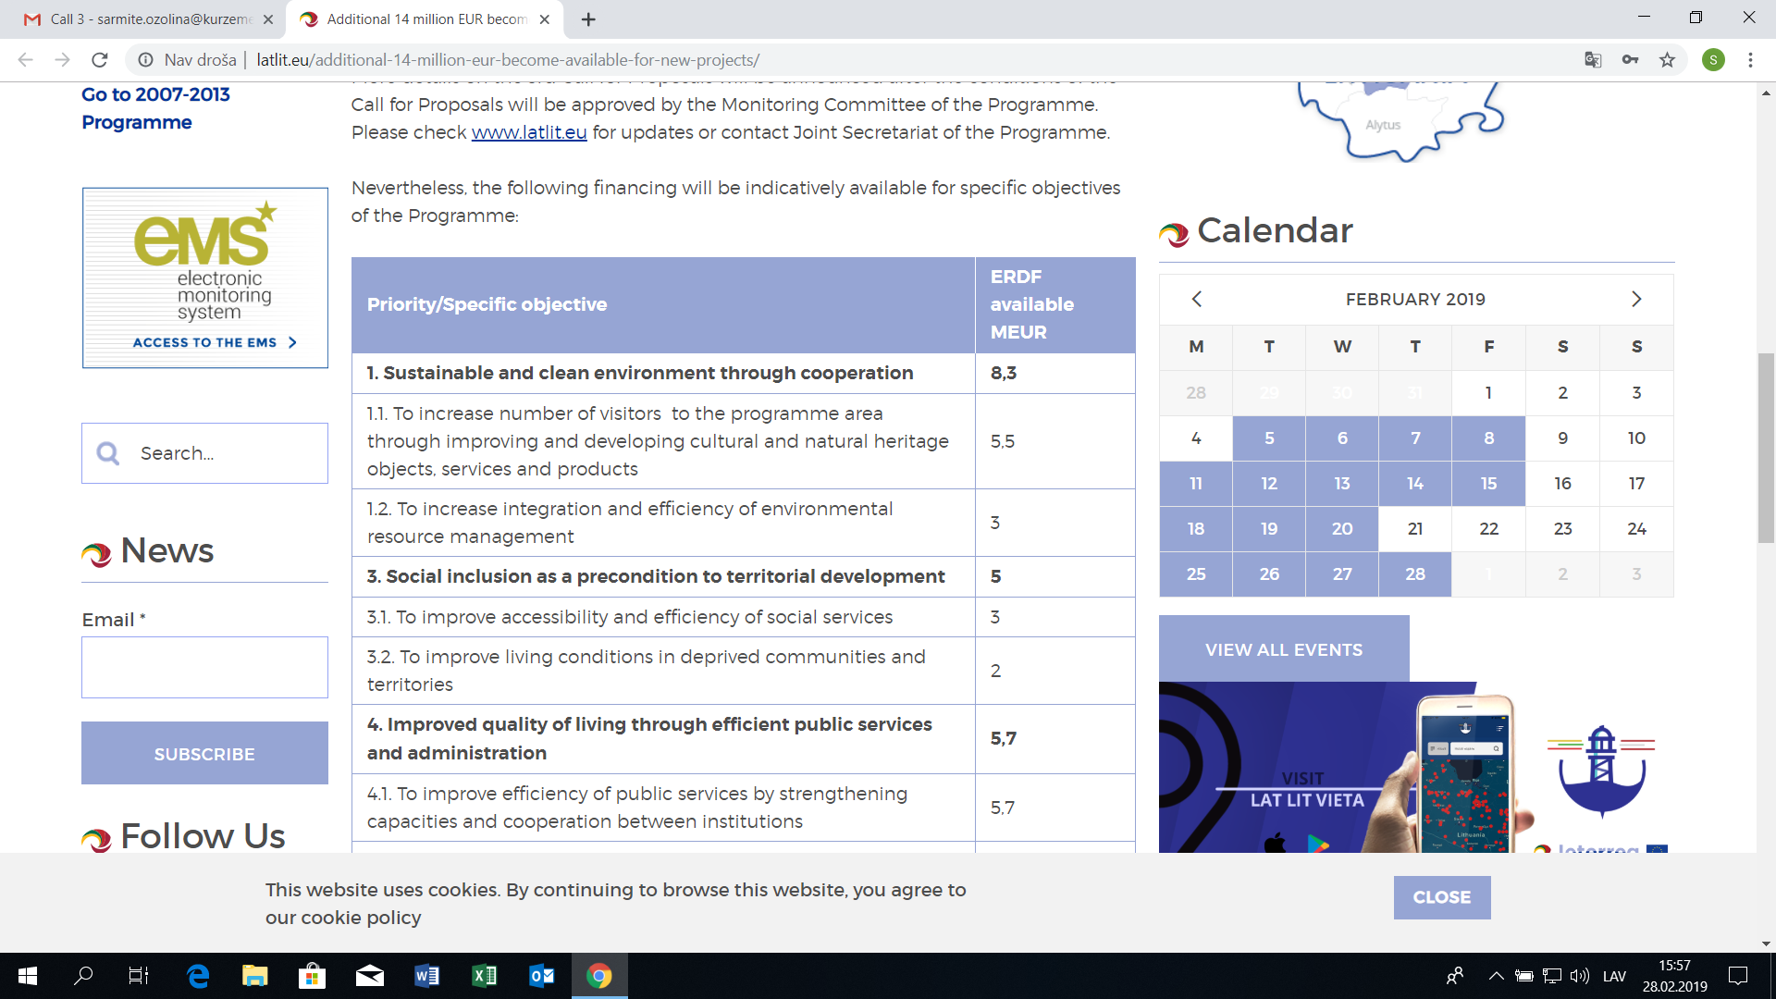
Next LV - LT Programme Call

Slide 16
Thank you! Sarmīte Ozoliņa, Project Manager, Administration of Kurzeme Planning Region phone +371 29453184, e-mail: sarmite.ozolina@kurzemesregions.lv www.kurzemesregions.lv

