Slide 1


CB786 Nature access to all
NatAc
An organisation of people with
disabilities and their friends
Apeirons
The project is co-financed by the Central Baltic Programme 2014–2020 www.centralbaltic.eu

Slide 2
Short overview
APEIRONS: Philosophical term from ancient Greek which describes
unlimited substance where everything starts and it is everywhere.
Aim: integration of people with disabilities in the society
Founded: March 6, 1997
Mission: to be together equal and independent
Has status of public benefit

Slide 3
Working directions
Accessible Environment/Universal Design
Promotion of employment
Providing social services
Video studio
Volunteers
Social campaigns and events
Close coperation with Municipality building inspections

Slide 4
Key definitions
Environments – physical, social, and attitudinal – can either disable people with impairments or foster their participation and inclusion
Universal design – a process that increases usability, safety, health, and social participation, through design and operation of environments, products, and systems in response to the diversity of people and abilities.
Usability, though, is not the only goal of universal design, and “adaption and specialized design” are a part of providing customization and choice, which may be essential for addressing diversity. Other overlapping terms for the same general concept are “design for all” and “inclusive design”.

Slide 5
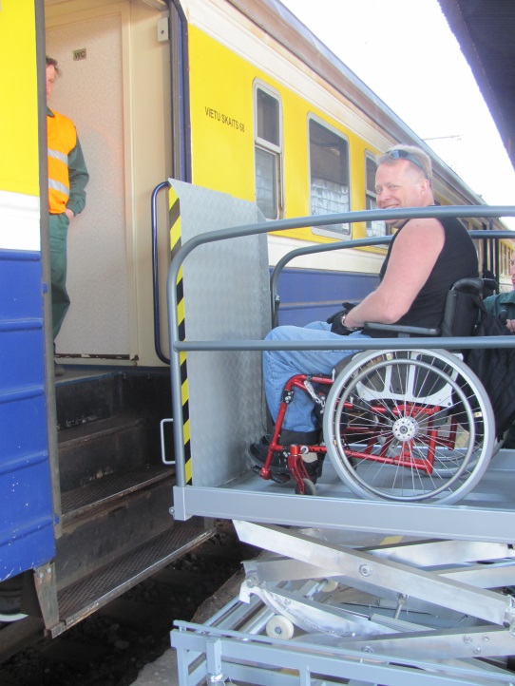
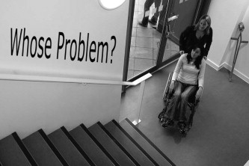
Accessible environment/
Universal Design
Consultation of accessible environment
Audit of environment
Active involvement in the building process
Starting new initiatives
Fighting failures by using existent legal ways
Contest GOLDEN CRUTCH
Consulting LDZ, Riga airport, Riga Bourse,
Sigulda city
..... all Latvia

Slide 6

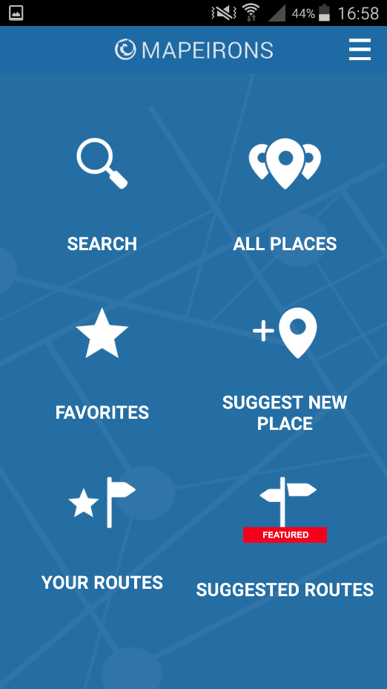
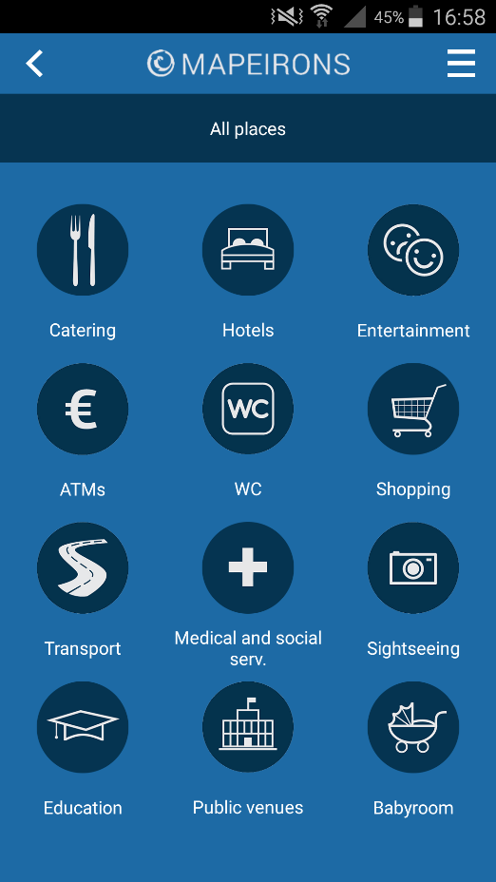
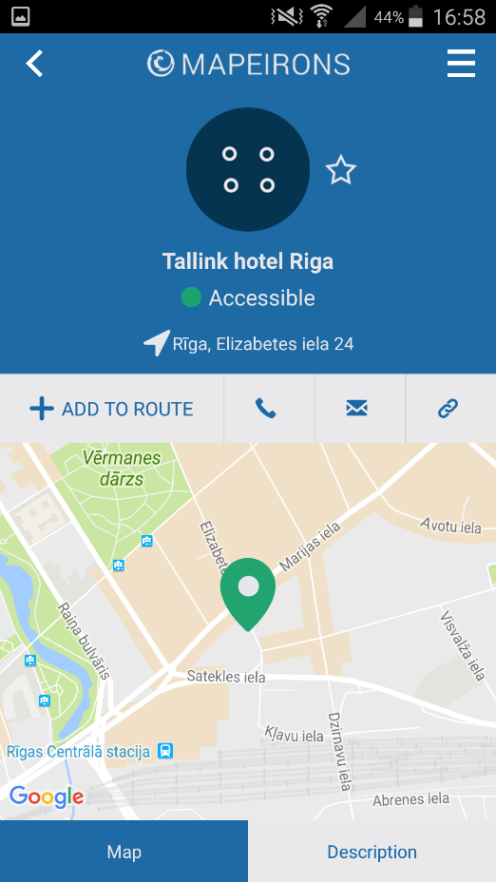

MOBILE APP
2252 fully or partly accessible places

Slide 7
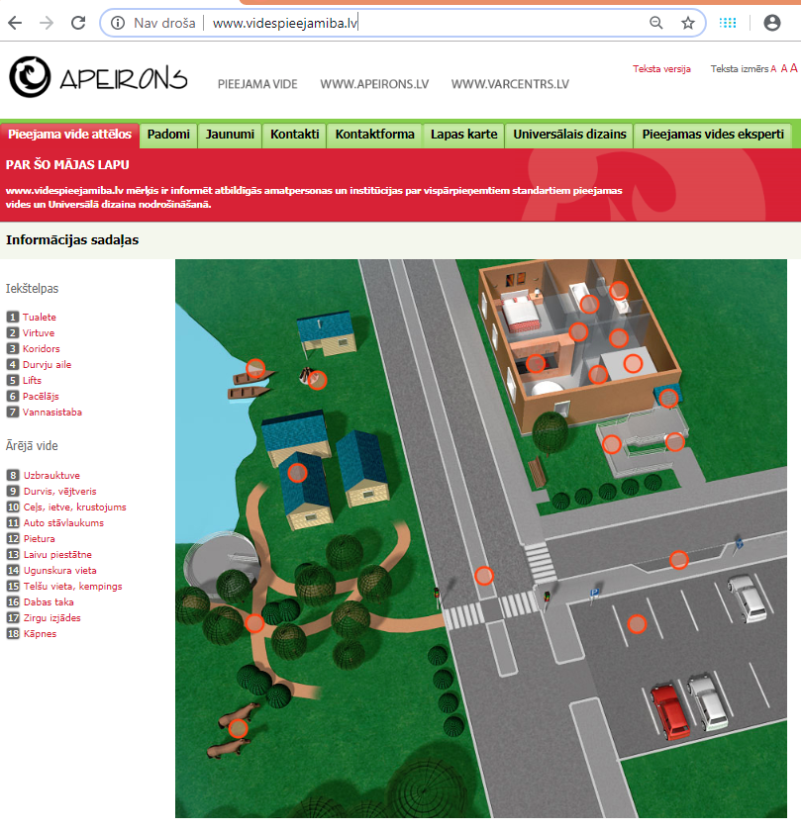
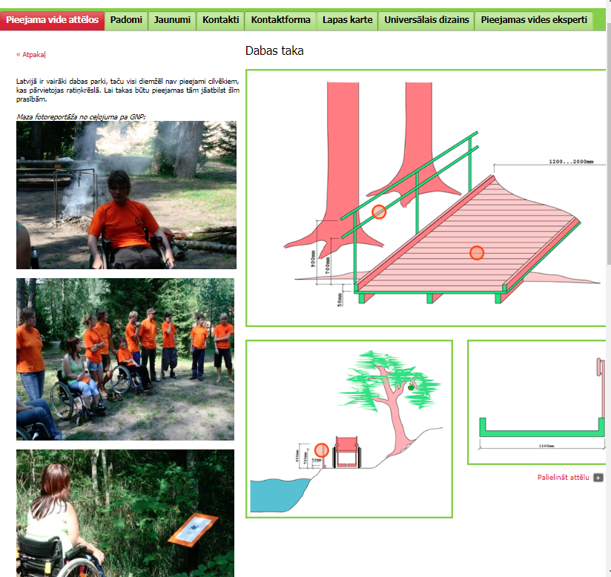
www.videspieejamiba.lv

Slide 8
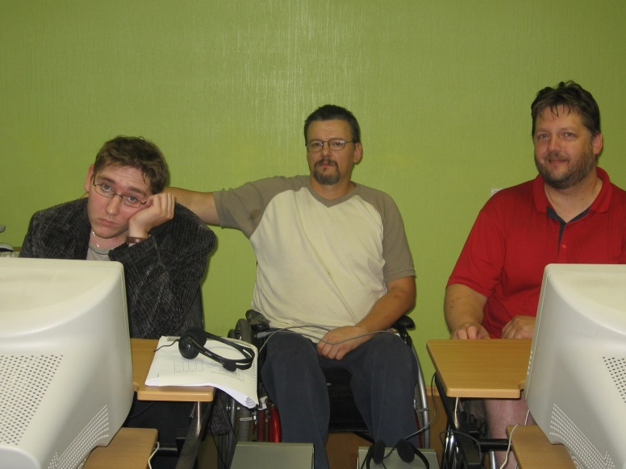
Promotion of employment
Social services
Employment
agency
Employers
People with
disabilities
Individual approach
Personal experience
Time for person
Addressing personally
Help to prepare
Feedback
Apeirons Employment
promotion centers
Employed, happy person

Slide 9
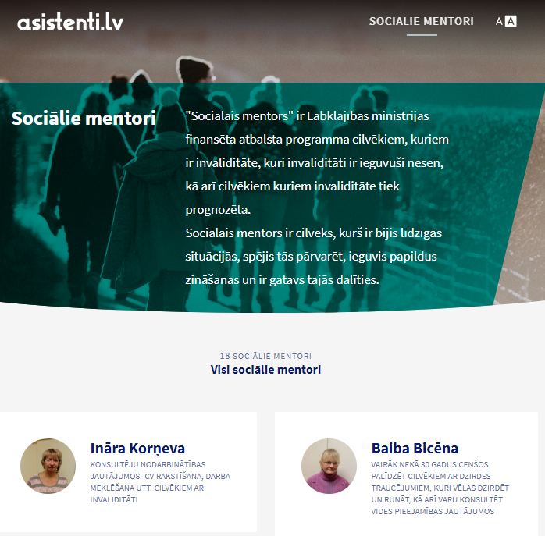
asistenti.lv
To suport people, who recently gained disability, we create service in coperation with Ministry of Welfare where they can find social mentor

Slide 10






More information
www.apeirons.lv
www.mapeirons.lv
MAPEIRONS
facebook.com/ApvienibaApeirons
twitter.com/Apeirons
youtube.com/ApeironsVideo

Slide 11
CONTACT INFORMATION:
An organisation of people with disabilities and their friends
Apeirons
info@apeirons.lv
Phone: +371 22 02 59 22
www.apeirons.lv

