Slide 1
Activities by Estonian Environmental Board
CB786 Nature access to all NatAc
The project is co-financed by the Central Baltic Programme 2014–2020 www.centralbaltic.eu

Slide 2
Environmental Board- environmental education (nonformal)
19 specialists in regions
Environmental programmes for schools and kindergartens- in 2018 more than 24 000 students participated
acitivities for different target groups: camps, conferences, hiking days, workshops – 2018 more than 21000 persons were involved.
Working out study materials, information booklets about protected areas
Managing portal of environmental education www.keskkonnaharidus.ee
Notes:
Informal education, formal education, non formal education

Slide 3
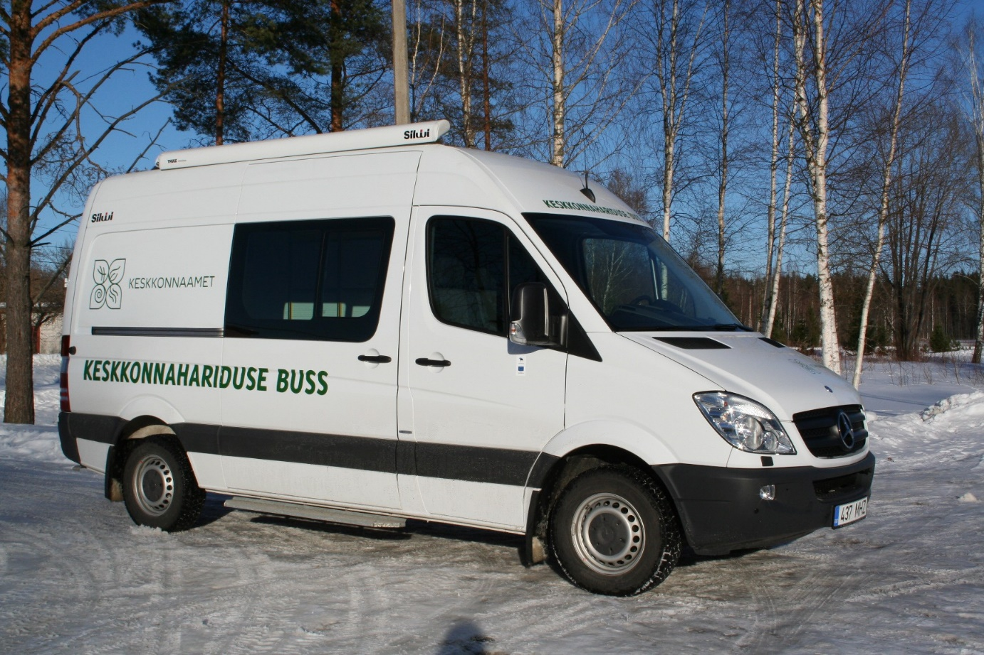
In West-Estonia:
Vilsandi National Park
Matsalu National Park
Viidumäe Nature Reserve
Kuressaare, Haapsalu, Pärnu offices
Environmental bus
https://www.kaitsealad.ee/eng
https://www.keskkonnaamet.ee/en

Slide 4
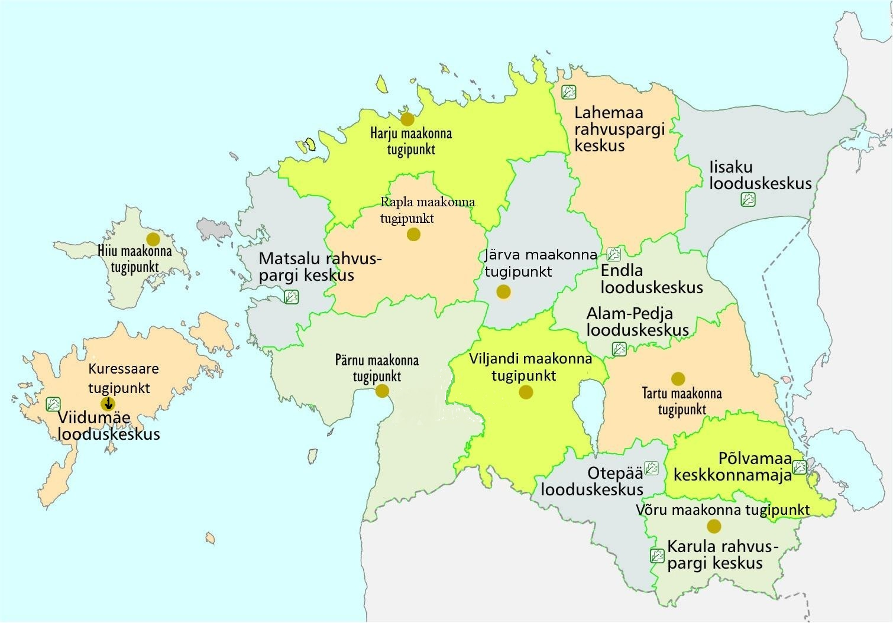

Slide 5
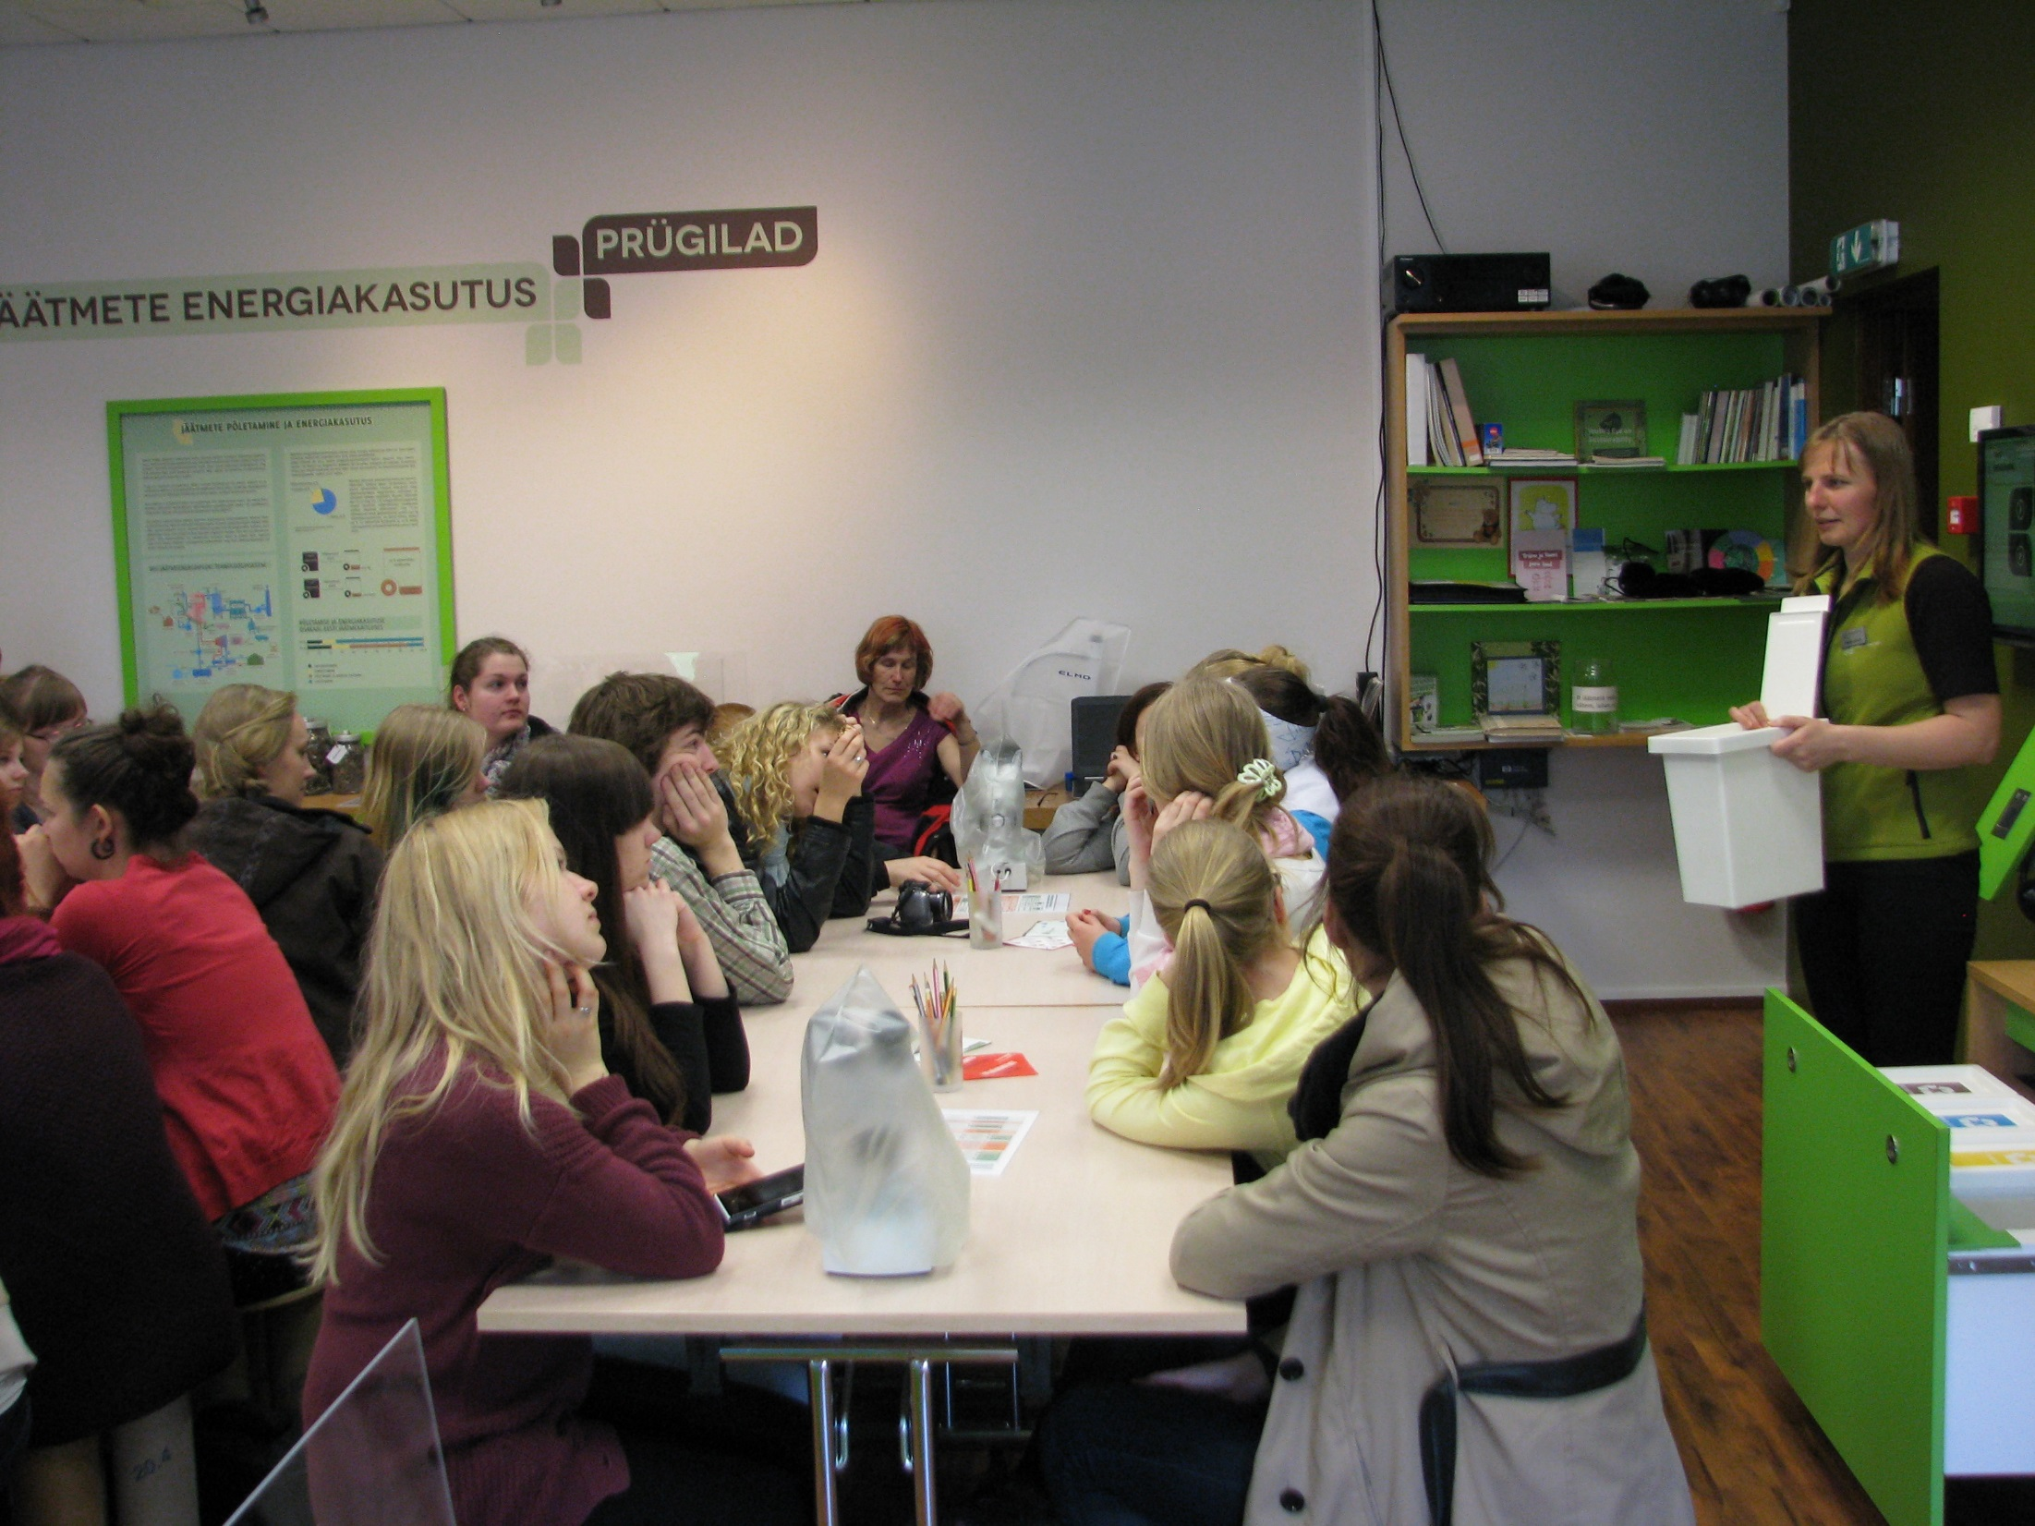
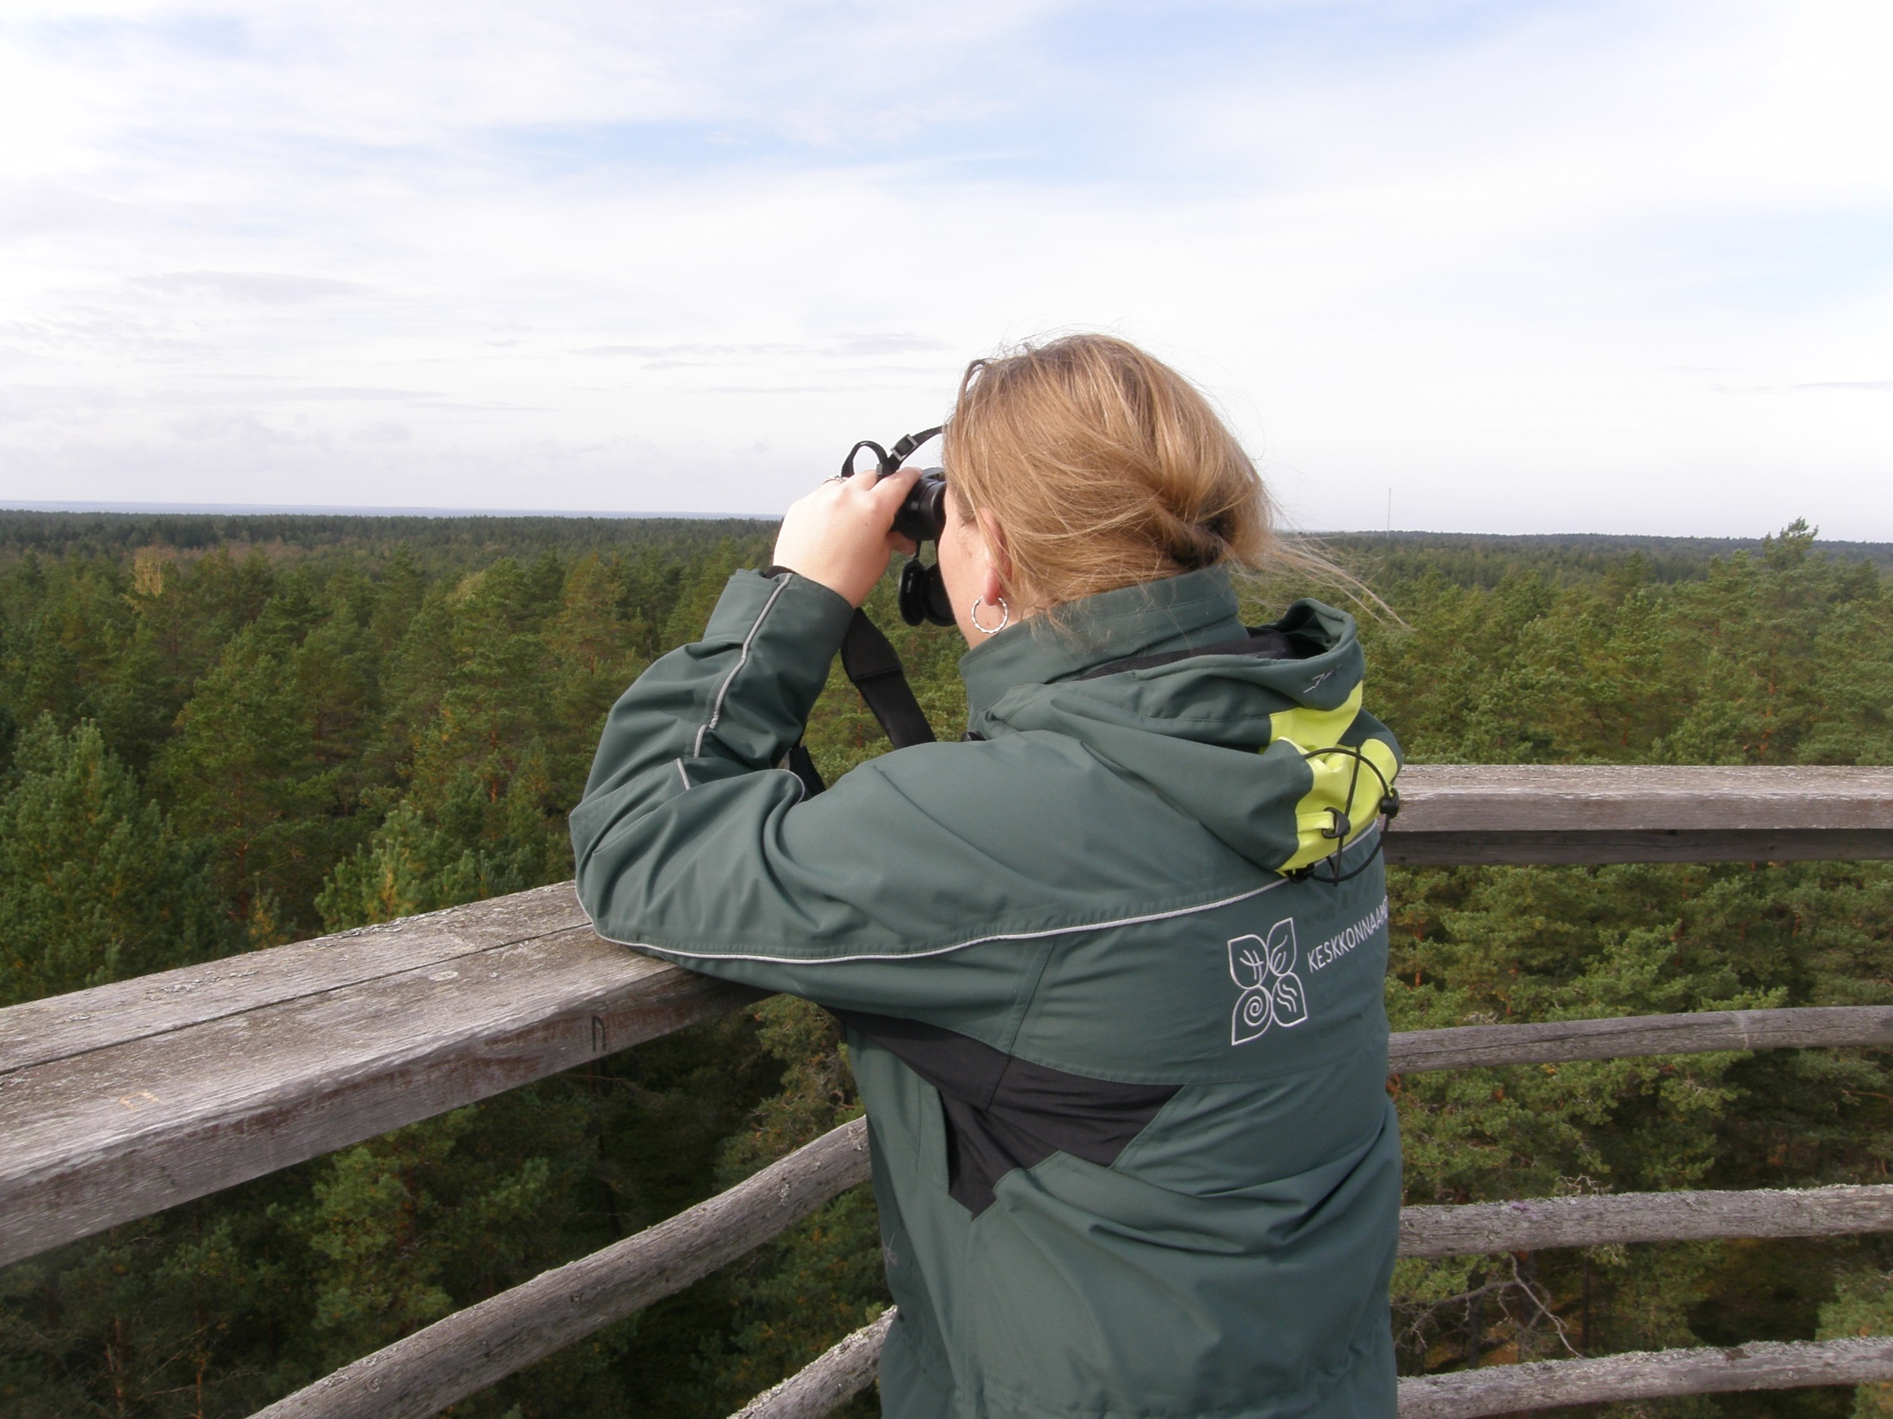
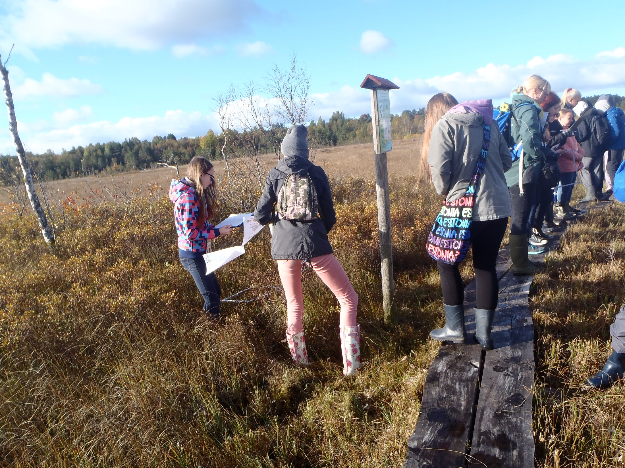
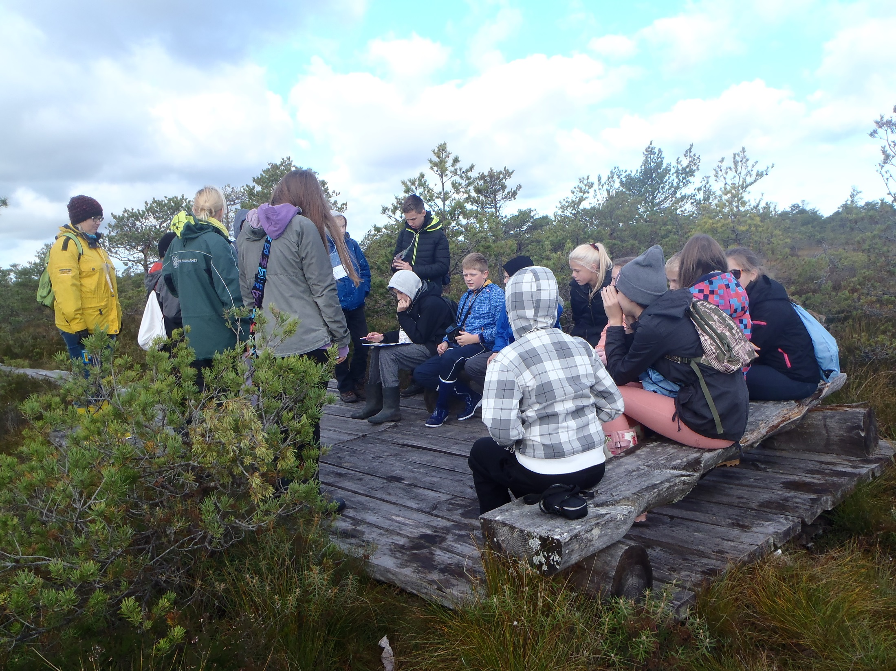

Slide 6
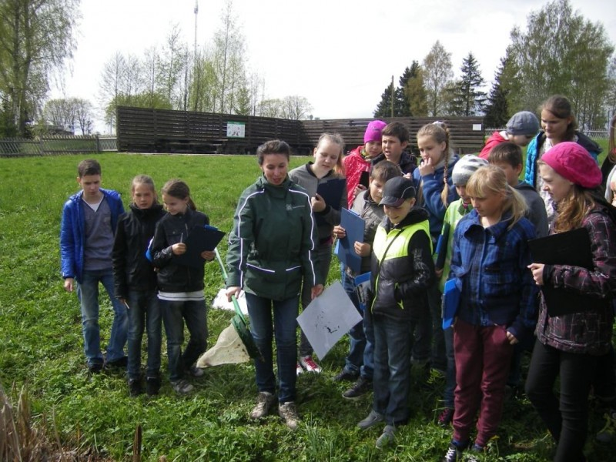

Slide 7
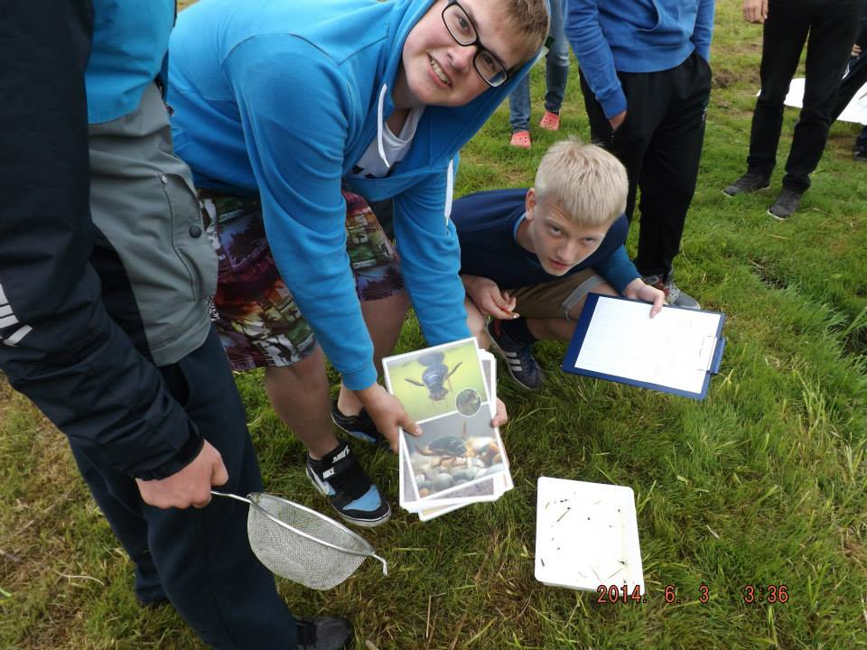

Slide 8
Mobile exhibitions
Nature conservation in Estonia
Notes:
EB has long experience in wokring out study materials and mobile exhibitions.

Slide 9
Mobile exhibitions
Coastal meadow box
Notes:
Meadows suitcase, for learning indoors

Slide 10
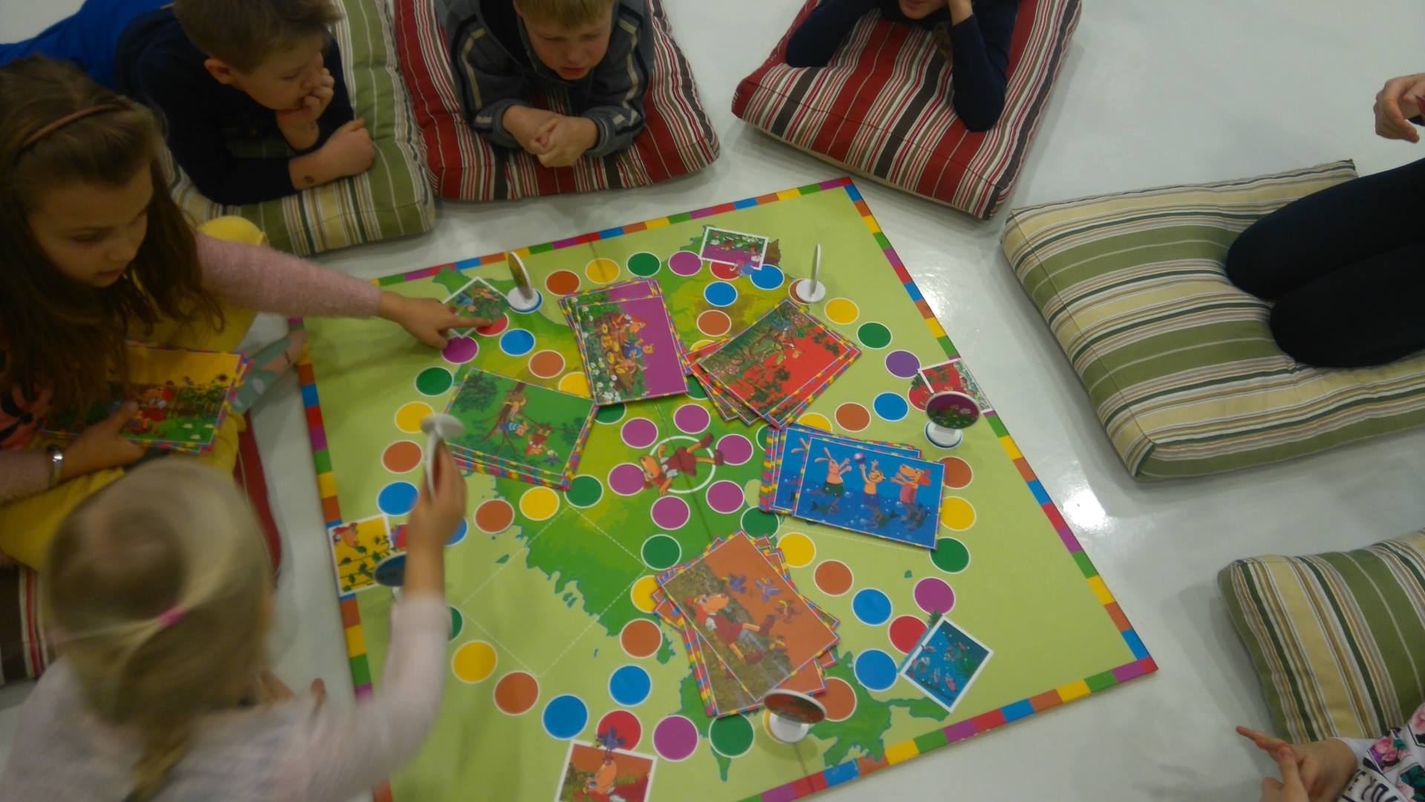
Mobile exhibitions
Lotte Nature Game
Notes:
Lotte nature game, quiestions and tasks about nature 2 levels, talking pencil, wellknown creatures

Slide 11
Study-trip to Denmark
39th or 40th week 2019
Participants: 30- Estonia 17, Latvia 7, Finland 6
4 days, 3 nights.
Interests:
database about infrastructure of nature trails/centres and other natural sights that are available for people with special needs.
Visiting sights (especially in nature) that are designed for people with special needs.
Study materials/exhibitions about nature that are designed regarding people with special needs.
Notes:
EB , bus rental, catering, guides,

Slide 12
Toolbox for people with special needs
Nature interpretation materials for learning in nature and also indoors to feel and experience nature practically, involving different senses.
Materials will be translated in LAT and FIN
10 toolboxes will be produced and delivered to nature centres in project area of Estonia
Development methodology to support inclusive education.
Notes:
We have had contcst with children wiht special educational needs and we undrestand that we need more soultions that give equal possibilities for studenst with special needs The materials will be universal and suitable in different sites.Metodolgy should support inclusive education. We have to focus on a target age level. The toolbox includes equipment and study materials about studying about nature and in nature. We would like to work out a pilot nature study program that is meant for a certain target group wiht study materials. First we have to find partnerts from Estonia who can hel

