Slide 1
Investīciju spēkstacija
Maijs, 2019

Slide 2
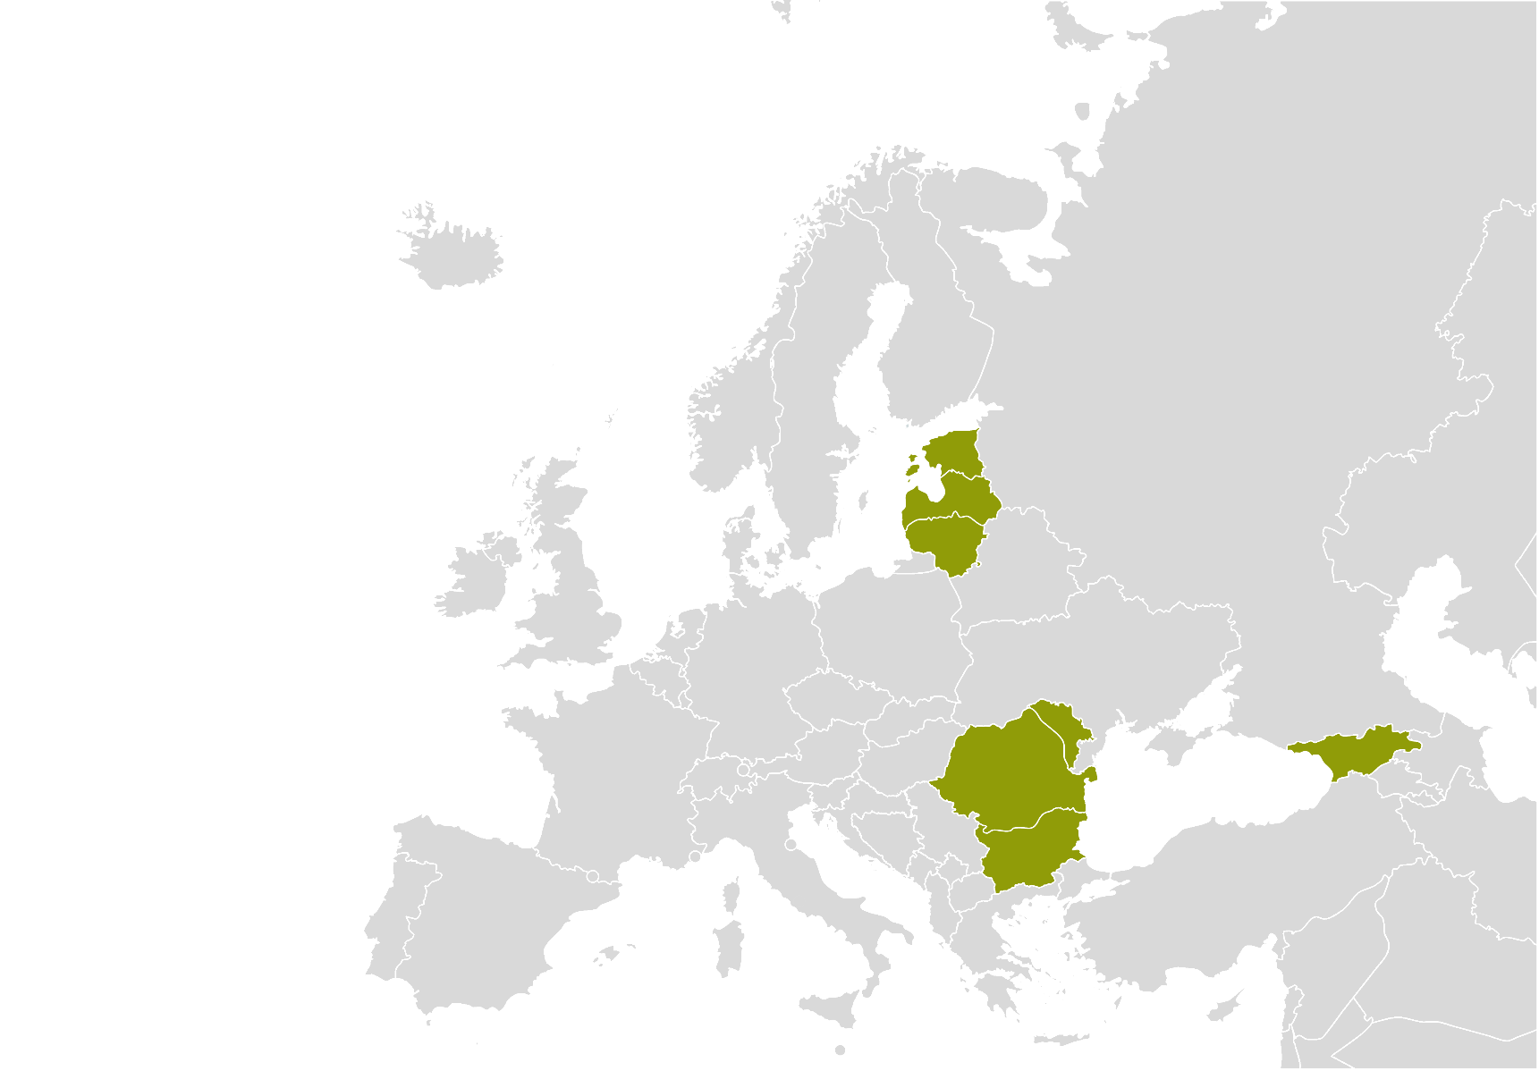
#1 Austrumeiropā kopš 2004
7 starptautiski biroji; Galvenā mītne – Rīga
Vairāk nekā 1000 klientu
1,2 M EUR apgrozījums
30 darbinieki + ārvalstu eksperti
15+ valodas
~50 000 uzņēmumu datubāze
Klientu apmierinātības rādītājs 8,2
45+
Vairāk nekā 45 valstis, kurās ir realizēti projekti
100%
Klientu ieteiktu mūsu pakalpojumus citiem uzņēmumiem

Slide 3
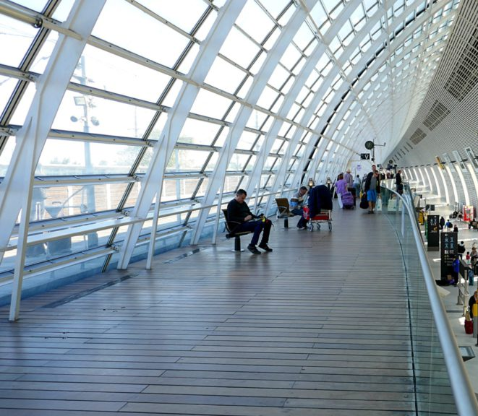
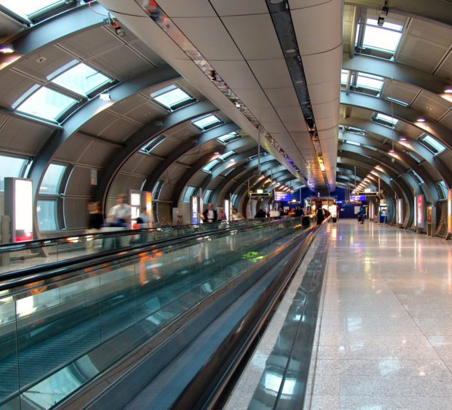
Mēs atbalstam Jūsu izaugsmi
Tirgus izpēte, analīze un monitorings
Industrijas pētījumi, fokuss grupas un ekspertu intervijas
Stratēģijas izveide
Attīstības virzienu priekšizpēte
Investoru meklēšana
Investoru vizītes organizēšana
MARKET INTELLIGENCE
INVESTMENT ATTRACTION
Individuālie partneru meklēšana projekti
B2B kontaktbiržu organizēšana
Eksporta vadība
Eksporta rīti
Eksporta akadēmija
Eksporta meistarklases
EXPORT INTELLIGENCE
EXPORT EDUCATION

Slide 4
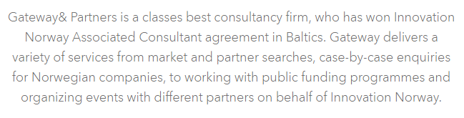
Atsauksmes
2000+ projekti

Slide 5
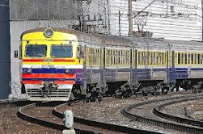
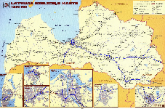
Client: Jets
Railway transportation
Task: To assist with company establishment and core team recruitment
NEED
After examining the market research conducted by GatewayBaltic the company decided to establish an office in Riga.
The main aim of the new office is to develop company’s operations in a new sector – railway trasnportation – and to work with international clients from both European and CIS countries.
SCOPE
The project had 3 main parts:
Assistance with company registration;
Recruitment of the core team, including active information campaign (online advertisments, presentation for association members, personal invitiations sent to selected candidates);
Assistance with office premise search process.
RESULT
With our assistance the client established the company in Latvia and succeeded to recruit the key personnel.
During recruitment process more than 400 applications were revewied and candidates selected & interviewed for managing director, sales manager, project manager, electrical engineer and mechanical engineer positions.
With our assistance the company has also found suitable office premises in Pardaugava, Riga.
Notes:
March- May 2012

Slide 6
KĀPĒC, LAI INVESTĒ

Slide 7
Kapēc kāds investēt?
Konkurētspējīgs piedāvājums
Cilvēki
Izejvielas
Loģistika
NAUDA
Kapēc investē?
Resursi
Tirgus
Inovācijas
Noieta tirgus
Inovatīva piedāvājuma izveide
Latvija &
Baltijas jūras reģions
B2B sektors
B2C sektors
Publiskais
Know-How, tehnoloģiski risinājumi, pētniecība
GatewayBaltic ©

Slide 8
KĀPĒC, NEINVESTĒ

Slide 9
Nezin!

Slide 10
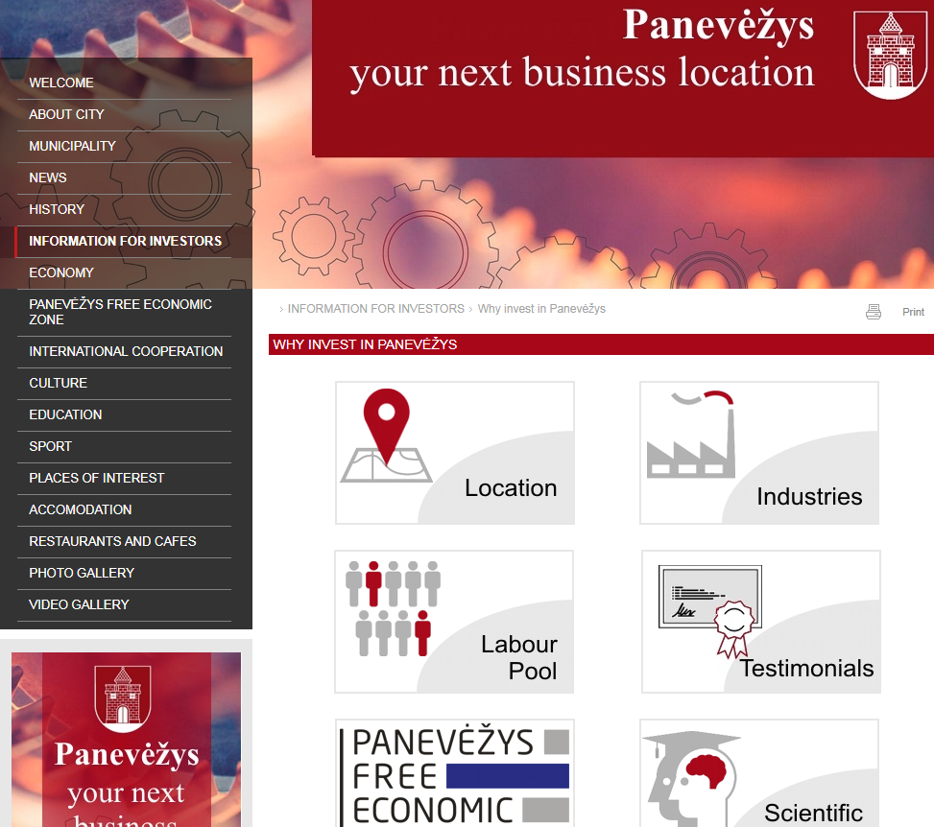

Slide 11
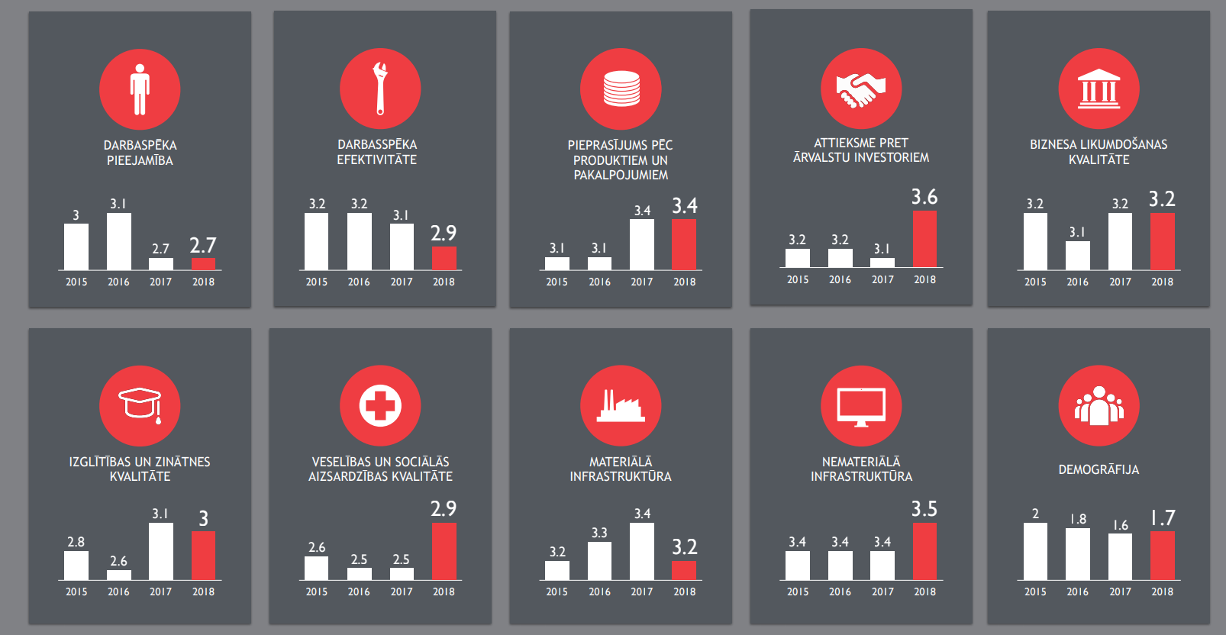

Slide 12
SOĻI, KAS DARĀMS
Kapēc investē?
Resursi
Tirgus
Inovācijas
1. JĀNOVĒRTĒ SEVI (PRIEKŠIZPĒTE)
2. JĀNOSAKA PRIORITĀTES- JĀNOFROMULĒ PIEDĀVĀJUMS
(STRATĒĢIJA)
3. JĀRĪKOJAS JĀINFORMĒ MĒRĶA KLIENTS PAR IESPĒJĀM (DARBĪBA)

Slide 13
DALĪBA INVESTĪCIJU IZSTĀDĒ
REKLĀMRAKSTI
MĀJAS LAPA _ INFORMĀCIJAS PIEEJAMĪBA
FORUMS
SEMINĀRI
IENĀKOŠO VIZĪŽU ORGANIZĒŠANA
TIEŠĀ KOMUNIKĀCIJA un VIZĪŽU ORGANIZĒŠANA PIE INVESTORA

Slide 14
Investīciju piesaistes piedāvājums
6 soļi, kā mērķtiecīgi strādājot, tiek piesaistīti investori
Šodienas situācijas analīze
Konkurētspējas stratēģisko jomu noteikšana
Attīstības ideju ģenerēšana investoru piesaistei
Investoru piedāvājuma izveide un stratēģija
Investīciju piesaistes procesa organizācija
Darbs ar investoriem
Šodienas situācijas analīze:
Ekonomiskā un industriju analīze
Vēsturiskās iestrādnes
SWOT analīze
Kādas aktivitātes ir veiktas? Izvērtējums?
Kādā virzienā attīstīsimies:
Kādas ir tendences pasaulē?
Stratēģisko industriju noteikšana
Labās prakses piemēri investoru piesaistei šajās industrijās?
Kāds būs mūsu piedāvājums investoram:
Resursi
Tirgus
Inovācijas
Kā redzam reģiona izaugsmi?
Ko varam piedāvāt?
Kā sasniegsim investoru?
Investīciju Piedāvājuma izveide
Investīciju Stratēģijas izveide
Investīciju piesaistes plāna izveide – mērķiem un aktivitātēm
Kā uzrunāt investoru?
Tiešā komunikācija, prezentējot iespējas
Semināru organizācija mērķa valstīs
Tiešā uzrunāšana un vizīšu organizācija
Follow up darbs un komunikācija
Investīciju process:
Lieliska pakalpojuma sniegšana
Investoru apkalpošana
Izvērtēšana
Stratēģija
Piesaiste

Slide 15
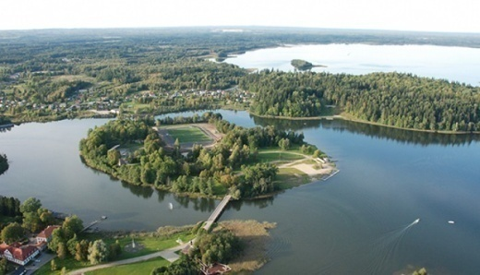
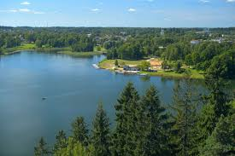
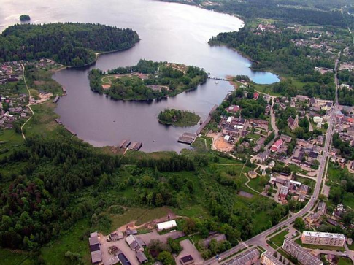
Aluksne Country Municipality
To carry out an investment attraction strategy for Aluksne county
The research was conducted in 4 parts by using primary and secondary sources of information:
Current situation analysis of Aluksne County investment attraction;
Competitiveness evaluation of main economic industries in Aluksne County;
Carrying out an investment attraction strategy for Aluksne County municipality;
Carrying out an investment attraction plan for Aluksnes County municipality.
The client received a detailed report with deep data analysis and assessment of current situation in Aluksne county.
Main economic industries in Aluksne county were determined and for each a SWOT analysis was made.
Potential investor profile was determined.
Long-term targets for Aluksne county for investment attraction development were defined.
3 years investment attraction plan was created for Aluksne County including specific proposed activities.
Aluksne county municipality approached Gateway & Partners to assist in carrying out an Investment attraction strategy for Aluksne county.
Aluksne county municipality needed a clear action plan and steps in order to proceed with investment attraction to Aluksne county.

Slide 16
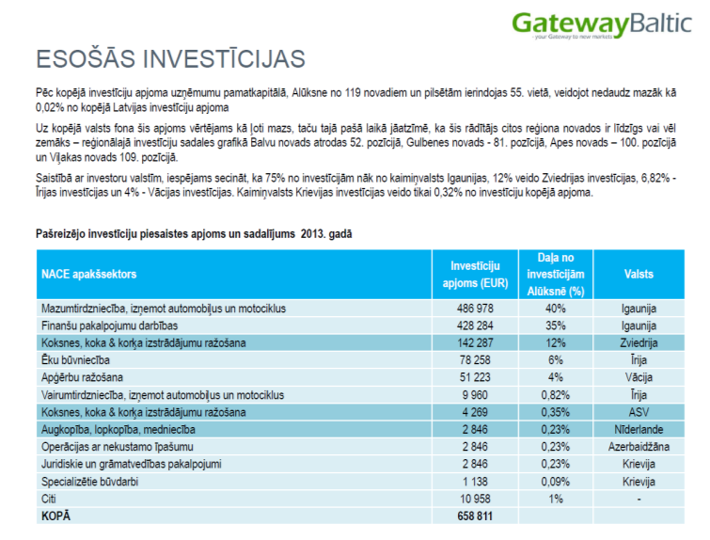
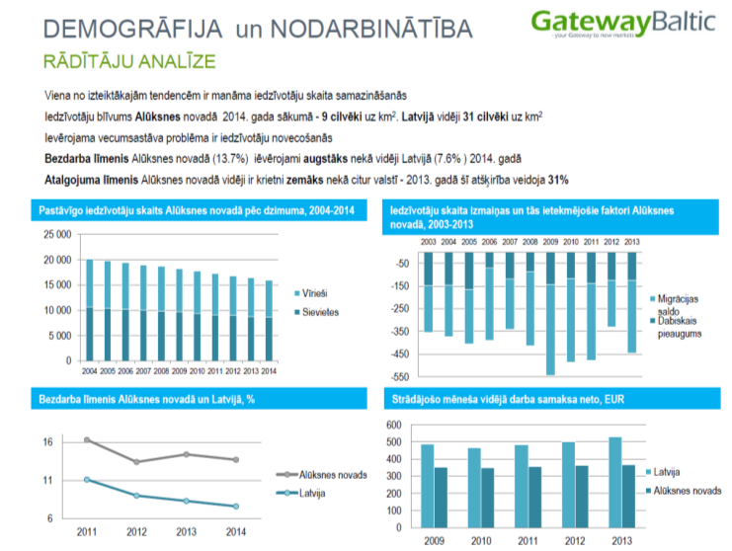
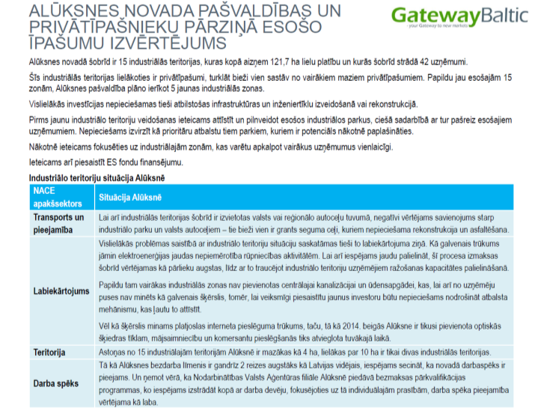
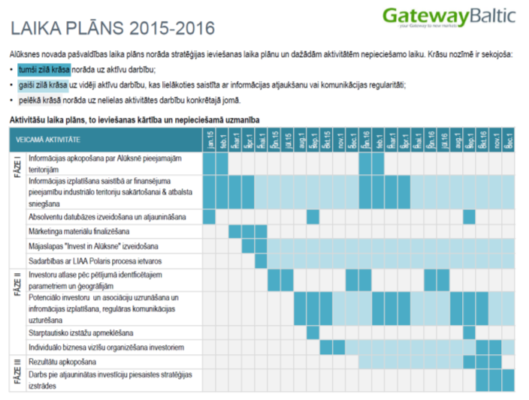

Slide 17
Saulkrasti municipality | SPA market in the Baltic states
To investigate the SPA market in the Baltic states and assess SPA hotel investment prospects.
To be able to define advantages and disadvantages of the county for attracting investors, the research had to both focus on a wider contextual approach that compared the county to other success stories in the Baltic states, and it also had to look at the available resources of the county and to estimate the potential demand for a new SPA hotel.
Research focused mainly on the Baltic states, namely, Latvia, Lithuania and Estonia, but Latvia was analysed in a greater detail.
The research study provided an outlook on several factors that would define the success of a new SPA hotel in the Baltic states, such as tourism trends, supply and demand of accommodation and SPA procedures, and a detailed look at the offering of existing competitors, including market position, price levels and offered services.
The findings from the research study established a basis for the direction in the next phase of attracting investors.
The client, a municipality council, needed an in-depth insights into SPA market activities in the Baltic states in order to determine the potential of an upcoming SPA hotel project. The overarching goal was to define advantages of the county to attract investors in the next phase.

Slide 19
Mārtiņš Tiknuss
Partneris +371 26677811
martins.tiknuss@gatewaypartners.net
Elizabetes 51, Riga, LV-1010, Latvia
www.gatewaypartners.net
Vija Volfa
Vecākā projektu koordinatore +371 26638379
vija.volfa@gatewaypartners.net
Elizabetes 51, Riga, LV-1010, Latvia
www.gatewaypartners.net

