Slide 1



WP Management
Alise Lūse
Project Manager
CB786 Nature access to all
NatAc
The project is co-financed by the Central Baltic Programme 2014–2020 www.centralbaltic.eu

Slide 2
Project Coordination Group
Partners
P2 – NGO West-Estonia Tourism: Sille Roomets
Lead Partner
Kurzeme Planning Region – Alise Lūse
P3 – Metsähallitus: Laura Lehtonen
P4 – Keskkonnaamet: Margit Turb

Slide 3
Project Steering Group
Partners and NGOs
P2 - NGO West-Estonia Tourism: tbc
Lead Partner
Kurzeme Planning Region: Aiga Petkēvica, Head of Project Division
P4 – Keskkonnaamet: Maris Kivistik
NGO Latvia: Apeirons, Raitis Briedis
NGO Estonia: Estonian Chamber of Disabled People, Meelis Joost
P3 - Metsähallitus: Hanna Ylitalo
NGO Finland: tbc

Slide 4
Subsidy Contract,
Partnership Agreements, other agreements
Subsidy Contract
MA to Lead Partner
Partnership Agreements
Lead Partner to Partners
Agreement with Apeirons on Mapeirons
All Partners

Slide 5
Meetings
Kick-off in Kurzeme 05.19.
PMM1 meeting in Estonia 10.19.
PMM2 meeting in Finland 05.20.
PMM3 meeting in Estonia 10.20.
PMM4 meeting in Kurzeme 01.21.
1 delegate to Project Coordination Group
1 delegate to Project Steering Group
M.1.1.
01.05.19.-31.10.19.
01.11.19.-30.04.20.
01.11.20.-30.04.21.
01.05.20.-31.10.20.

Slide 6
Reporting
ems.centralbaltic.eu
Finland should contract an external auditor
Partner Report 0
during the first months of project implementation
Partner Reports 1 – 4
15 days after the end of the reporting period
Project Reports 1 – 4
in 4 months after the end of the reporting period
Partners reports
Consolidated reports (LP)
01.05.19.-31.10.19.
01.11.19.-30.04.20.
01.11.20.-30.04.21.
01.05.20.-31.10.20.
Notes:
+ Info on Ems on Procurements above the national thresholds

Slide 7
Payments
Partner Report submitted
15 days after the end of the period
FLC check
3 months
Project Report
4 months after the end of the period
60% advance of certified ERDF
JS check
90 days
Final payment
7 months
⓪ = first months of project implementation
① = 03.20. 60% payment ERDF to Lead Partner; 06.20. >40% payment ERDF to Lead Partner
②③④ = max 4 months 60%; max 7 months >40%

Slide 8
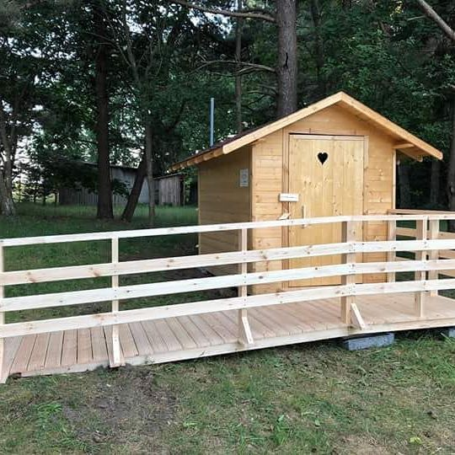
Infrastructure improvements
Lead Partner

Slide 9
Infrastructure improvements
Lead Partner
Deliverable No. | Deliverable title | Target value | Delivery date
I1.1.1 | Alsunga municipality, Žibgrava trail (dry closet, benches, wooden boardwalk, small bridges, reconstruction of a trail stretch) | 1 | Period 4
I1.1.2 | Aizpute municipality, Kazdanga Park and Kazdanga Castle Park (2 dry closets, ramp, benches, reconstruction of trail stretches) | 1 | Period 4
I1.1.3 | Ventspils municipality, Lake Būšnieku Trail (dry closet, installation of edges on the wooden boardwalk, benches) | 1 | Period 1
I1.1.4 | Liepāja, Horse Island Trail (dry closet, trail stretch to it, accessibility improvements at parking lot) | 1 | Period 2
I1.1.5 | Skrunda municipality, trail along the River Venta (dry closet, trail stretch to it) | 1 | Period 1
I1.1.6 | Priekule municipality, Kalētu Forest park (dry closet, resting area, ramp, tables, benches, reconstruction of trail stretches and a small bridge) | 1 | Period 4

Slide 10
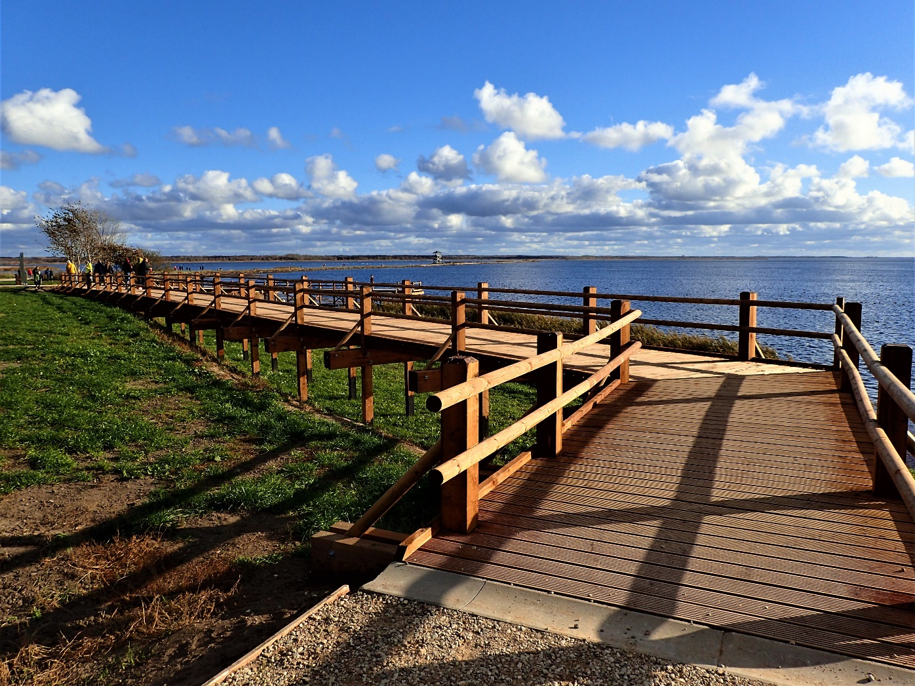
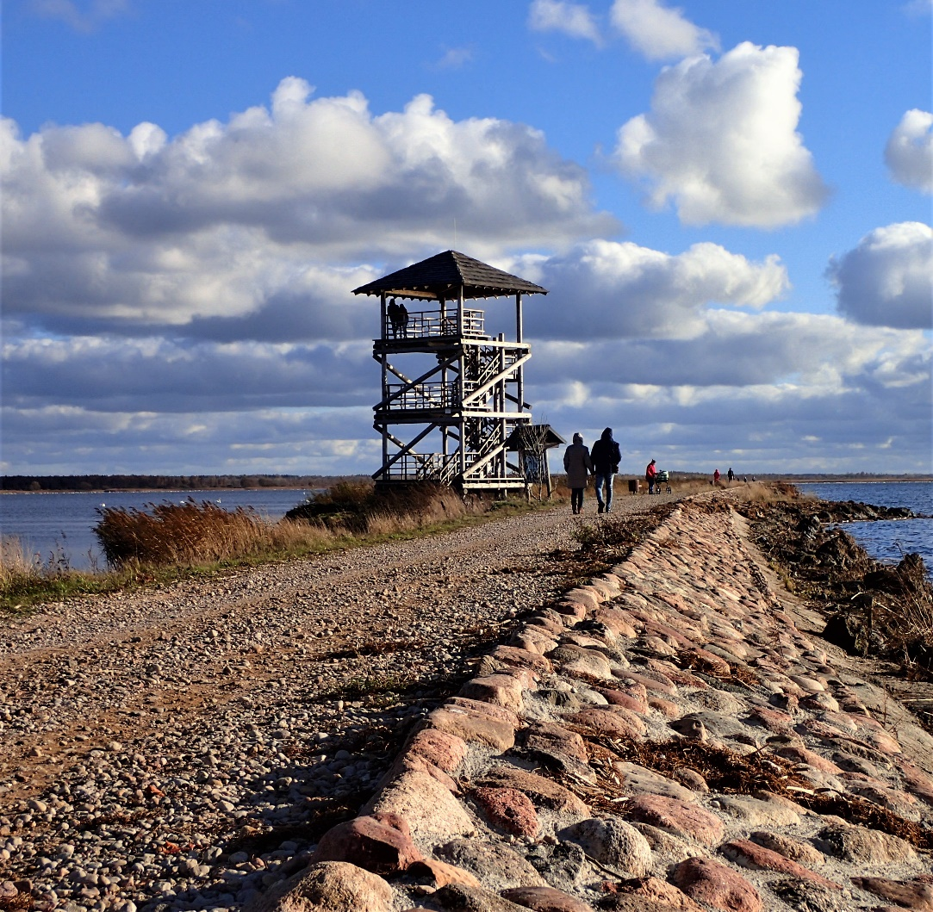
Infrastructure improvements
Lead Partner – Liepāja Horse island

Slide 11
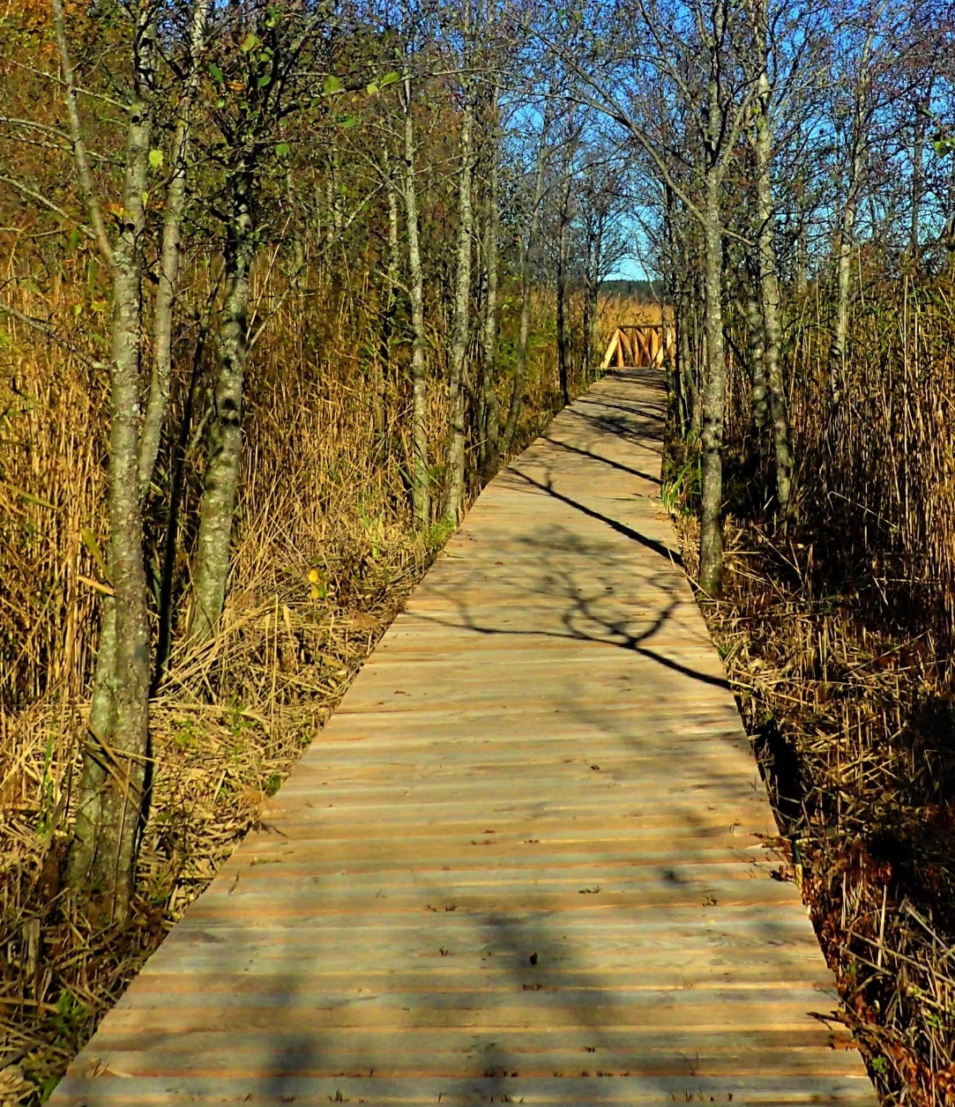
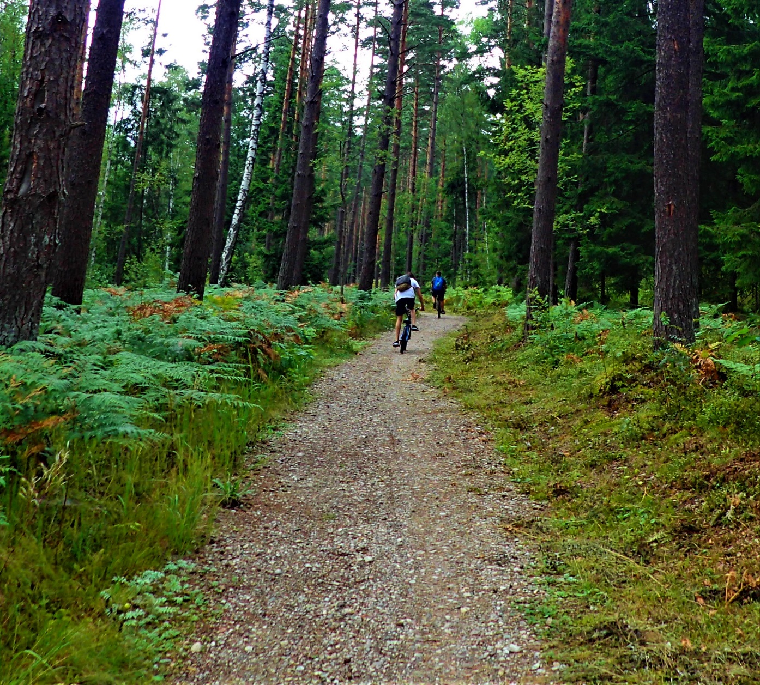
Infrastructure improvements
Lead Partner – Ventspils, Lake Būšnieku trail

Slide 12
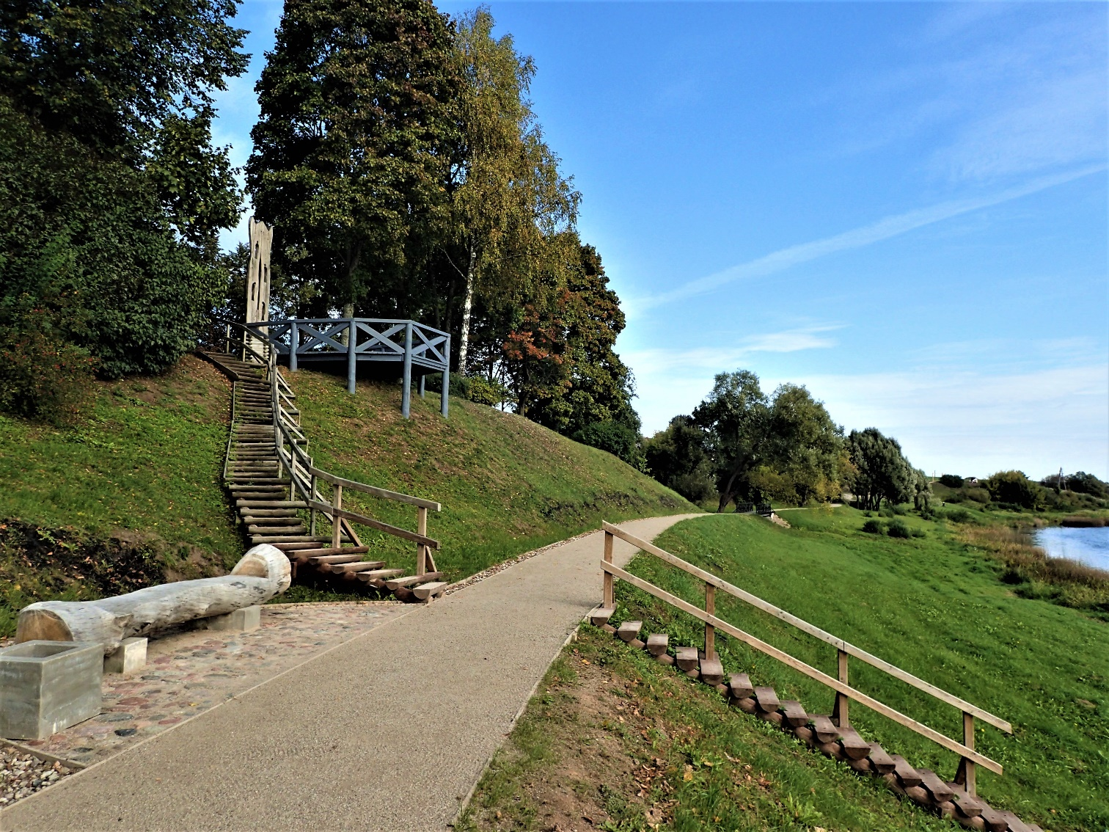
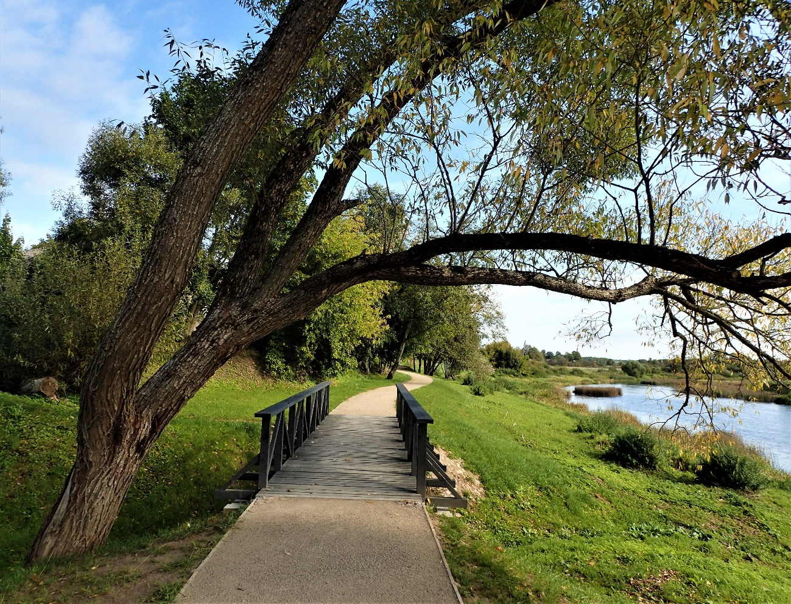
Infrastructure improvements
Lead Partner – Skrunda, trail along the River Venta

Slide 13
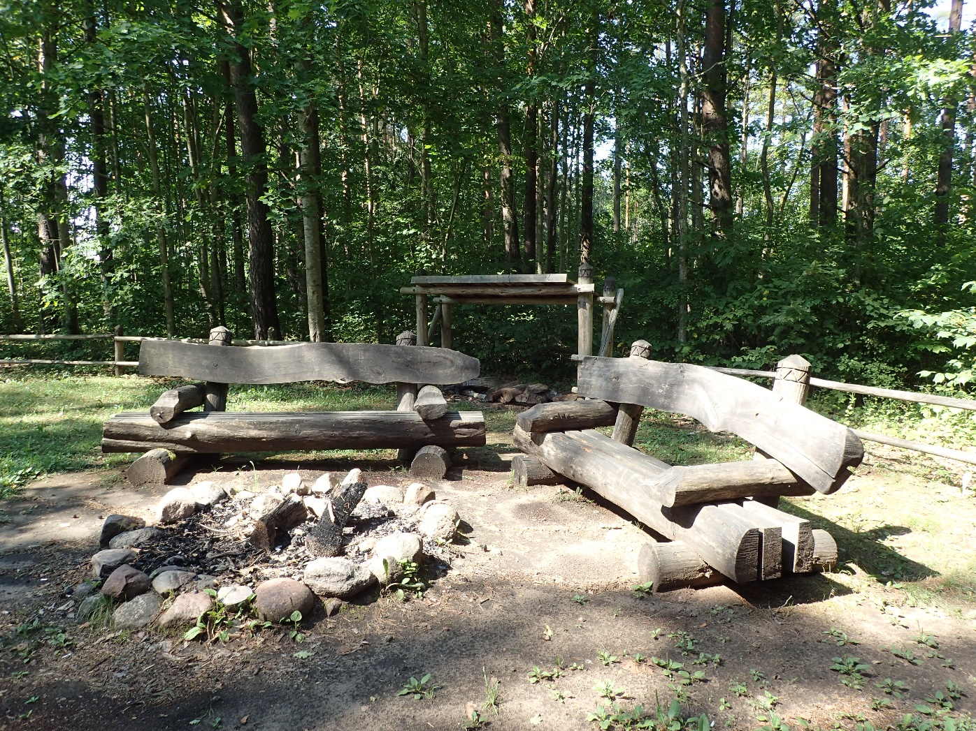
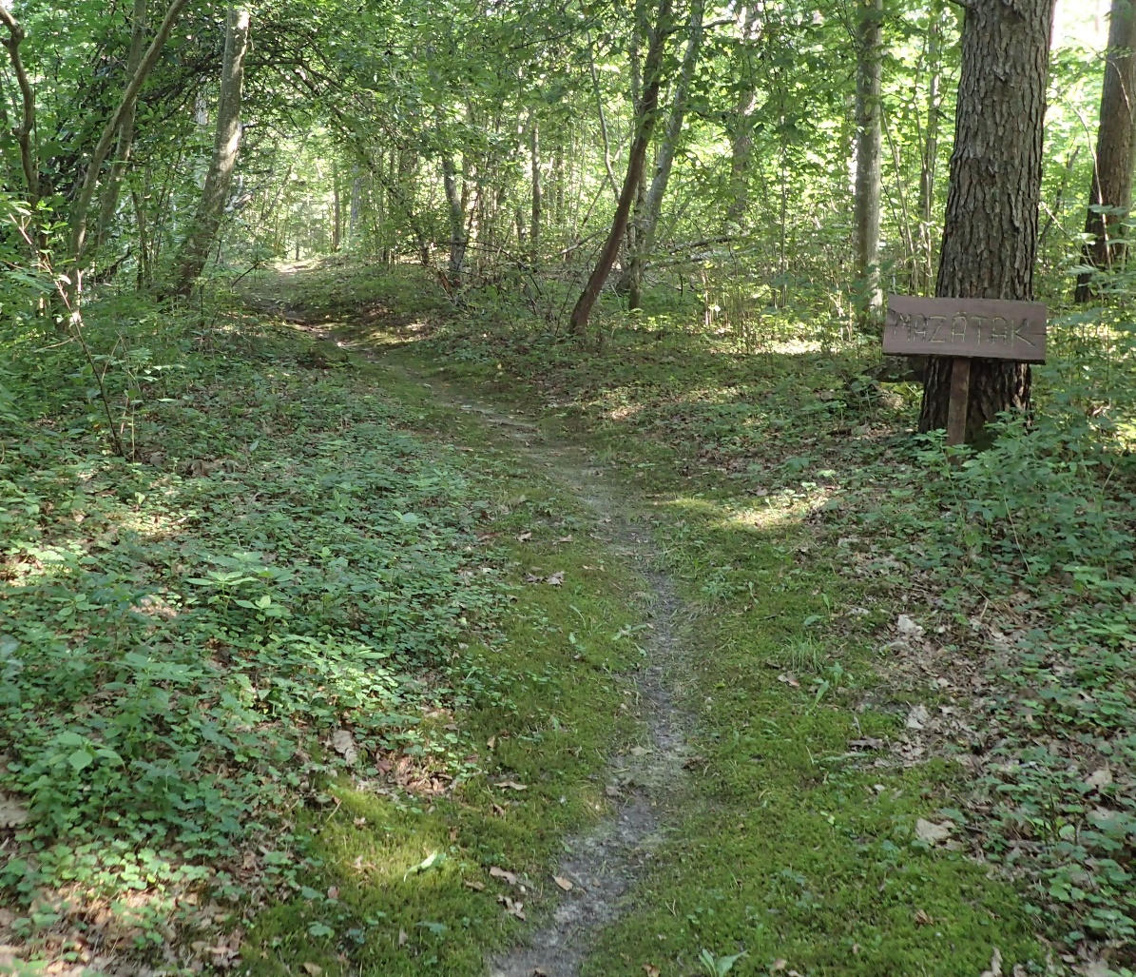
Infrastructure improvements
Lead Partner – Alsunga, Žibgrava trail

Slide 14
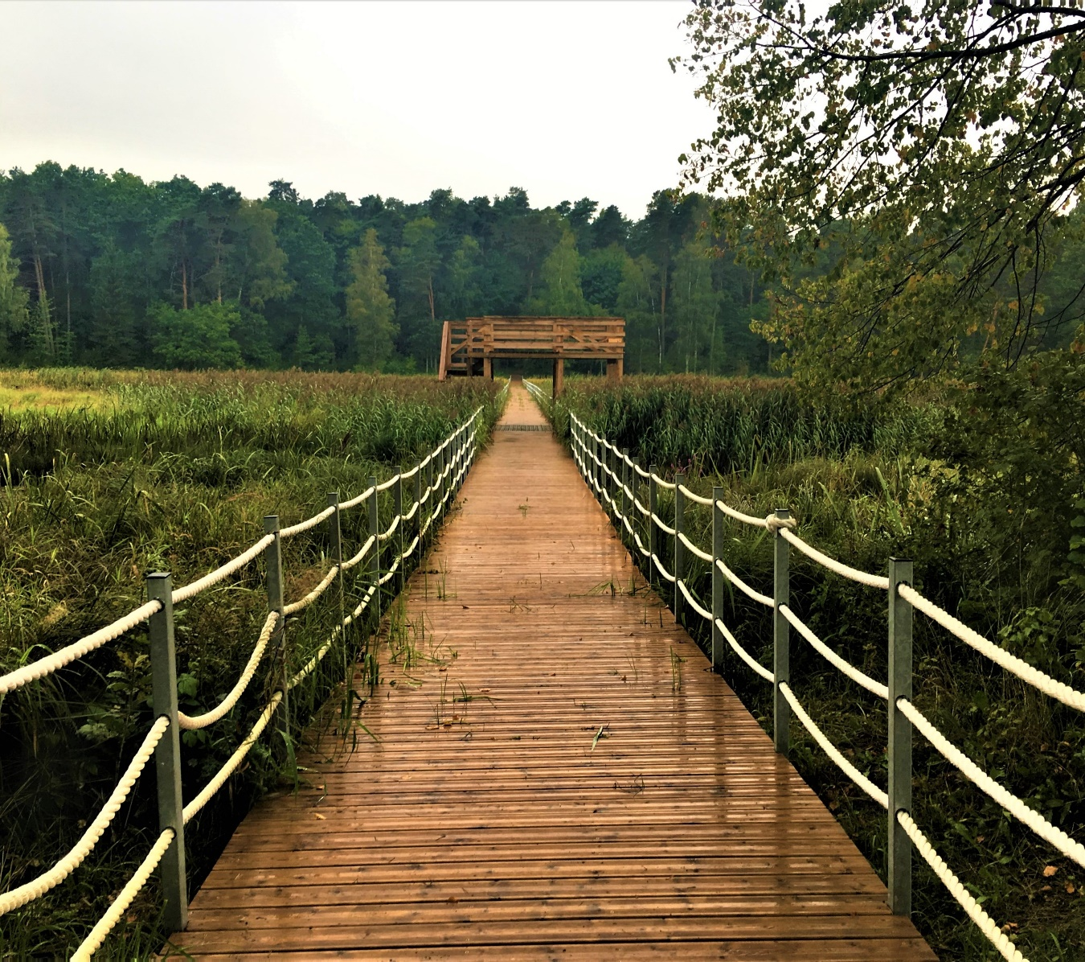
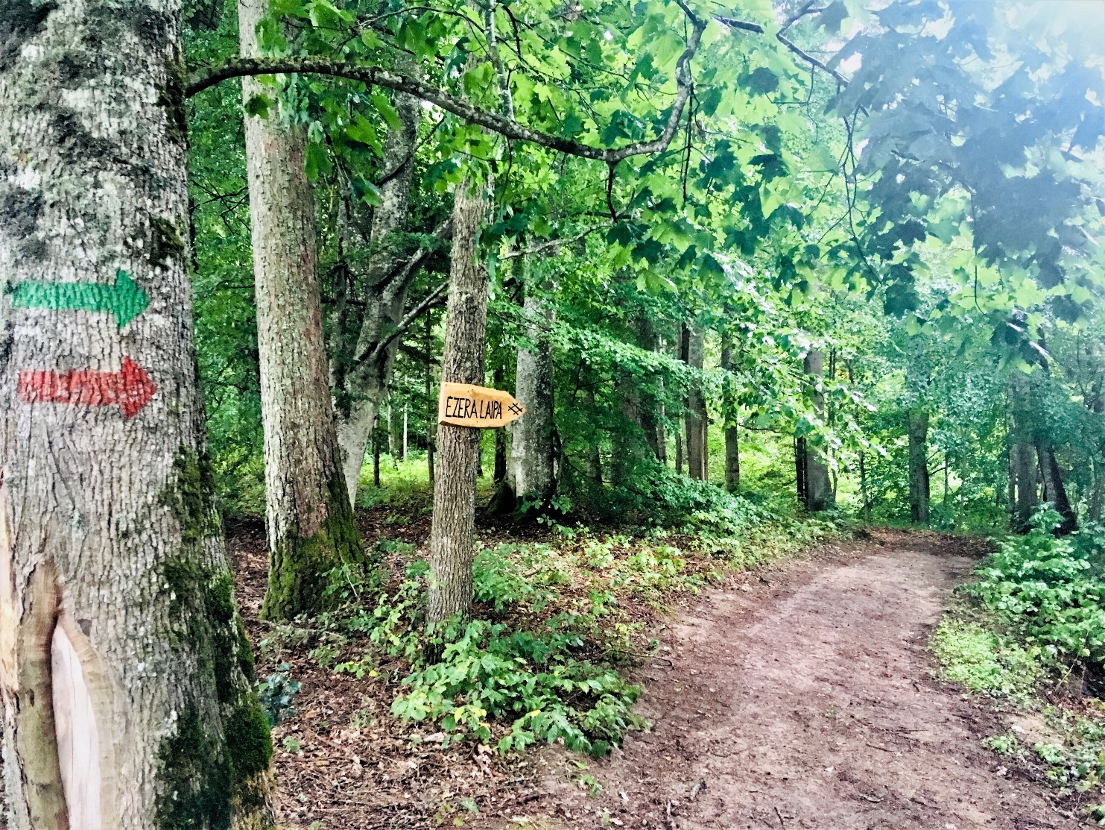
Infrastructure improvements
Lead Partner – Kazdanga park

Slide 15
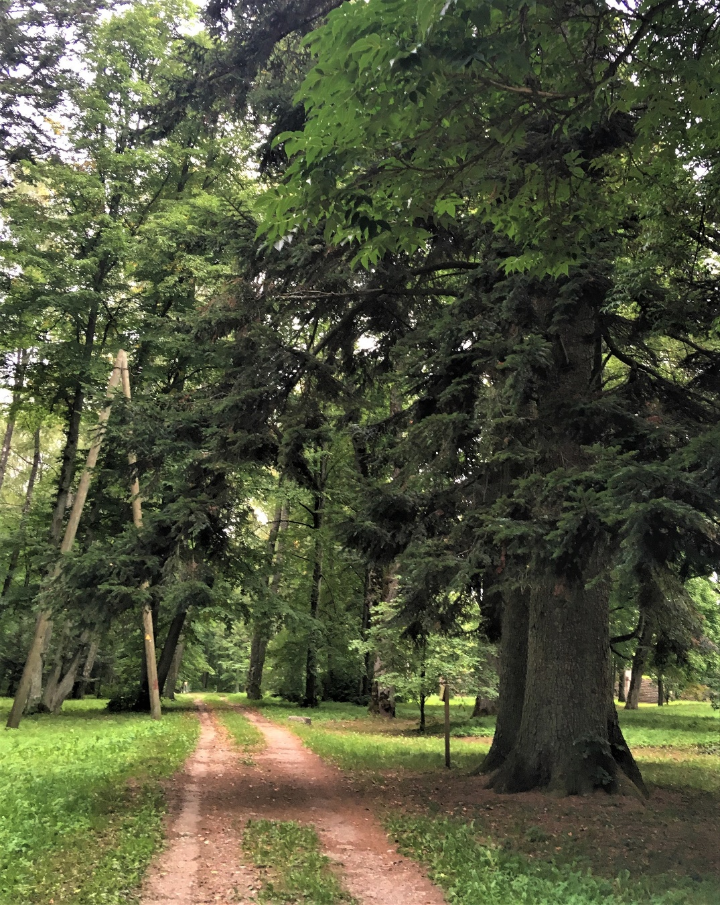
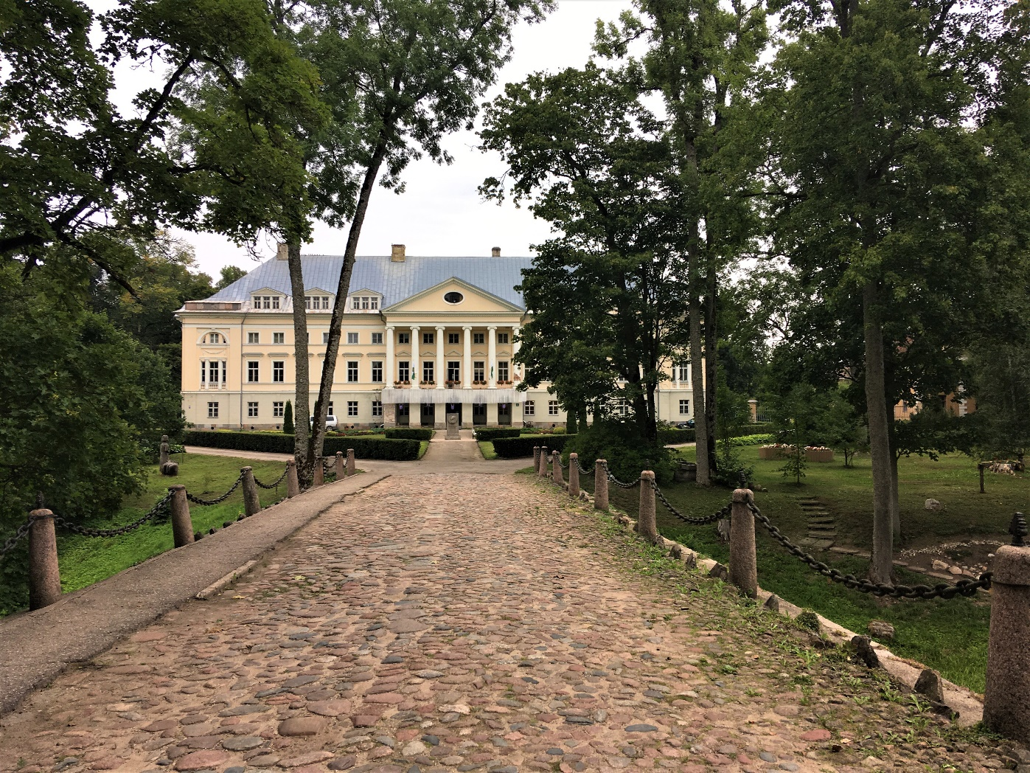
Infrastructure improvements
Lead Partner – Kazdanga Castle park

Slide 16
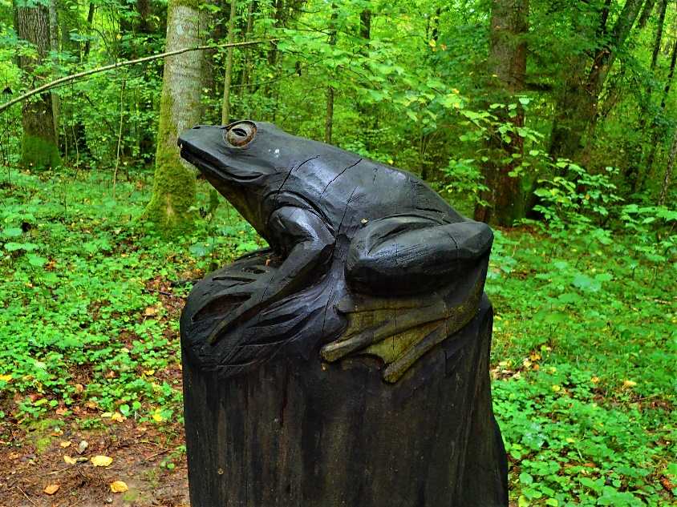
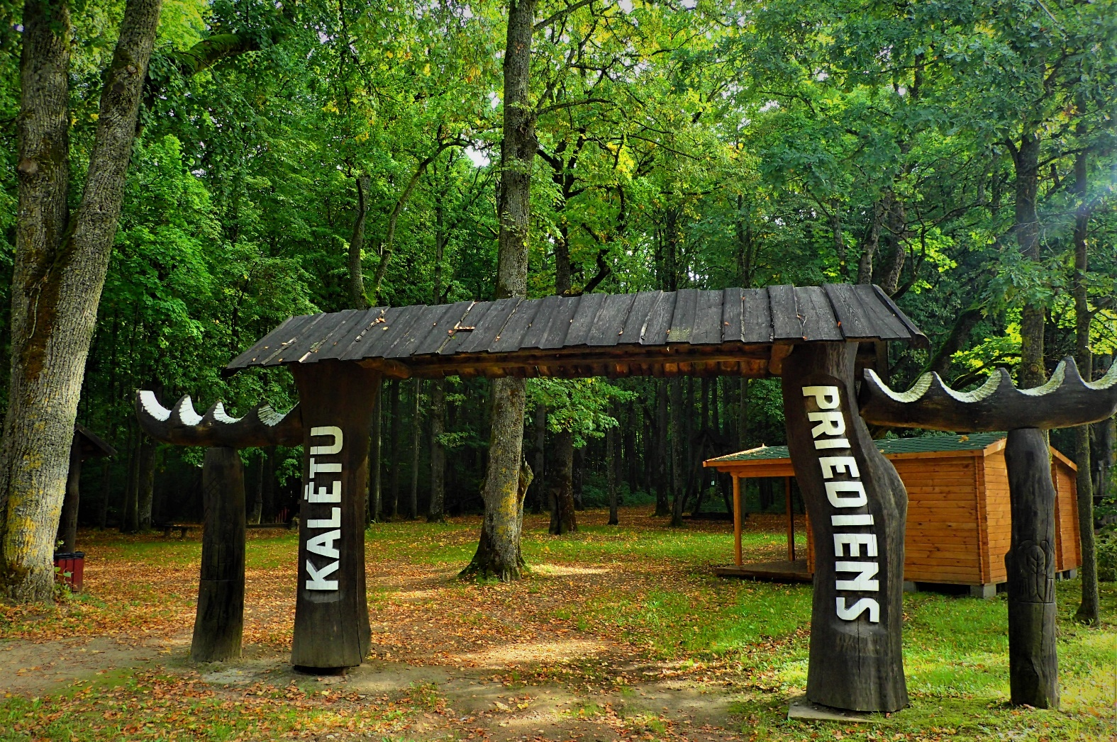
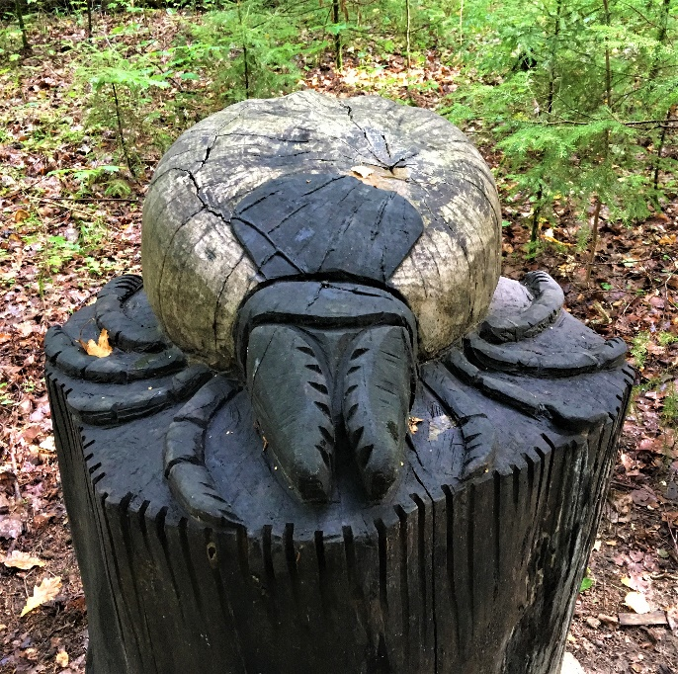
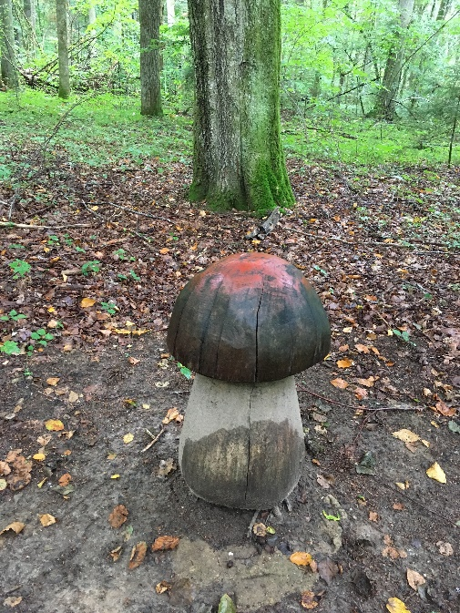
Infrastructure improvements
Lead Partner – Priekule, Kalēti Forest Park

Slide 17
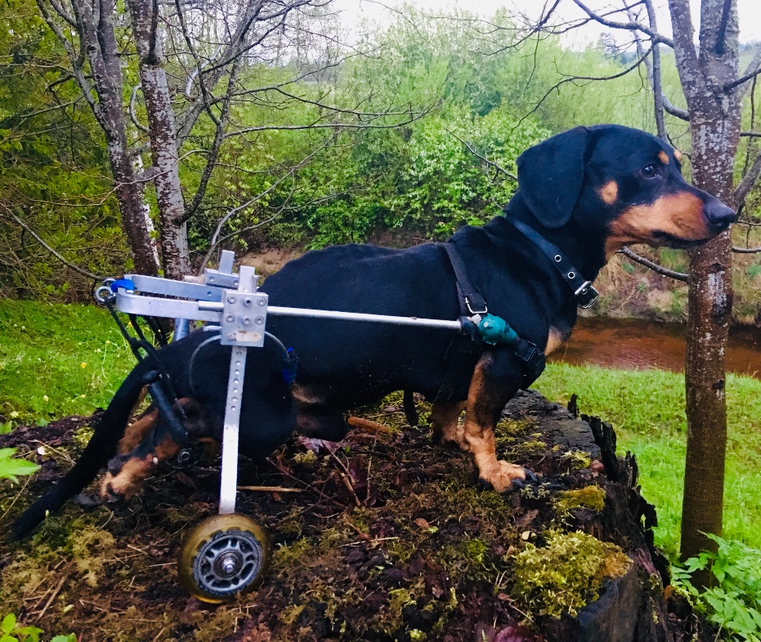
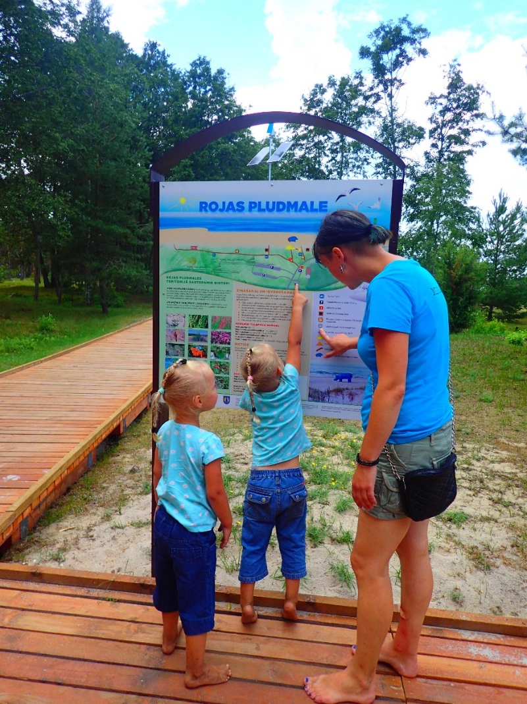
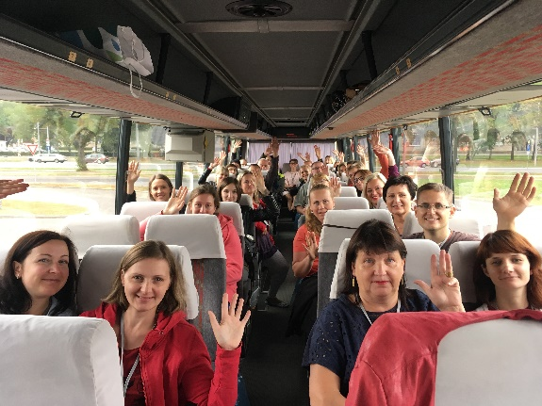
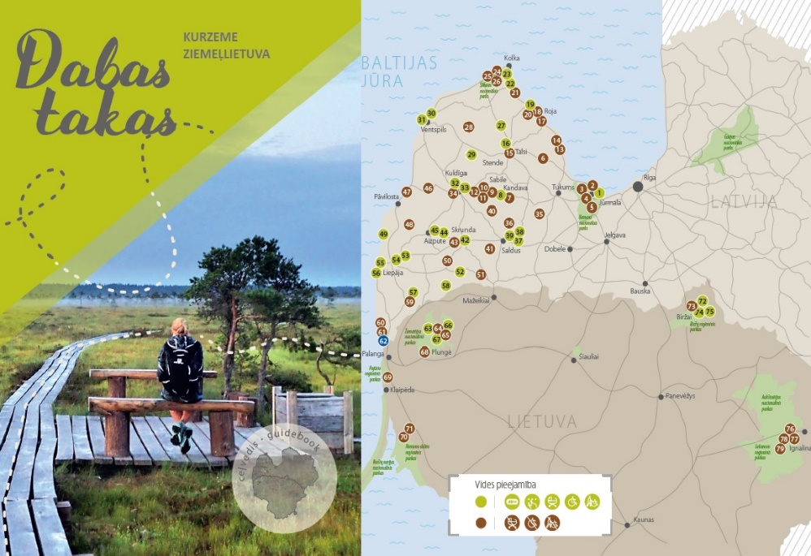
Joint Product Development
Development of joint materials
Development of accessibility CL
Learning best practise
Developing chain of accessible sites

Slide 18
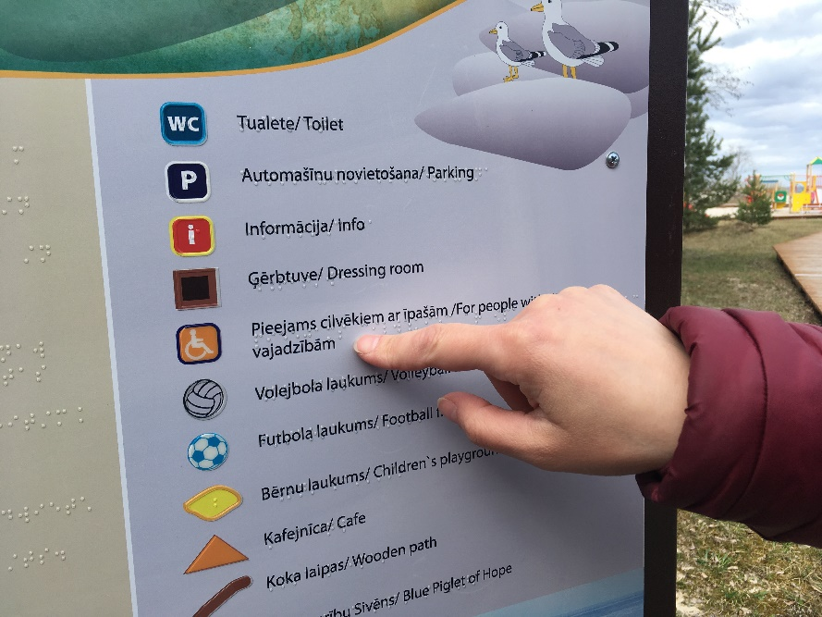
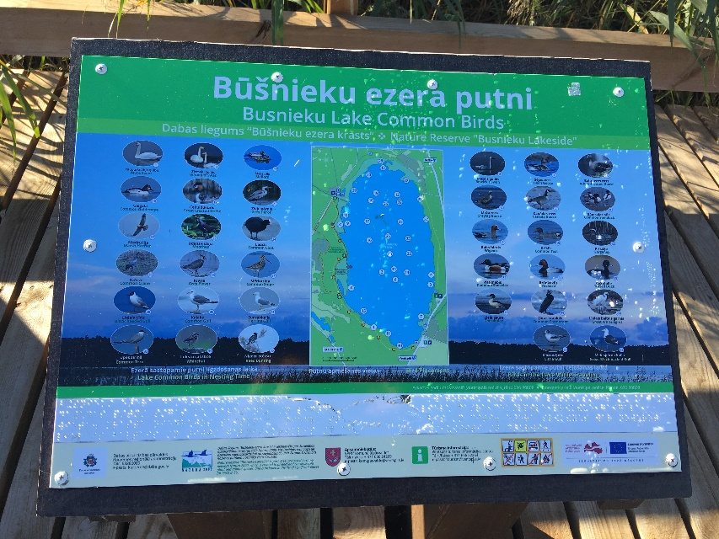
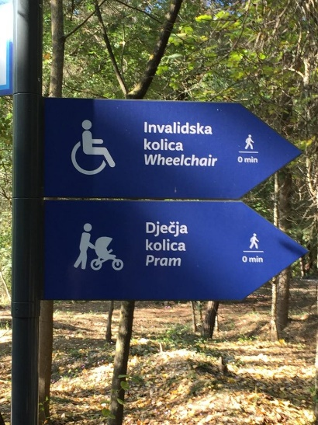
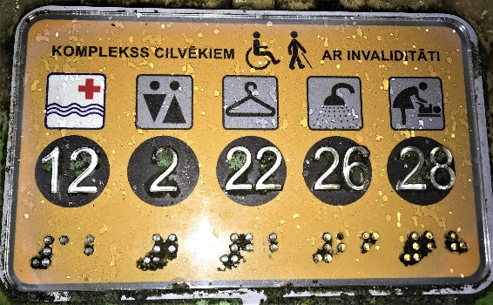





Joint Materials
Signs and info boards
16
Period 3
Responsible partner for development: Metsähallitus
Production: LP, PP2, PP3

Slide 19
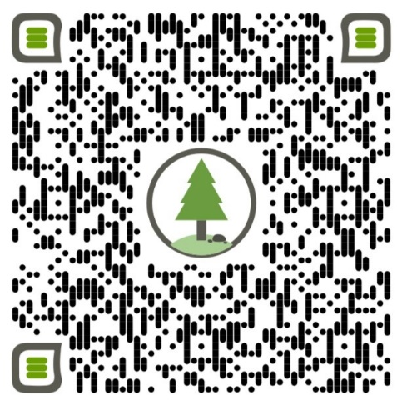
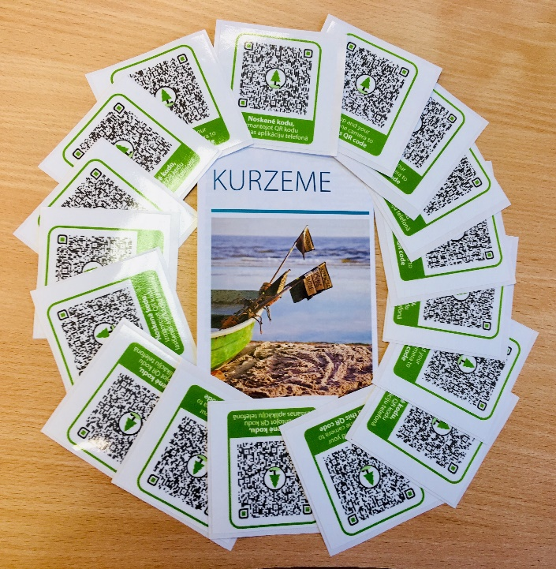
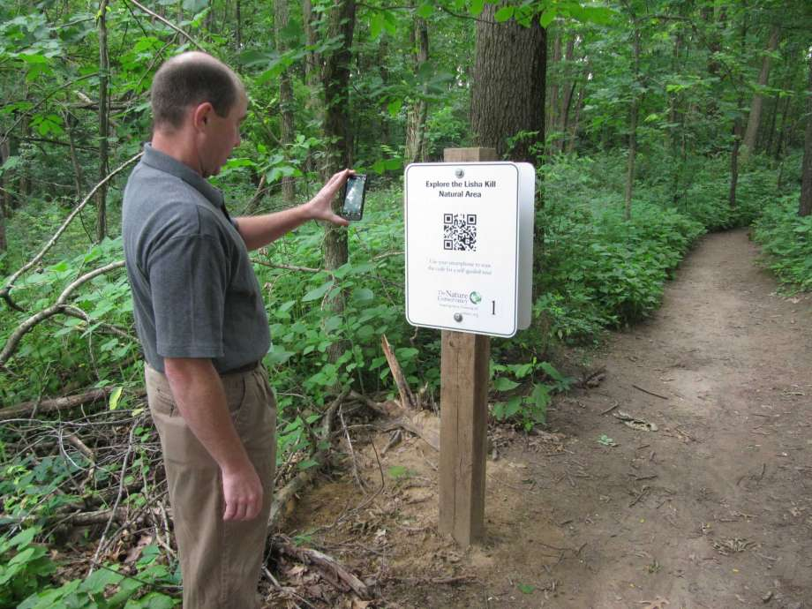
Joint Materials
QR codes with audio and video
16
Period 3
Responsible partners: LP, PP2, PP3

Slide 20
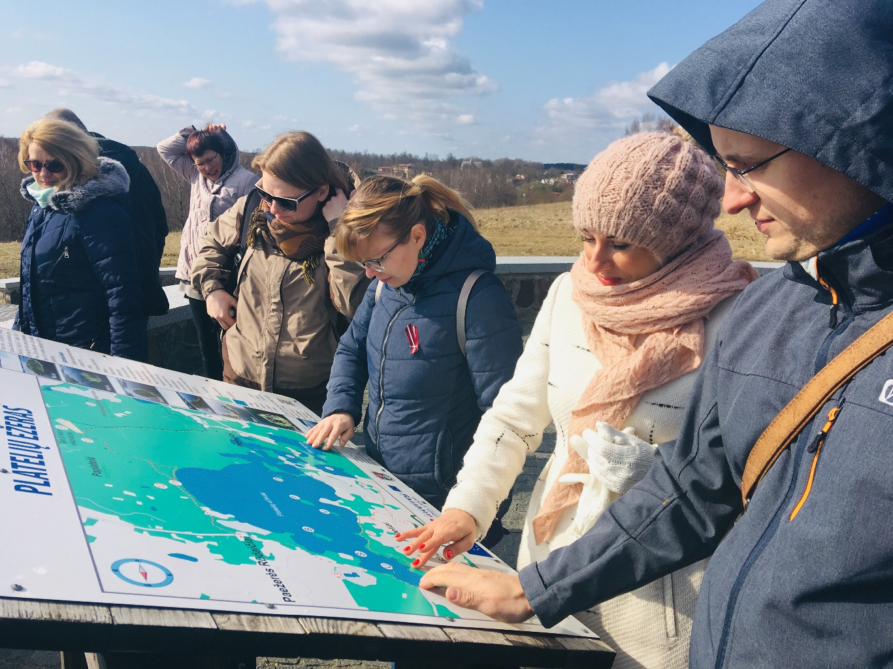
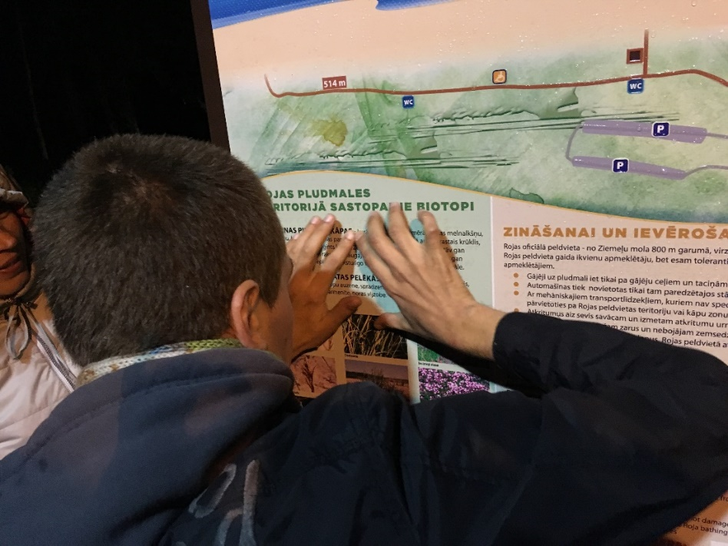
Joint Materials
Tactile & Braille info stands
16
Period 2
Responsible partners: LP, PP2, PP3

Slide 21
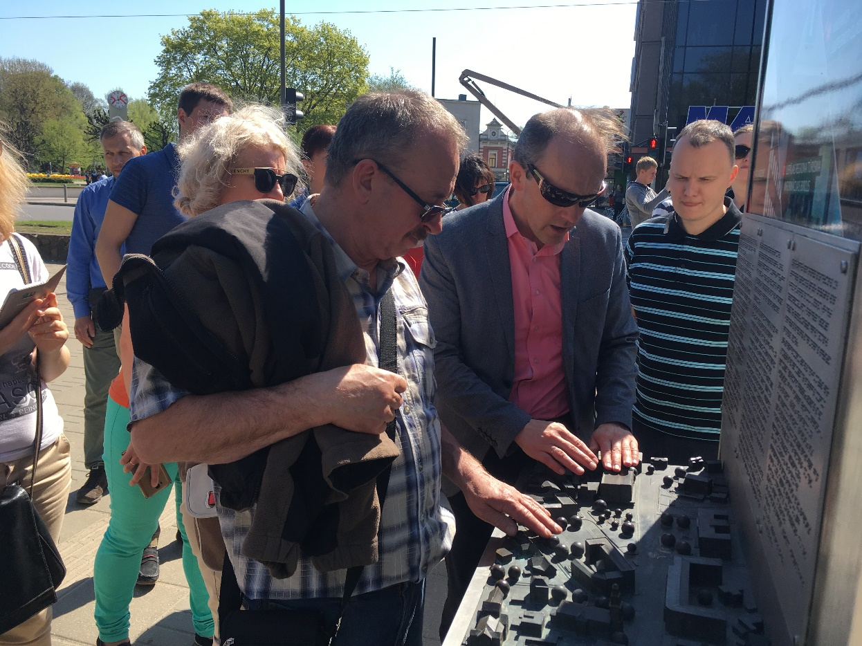
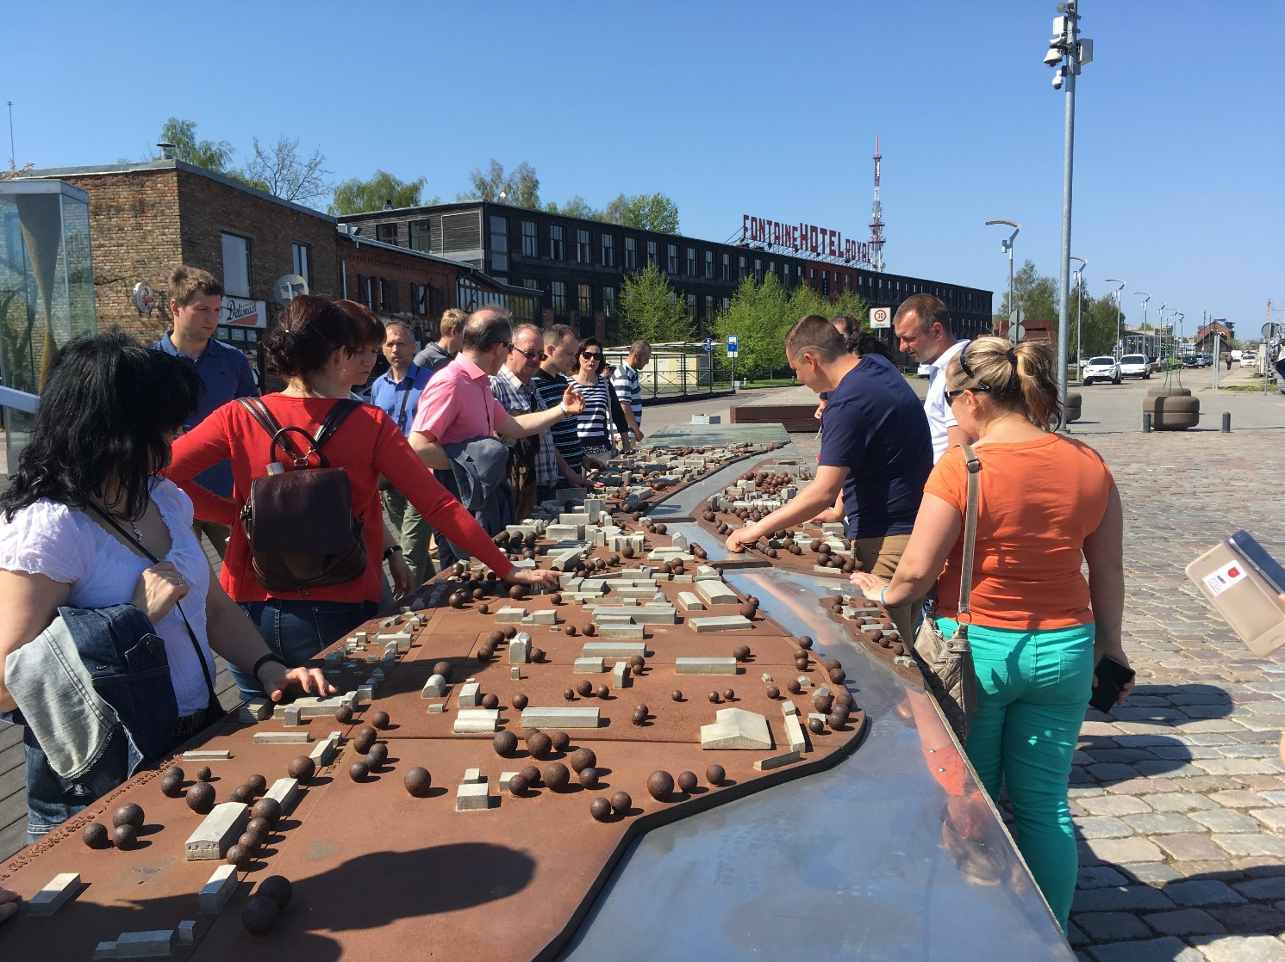
Joint Materials
Tactile objects
16
Period 3
Responsible partners: LP, PP2, PP3

Slide 22
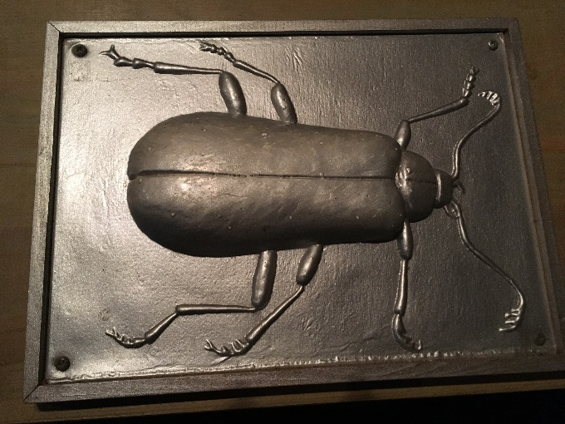

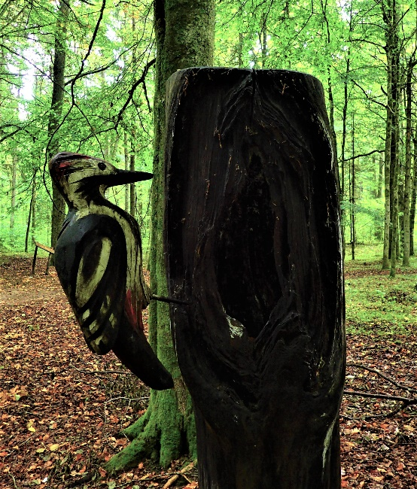
Joint Materials
Tactile objects
16
Period 3
Responsible partners: LP, PP2, PP3

Slide 23

Joint Materials
Senses focused toolboxes
15
Period 3
Responsible partner: PP4

Slide 24
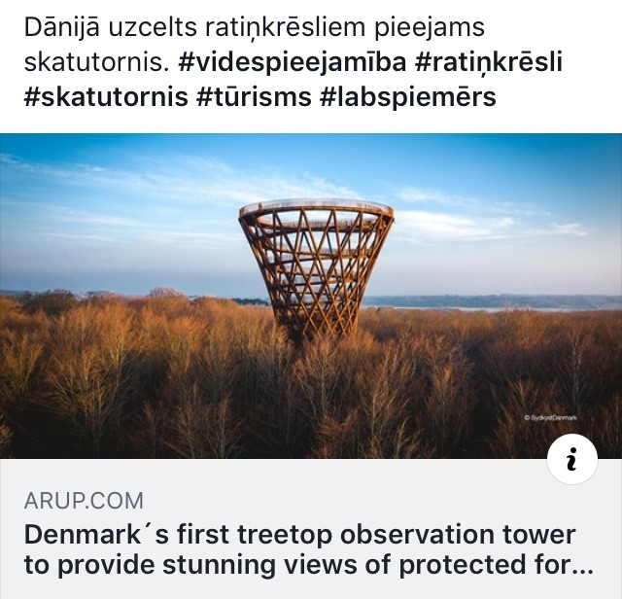
Learning best practise
Experience exchange visit to Denmark
32
Partners, municipality & tourism specialists, NGOs
Period 1
Focus on the nature visitors centres and organisations that deal with outdoor accessibility issues to learn from best examples on accessible nature sites and on development of materials for disabled people, accessibility branding and information channelling. Visits to accessible sites.
Responsible partner: PP4

Slide 25
Accessibility Check-list
Development of the CL
1
In cooperation with NGOs
Period 1
Thematic workshops
3
LV, EE, FI
Period 2
for municipalities, visitor centres, local operators etc. on developing accessible tourism products, use of self-testing tool, efficient accessibility solutions (total 150 participants)
Responsible partner: LP

Slide 26
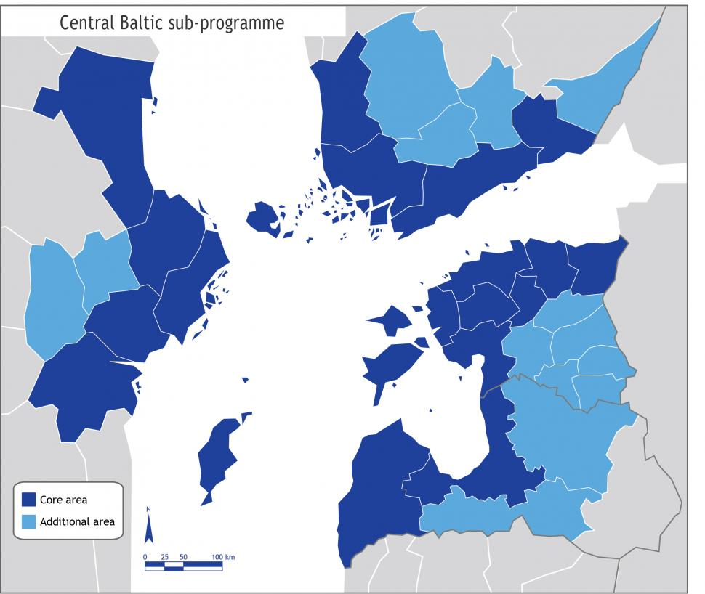
Development of the chain of accessible nature sites
On-spot inspection visits
at project sites
48
Period 1: 16
Period 2: 11
Period 3: 11
Period 4: 10
On-spot inspection visits
at other sites
35 round visits
Period 1: 17
Period 3: 18
To agree on inspection criteria for trails – type, length, hiking time, marking, trail surface, difficulty, accessibility level, facilities, rules to follow etc.
2) Trail passports
3) Recording GPX
Responsible partner: LP, PP2, PP3

Slide 27
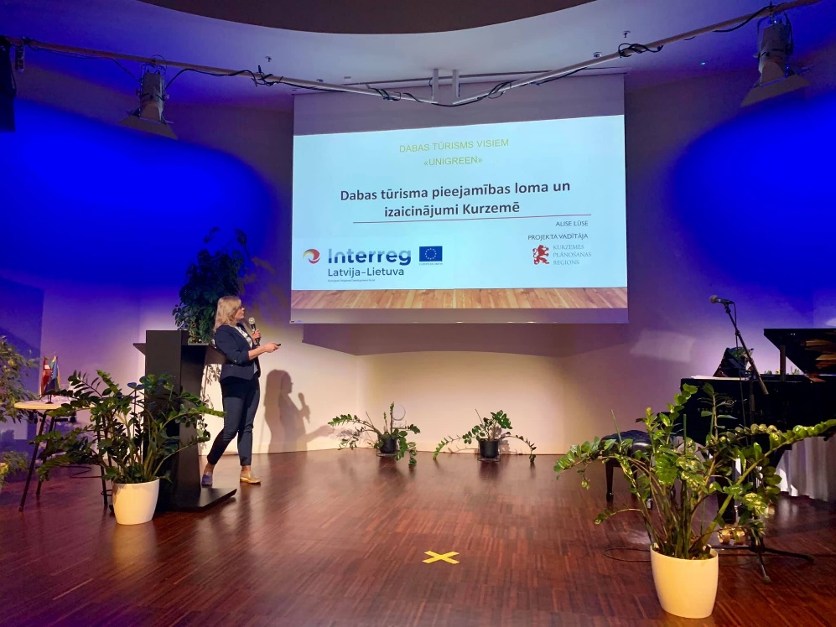

Marketing&Promotion
Public events&promotional materials
Marketing activities

Slide 28
Public events&promotion
FAM workshops for messengers
3
LV, EE, FI
Period 2
Responsible partner: LP, PP2, PP3
How to access and spread info on accessible destinations among the target group. Total no of participants - 20.
Participation at Europarc Conference 2020
1
In Latvia – Ķemeri National Park
Period 3
Responsible partner: PP4
workshop on accessibility challenges and achievements by project partners (PP3 covers costs from own resources)

Slide 29
Public events&promotion
FAM workshops with GER, UK, SE, USA, Asia tour operators
5
09.2019 - 02.2020
Period 2
Responsible partner: PP2
to market the CB core area in LV, EE nad FI as a single accessible nature tourism destination
FAM workshops
3
LV, EE, FI
Period 3
Responsible partner: LP, PP, PP3
Accessibility Days for families with disabilities to meet and visit the improved project sites. Total no of participants - 90.

Slide 30
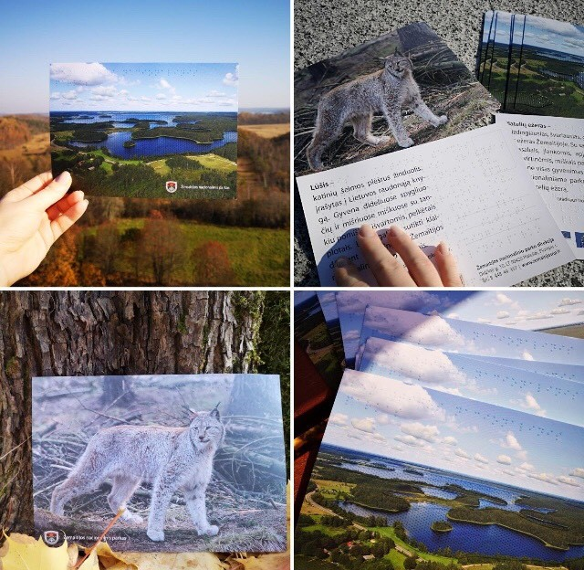
Public events&promotion
Tactile and Braille info cards & flyers for project sites
16
Period 4
Responsible partner: LP, PP2, PP3

Slide 31
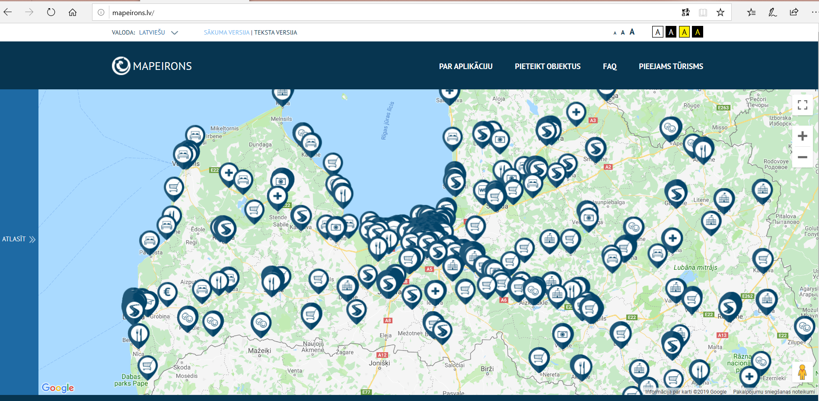
Marketing
Mobile-friendly internet platfom
Period 3
Responsible partner: LP

Slide 32
Marketing
Travel Guide on accessible sites
16000
LV, EE, FI, ENG
Period 4
Responsible partner: LP, PP2, PP3

Slide 33
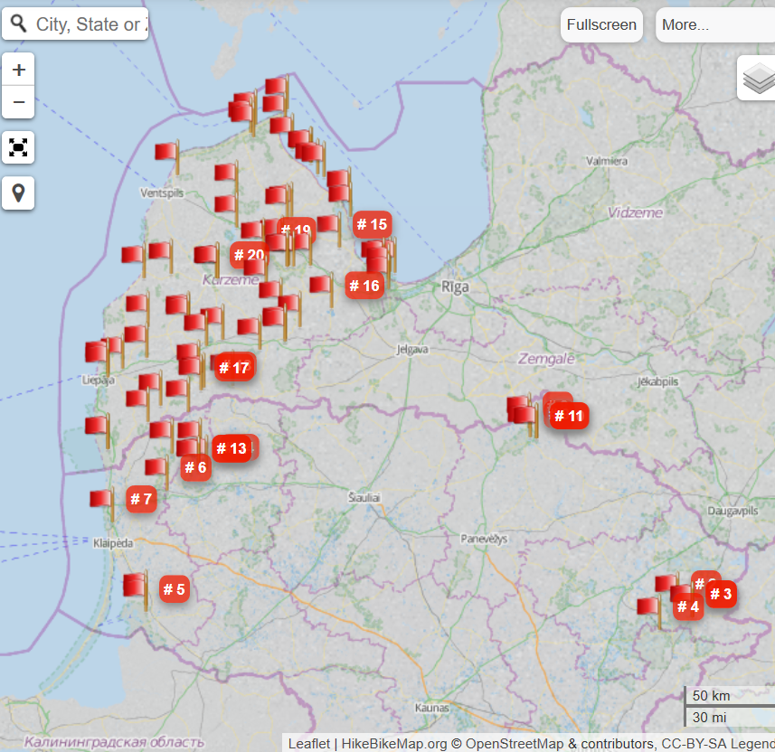






Marketing
Publishing on other sites & apps
15
Period 4
Responsible partner: all partners
PP2 site adapted to visually impaired
visitkurzeme.lv, kurzemesregions.lv, latvia.travel
westestonia.com, visitestonia.com,
metsa.fi, nationalparks.fi

Slide 34
Communication
Project Poster

Slide 35
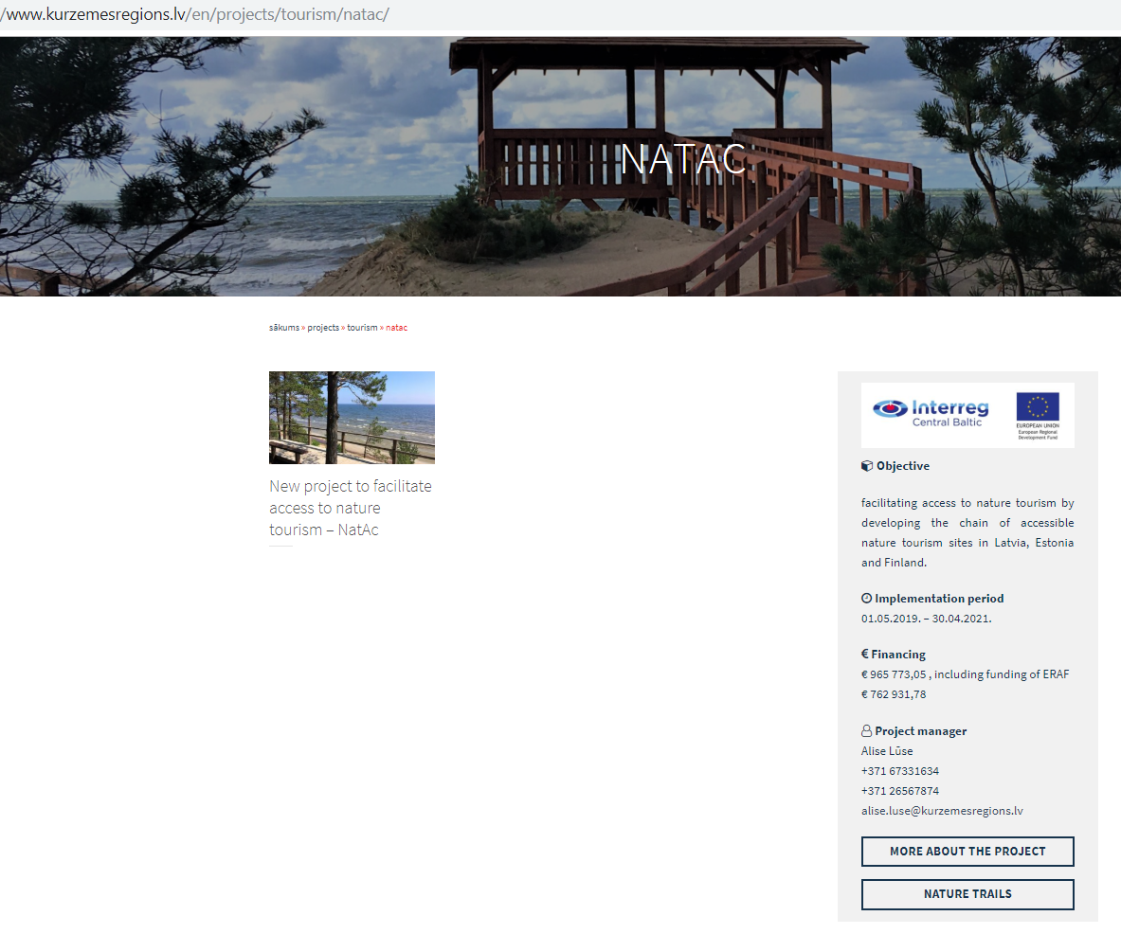
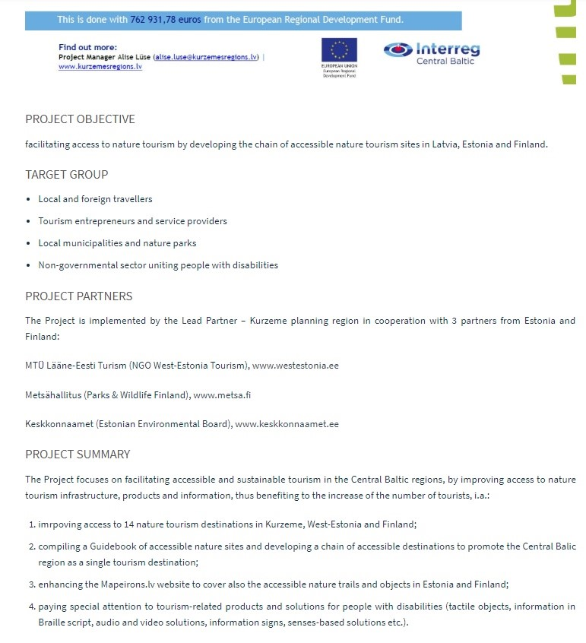
Communication
Website section
https://www.kurzemesregions.lv/en/projects/tourism/natac/

Slide 36
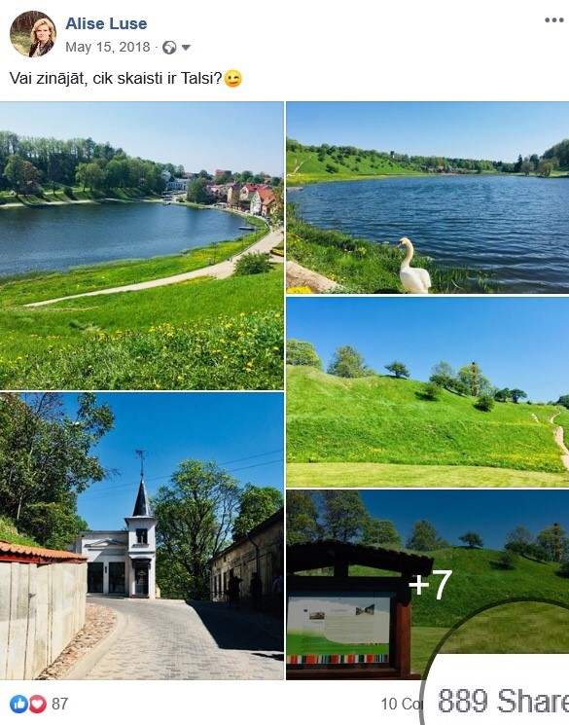
Communication
Facebook posts - 50
Period 1 - 8, in Period 2 - 10, in Period 3 - 16, in Period 4 - 16
Website updates - 40
Period 1 - 8, in Period 2 - 10, in Period 3 - 11, in Period 4 - 11
Articles - 3
Period 1 - 1, in Period 3 - 1, in Period 4 - 1

Slide 37
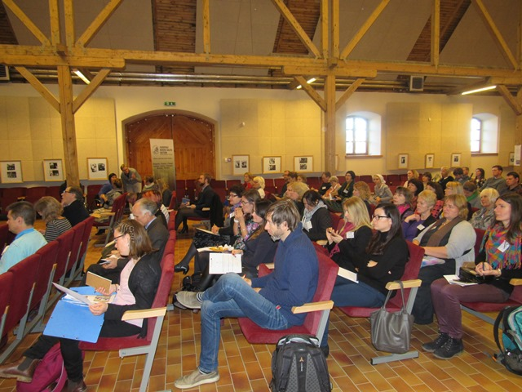
Communication
Final conference in Kurzeme – 100 participants

Slide 38
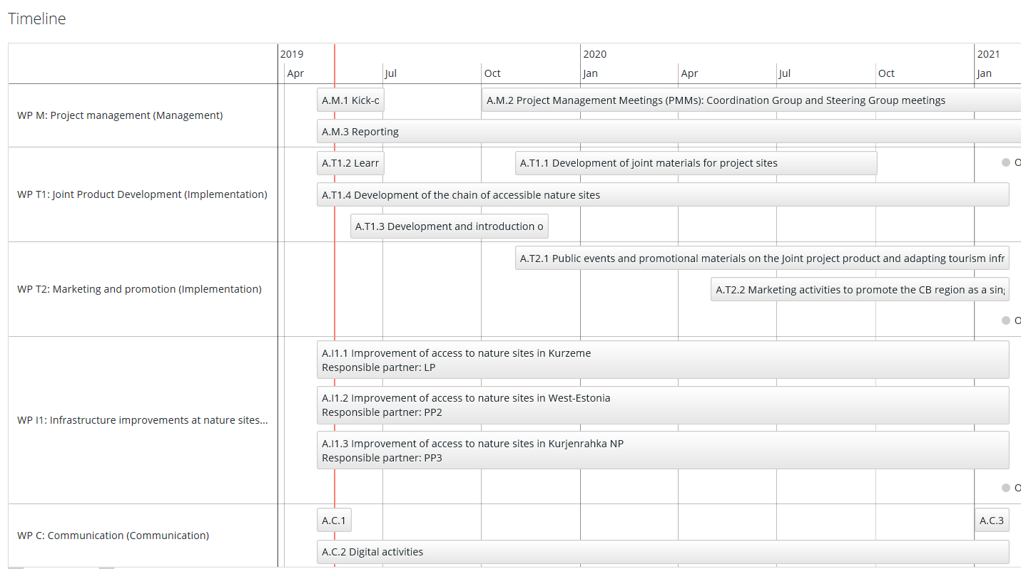
Period 1

Slide 39
Period 1
Infastructure development activities
LP – at Skrunda and Ventspils
West-Estonia – at Haapsalu, Lääne-Nigula and Lääneranna
Joint Product Development
LP – Accessibility CL
All partners – Study visit to Denmark
All partners – on-site inspection visits at project sites and outside
Communication
LP - article
All partners – website section + updates + FB posts

