Slide 1
CB786 Nature access to all NatAc
PP3, Metsähallitus/ Parks&Wildlife Finland
The project is co-financed by the Central Baltic Programme 2014–2020 www.centralbaltic.eu

Slide 2
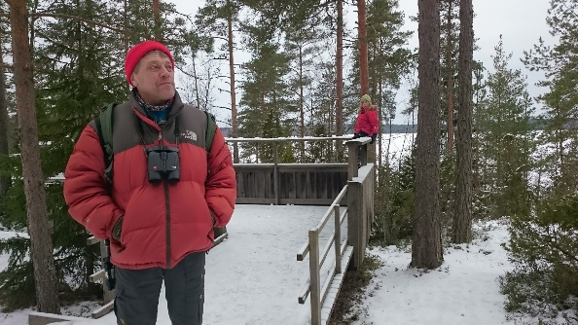
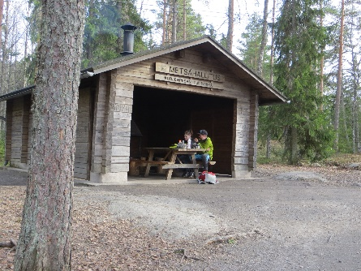
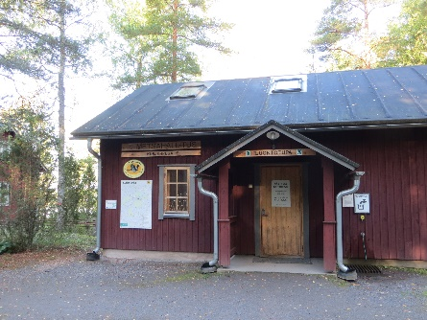
WP 4: Infrastructure and improvements at nature sites
Activity 4.3
Improvement of access to nature sites in Kurjenrahka NP
Deliverable 4.3.2:
“Kurjenpesä” - accessible gate to the nature! Consist of:
Parking area
Scenic lookout place
Open information hut
Dry closets with ramp
Cooking shelter
Renovation of constructions for disabled. Updating of accessible ”service package”.

Slide 3
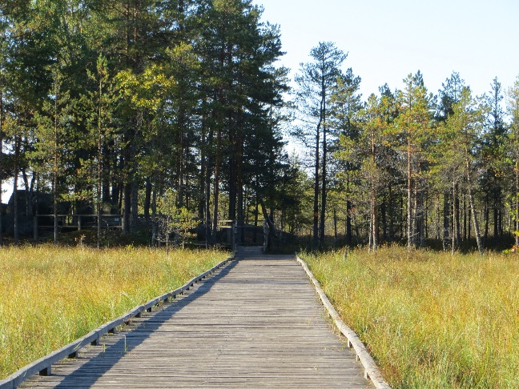
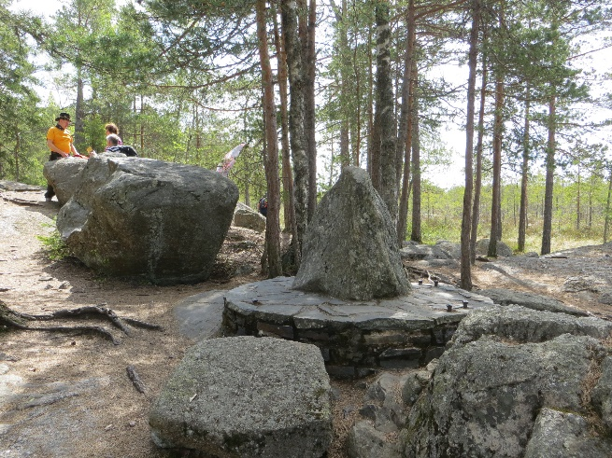
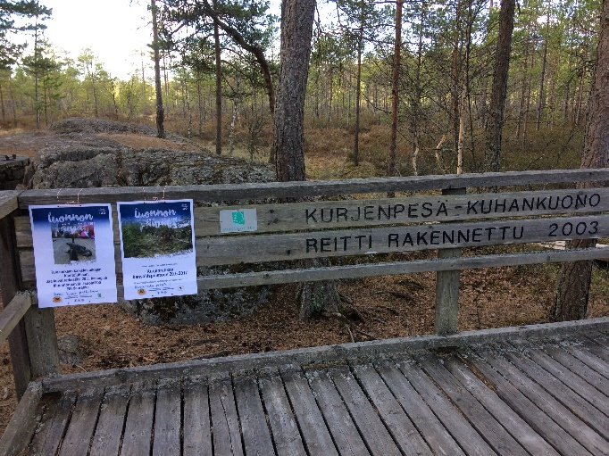
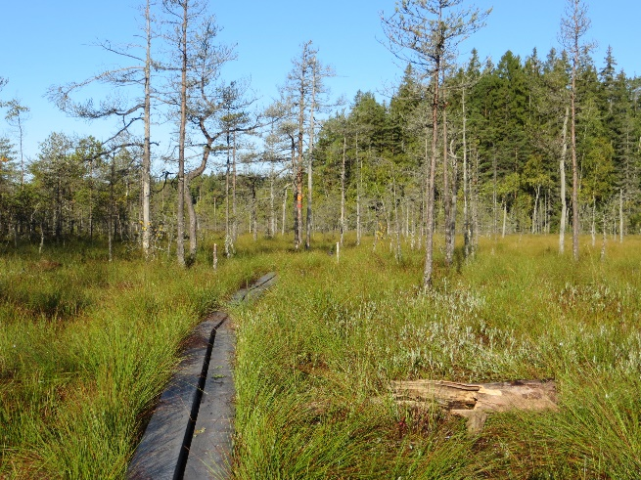
WP 4: Infrastructure and improvements at nature sites
Activity 4.3
Improvement of access to nature sites in Kurjenrahka NP
Deliverable 4.3.1:
Trail to main attraction "Kuhankuono" boundary mark over Kurjenrahka bog and "Karpalopolku” trail.
The reconstructions of the old wooden boardwalk over the bog will offer access to most exclusive nature site in Turku area.
Constructions of ”Karpalopolku” 1,5 km making the trail more accessible for visually impaired people.

Slide 4
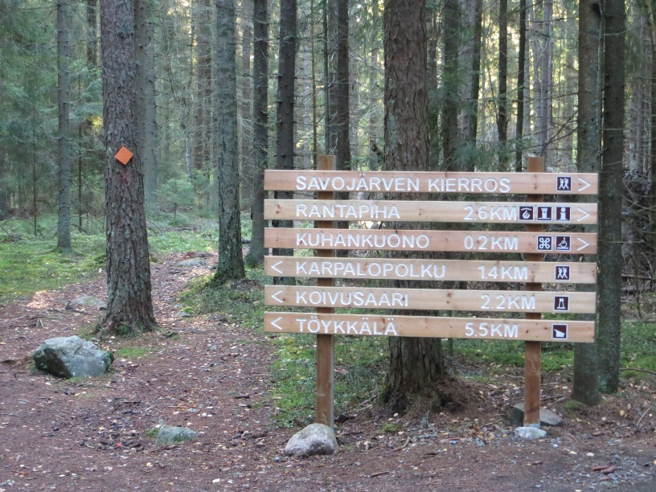
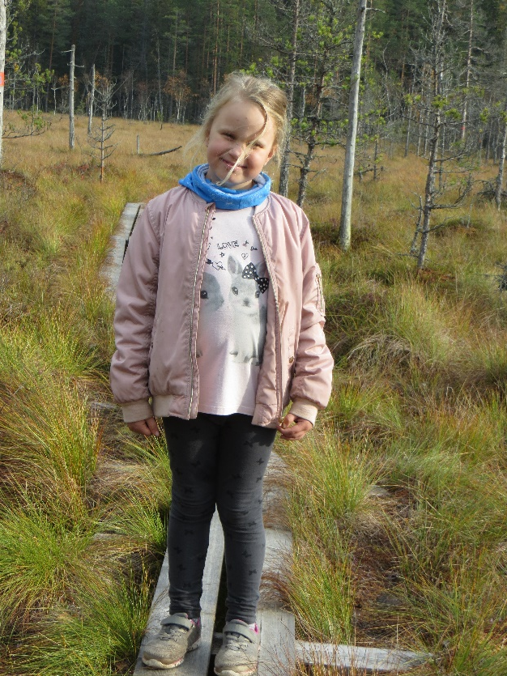
WP 4: Infrastructure and improvements at nature sites
Activity 4.3
Improvement of access to nature sites in Kurjenrahka NP
Selected target groups
local public authority
Pöytyä, Turku, Nousiainen municipalities
interest groups including NGOs
VAU = Finnish Sports Association of Persons with Disabilities
https://www.vammaisurheilu.fi/in-english
Soveli = The Finnish Adapted Physical Activity Federation
https://www.soveli.fi/soveli/in-english/
Näkövammaistenliitto = Fin­nish Fe­de­ra­tion of the Vi­sual­ly Im­pai­red
https://www.nkl.fi/en
General public, families

Slide 5
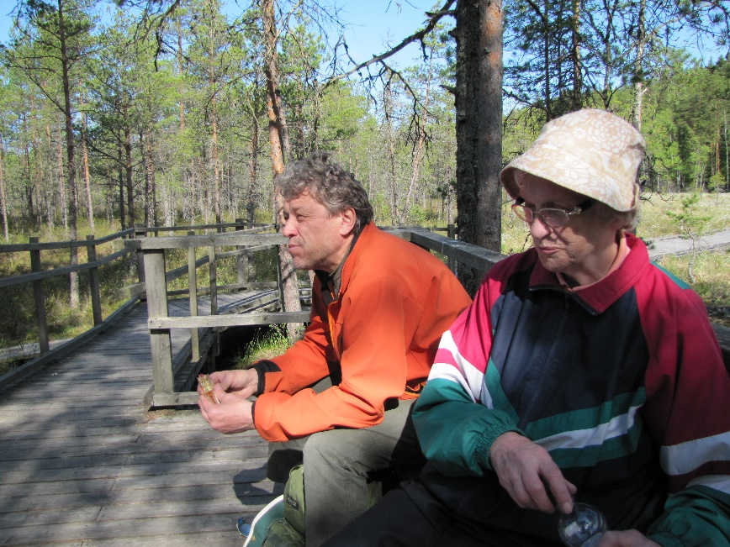
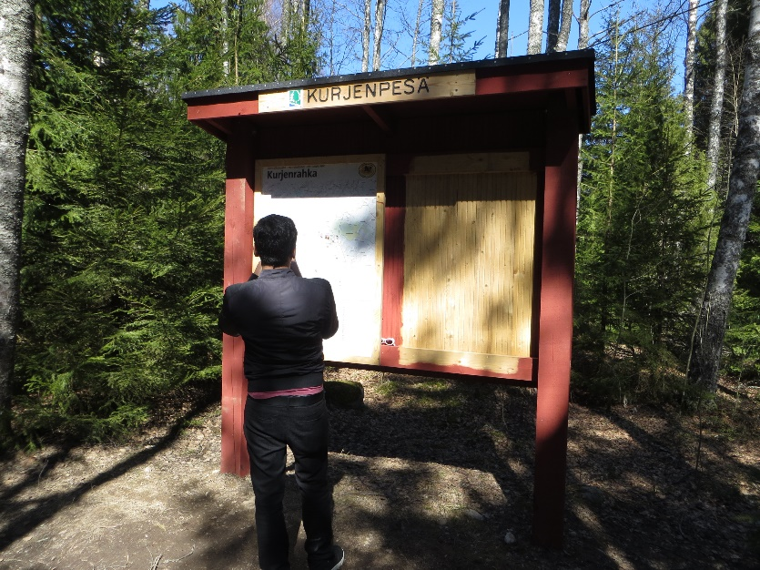
WP 2: Joint Product Development
Activity 2.1
Development of joint materials for project sites
Deliverable 2.1.1
Development and production of unified design on plain texted and visually clear signs and info boards for all project sites.
Design adapted for children, foreigners and DP.

