Slide 1
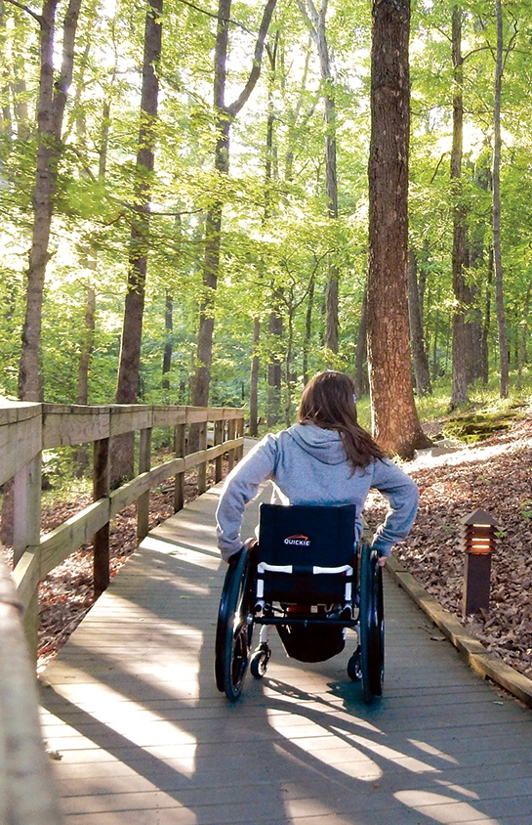
Nature Access to All
west-estonia tourism
Sille Roomets
MTÜ Lääne-Eesti Turism

Slide 2
Investments
*Improvement of Pärnu beach area (invatoilet, access to beach, 2 beach wheelchairs);
*Improvement of accessibility in Haapsalu Paralepa hiking trail and beach (invatoilet with electricity and washing possibility)
*Improvement of Access to Palivere Health Trail (trail, infostands, audio-infostands, signs, benches, waste-bins, closet);
*Improvement of Access to Matsalu National park (wheelchairs);
*Improvement of Access to Matsi resting area, port and beach (dry-closets, parking spots, tactile path);
*Improvement of access to fishing sites in Saaremaa (solutions will be worked out).
Notes:
Pärnu (Improvement access to coastal areas in Pärnu town, streches between resting areas and light traffic roads and promenades. Accessibility solutions and sites in the town will be chosen in cooperation with disabled experts and local municipality.)
Haapsalu (Improvement of access to Haapsalu Paralepa Trail and beach - construction of ramp and 2 invatoilets (watercloset with electicity connection and washing possibility)) 50 000€.
Lääne-Nigula (Palivere Health trail - reconstruction of trail, benches, waste bins, regular infostands, invatoilet).
Lääneranna (Improvement access to Coastal Hiking Trail and Matsi resting area - installation of dry-closet invatoilets, updation of parking lot and tactile path).
Saaremaa (Improvement access in Saaremaa island for wheelchairs to several fishing sites. Solutions at sites will be chosen within project in cooperation of disabled experts and local municipality.)

