Slide 2
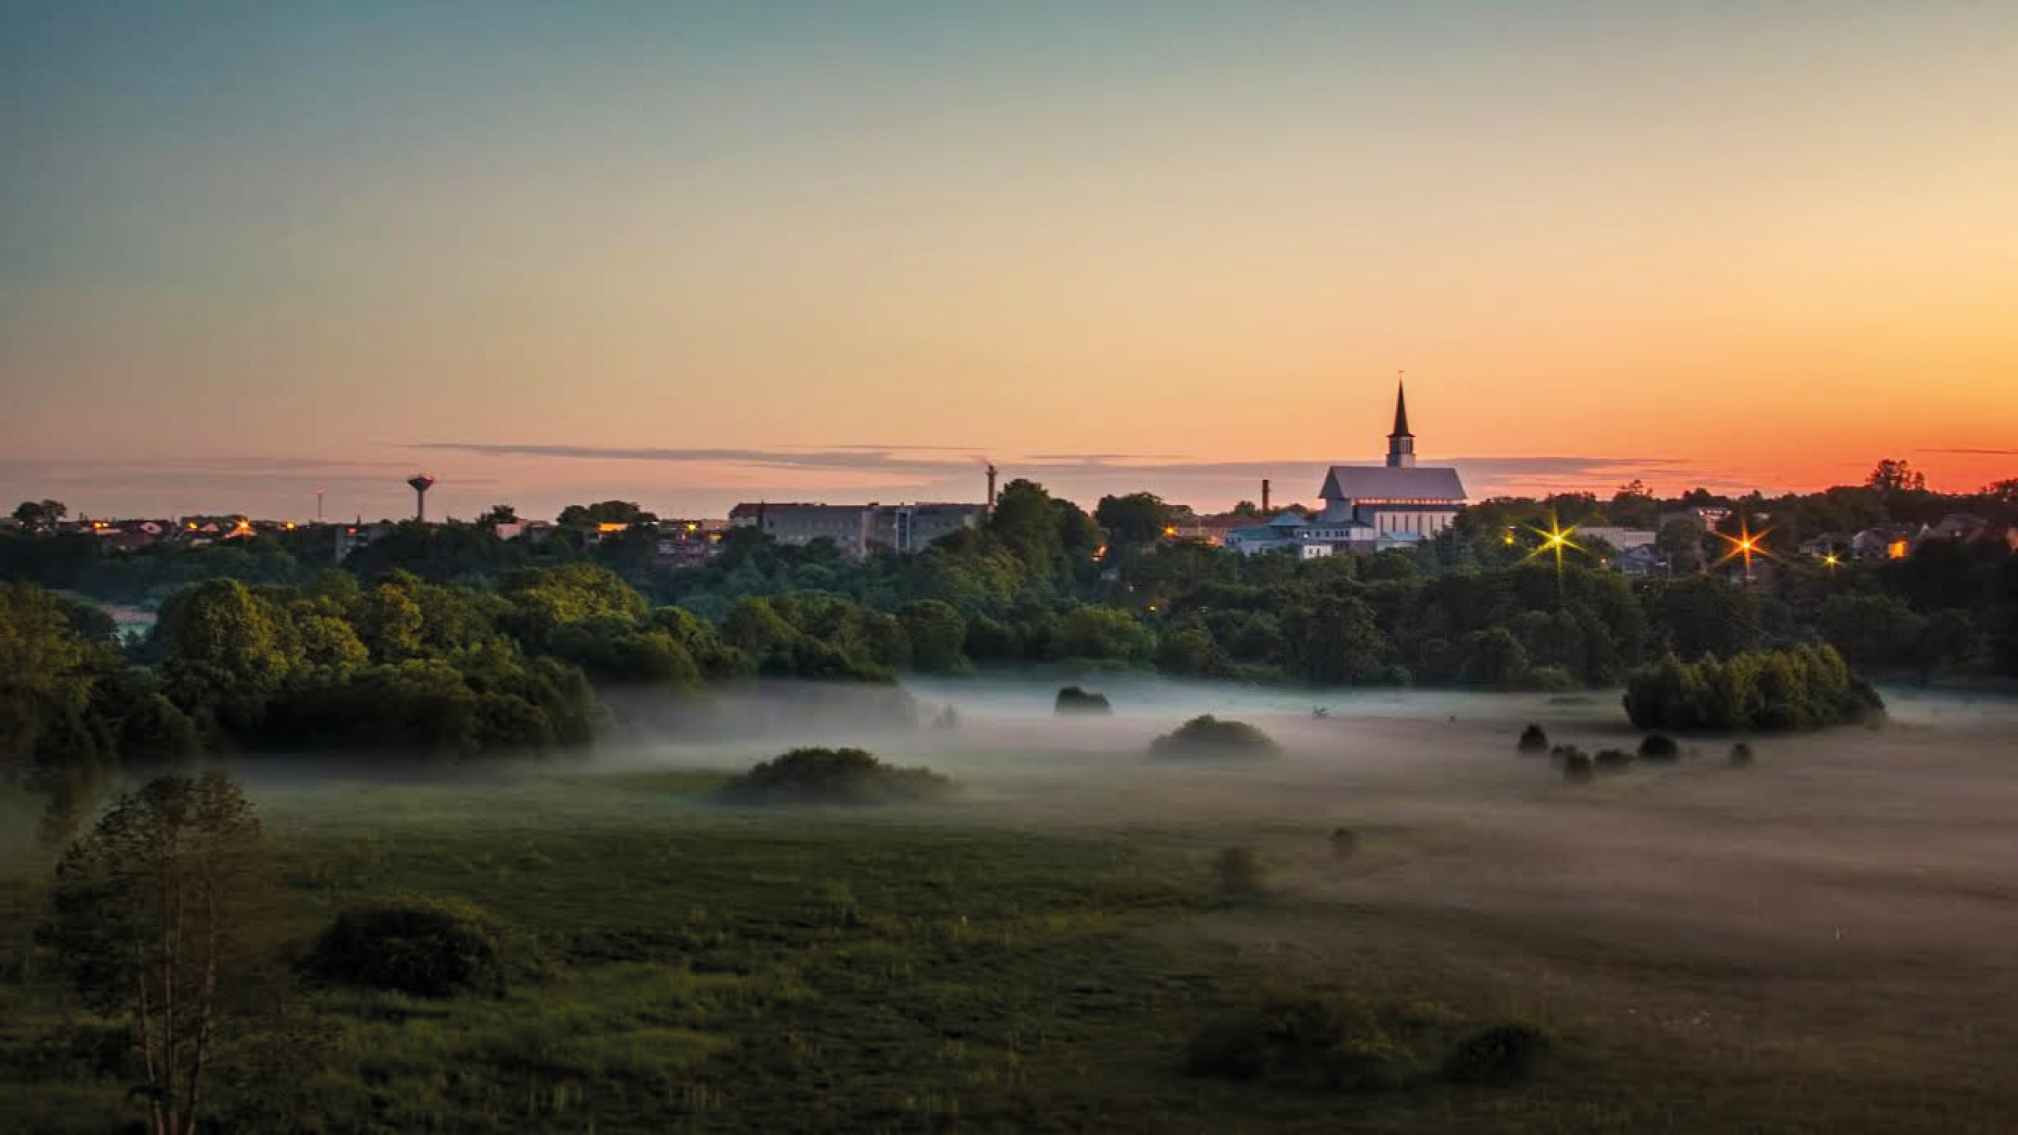
LLI-303 Clean Brownfields
Thematic workshop „Management of brownfields in Latvia and Lithuania: challenges and practical solutions“
Rasa Grubliauskytė
Klaipėda District Municipality

Slide 3
History
Building materials (gravel and sand) were found in the present Gargzdai quarry area at the end of the 1960s. In the vicinity of the port, in a geographically convenient place, it was decided to set up the Gargždai building materials complex , and in 1961 it was established. In the 9th century, according to the value of the production, the factory occupied the 2nd place in Lithuania after Akmenė cement plant, and about 1,500 employees worked in the construction materials combination (at that time about 6,000 people lived in Gargzdai).

Slide 4
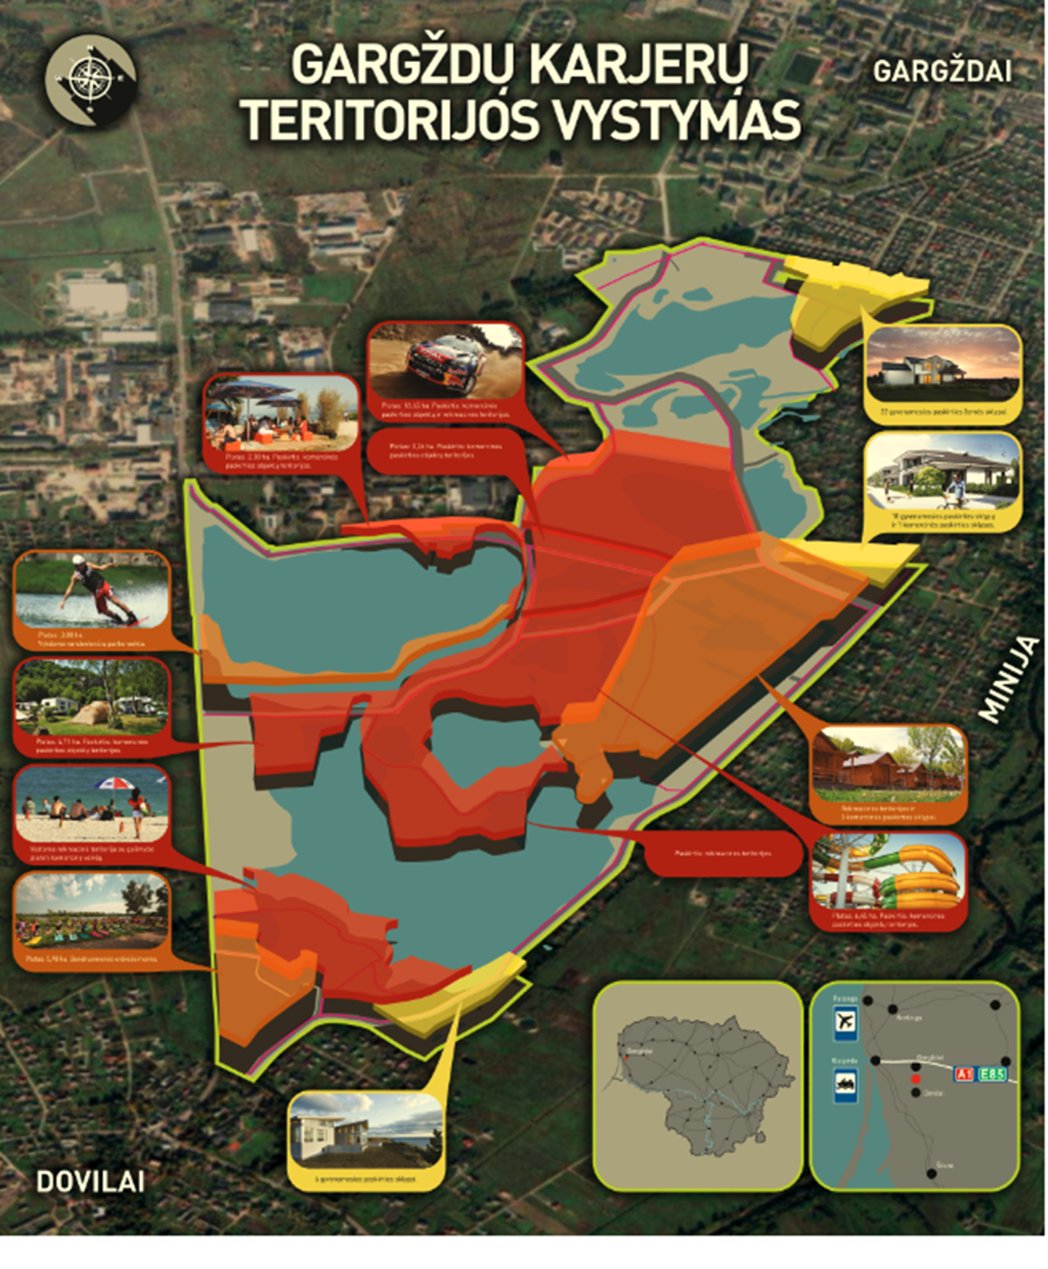
Development of Gargždai Water Ponds territory
Recreational infrastructure in the territory:
- Wake park
- Cafe
- Dogs training site
- Cycling path
- Beaches
- Fishing places
Water trampoline park – still in plans.

Slide 5
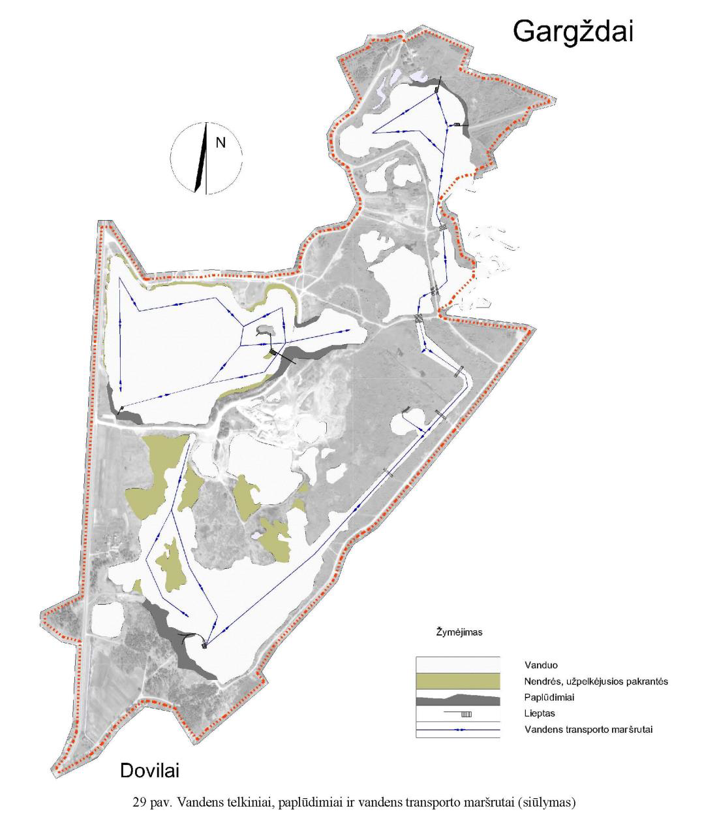

Slide 6
What is done up today:
The working group is formed
The contract with audit company signed
The second report of the project presented
The working group took part in a study visit
Technical task for the contest prepared and changed after recultivation possibilities of the area
The 3 Public procurement tender published

Slide 7
Aim of the project competition:
The project competition is carried out in order to identify the best project. The tender is organized as part of a procedure for the service contract. The winning company carries out the design work in the area specified in the technical specification work task, while maintaining a consistent architectural style according to the submitted draft of the tender.
Objectives of the project competition:
To implement all the options of the Posibility Study designed in the planned area (265 ha):
to make all the necessary investigations (topographical and ecogeological)
to prepare project for beaches, marinas, relax zones, cognitive paths, bicycle roads, landscaping, lighting solutions
elements of small architecture (benches, trash bins, bicycle stands, playing stations for children etc.).

