Slide 1
Pp 6: Kaunas regional development agency
Project No LLI-303
„Life in Clean Environment – a Better Future“
Project partners‘ meeting, Jurkalne, September 11, 2019

Slide 2
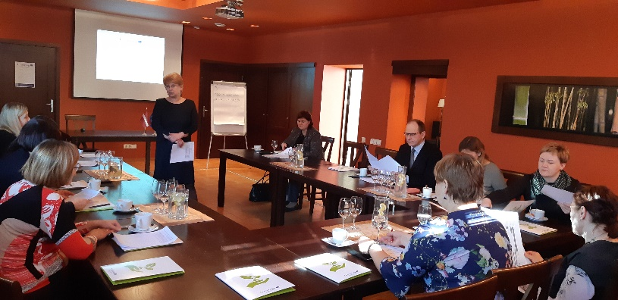
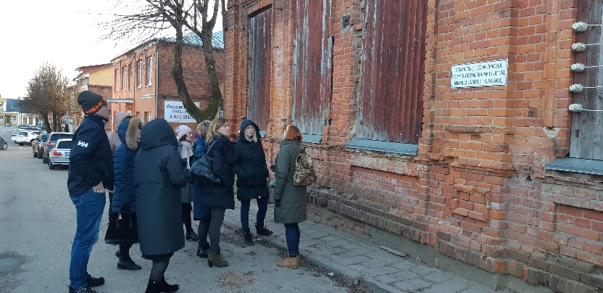
Activities implemented during period 2 (1)
Work package M (Managmenet):
Day-to-day management, planning and coordination.
Communication with Lead Partner and Lithuanian partners.
Report 2 prepared.
PMG meeting organised in Telšiai on March 6, 2019

Slide 3
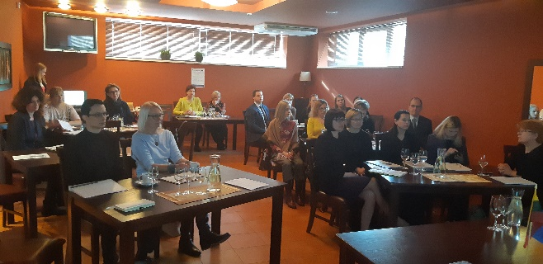
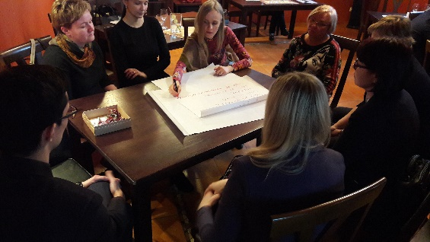
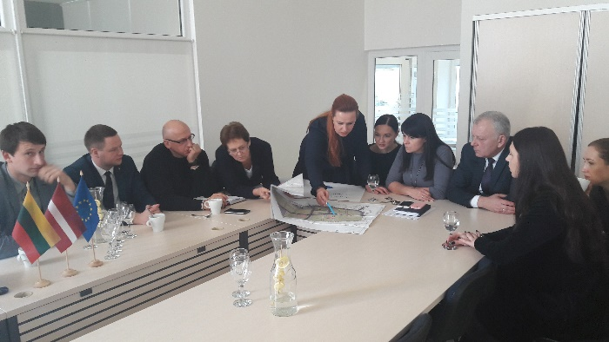
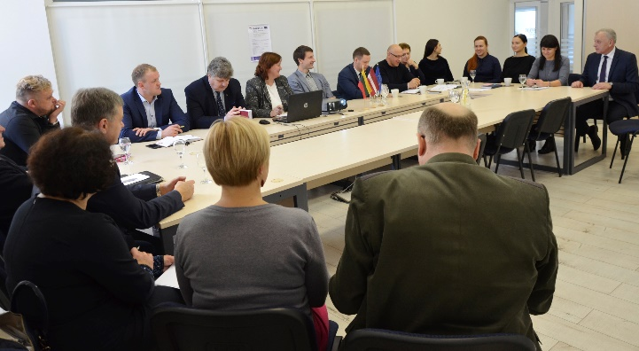
Activities implemented during period 2 (2)
Work package T1 (Implementation):
Thematic workshop in Telšiai on March 7, 2019 – 26 participants
Roundtable discussion in Telšiai on November 11, 2018 – 21 participant
Participation in seminar in Liepaja on April 24, 2019 – indirect project outcome – use of knowledge from the seminar - prepared and submitted ESPON application

Slide 4
Activities implemented during period 2 (3)
Work package C (Communication)
Information about the project and first events published on KRDA web-page and Facebook profile.
Project poster is displayed in KRDA office and used during events.

Slide 5
Activities planned
1 article about project results.
2 roundtable discussions:
Gargždai (Period 2) will be moved to Period 4
Kaunas (Period 3) planned in October
Participants – local stakeholders, Lithuanian partners.
Experience exchange visit to Latvia:
Period 4. 12 participants from Lithuania. 2 days (1 night).
KRDA is responsible for the development of content, rent of bus, accommodation and catering of Lithuanian participants.
1 project management group meeting (PMG):
PMM4 in Kaunas (Period 4), 2-3 persons from each partner. 1 day.
Final conference:
Kaunas (Period 4), together with PMM4. 2-5 participants from each partner. 1,5 days event (1 night)

Slide 6
Issues for the discussion
Experience exchange visits to Latvia and Lithuania:
When?
Content?
Seminars
Who?
When?
Content?
Final conference:
When?
Content?

Slide 7
Thank you for your attention!
Elena Taločkaitė
Kaunas Regional Development Agency
Project Manager
elena@krda.lt, +370 616 56771

