Slide 1



LP & overall project progress, Period 1
Alise Lūse
Project Leader
CB786 Nature access to all
NatAc
The project is co-financed by the Central Baltic Programme 2014–2020 www.centralbaltic.eu

Slide 2
Project Coordination Group
Partners
P2 – NGO West-Estonia Tourism: Sille Roomets Anneli Haabu
Lead Partner
Kurzeme Planning Region – Alise Lūse
P3 – Metsähallitus: Laura Lehtonen
P4 – Keskkonnaamet: Margit Turb

Slide 3
Project Steering Group
Partners and NGOs
P2 - NGO West-Estonia Tourism: tbc Sille Roomets
Lead Partner
Kurzeme Planning Region: Aiga Petkēvica, Head of Project Division
P4 – Keskkonnaamet: Maris Kivistik
NGO Latvia: Apeirons, Raitis Briedis Ivars Balodis
NGO Estonia: Estonian Chamber of Disabled People, Meelis Joost Helen Kask
P3 - Metsähallitus: Hanna Ylitalo
NGO Finland: tbc Finnish Sport Association of Persons with Disabilities, Aija Saari

Slide 4
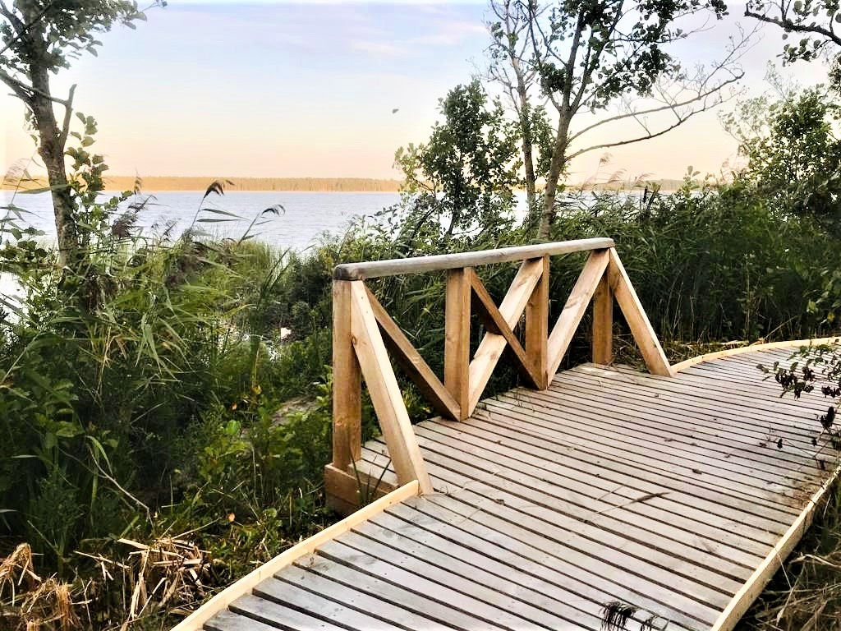
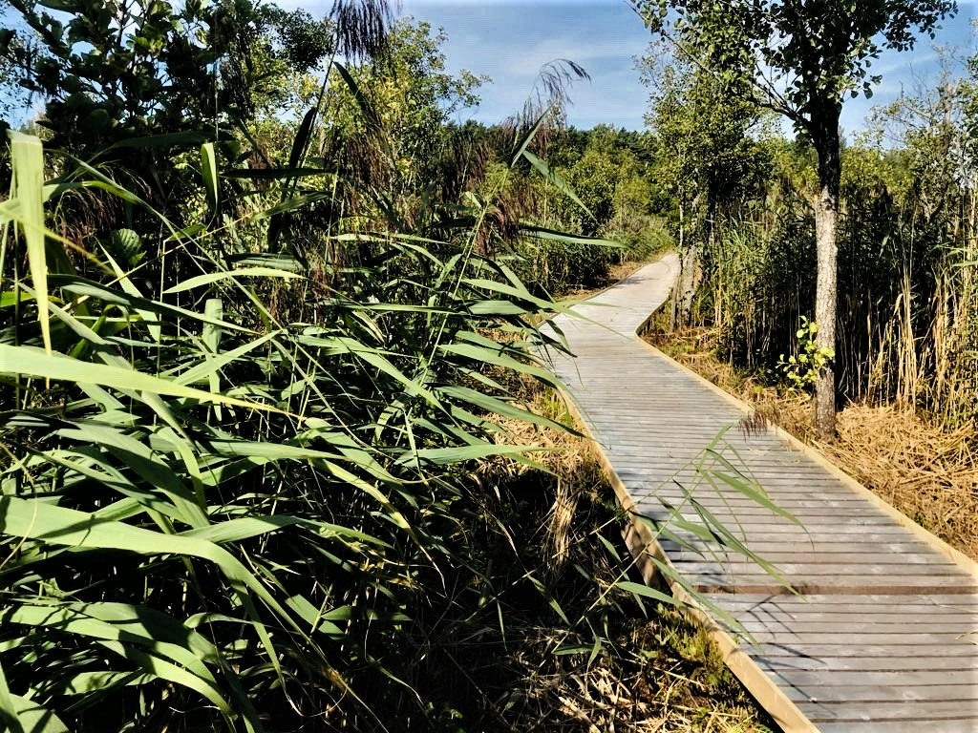
Activities carried out in Period 1
Lead Partner – WP Infrastructure
Protective boardwalk edges in Ventspils

Slide 5
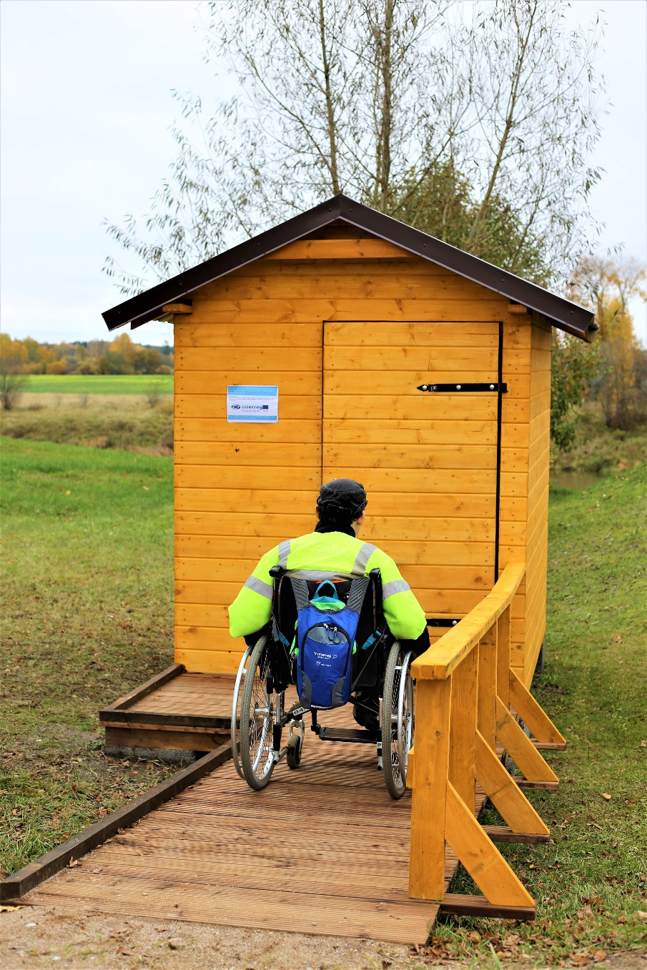
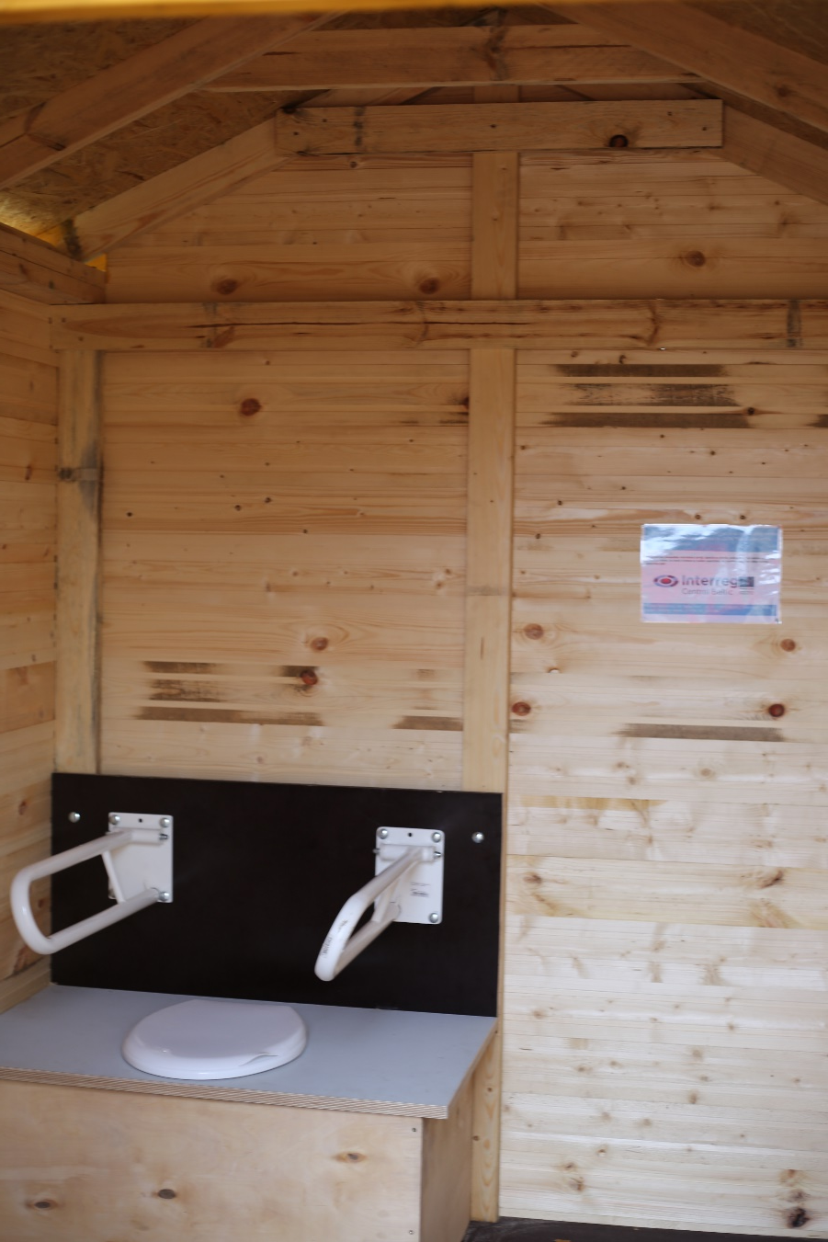
Activities carried out in Period 1
Lead Partner – WP Infrastructure
Dry toilet in Skrunda

Slide 6
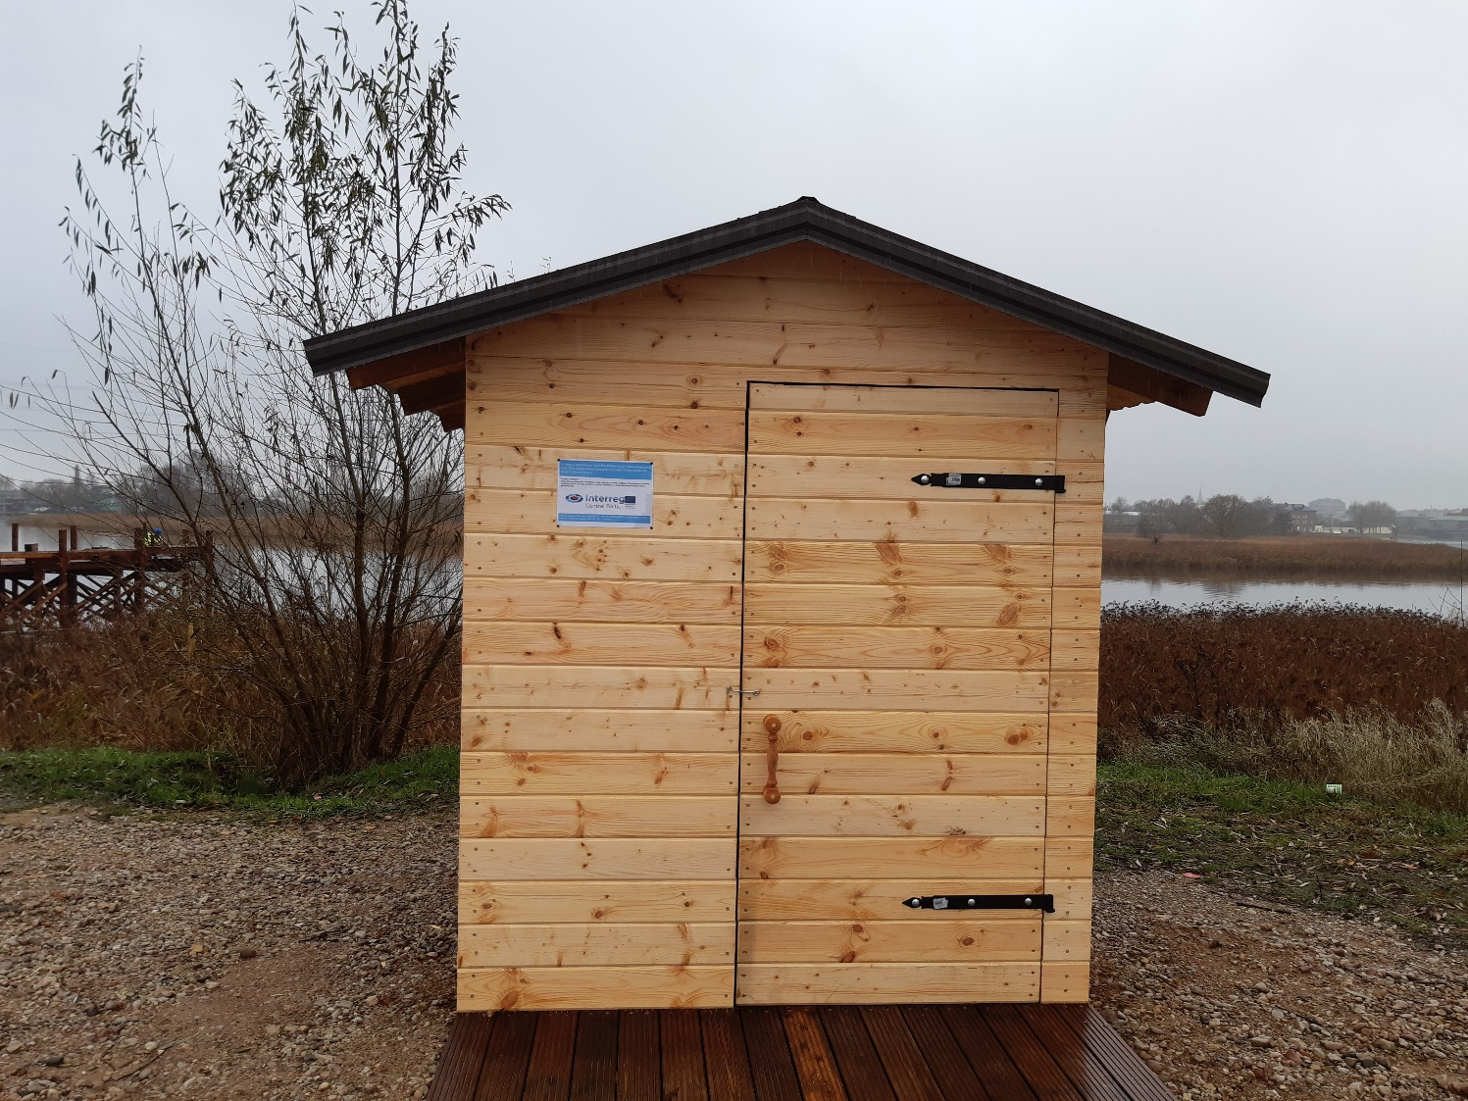
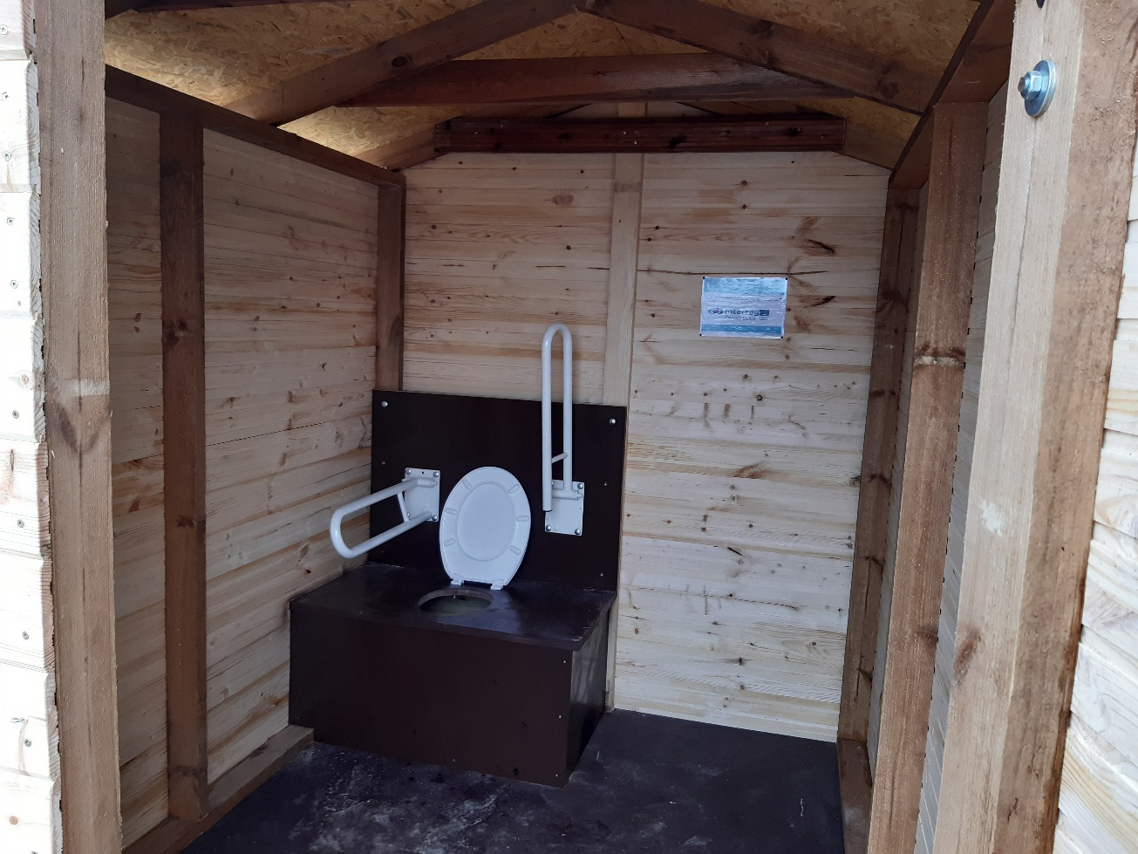
Activities carried out in Period 1
Lead Partner – WP Infrastructure
Dry toilet in Liepaja

Slide 7
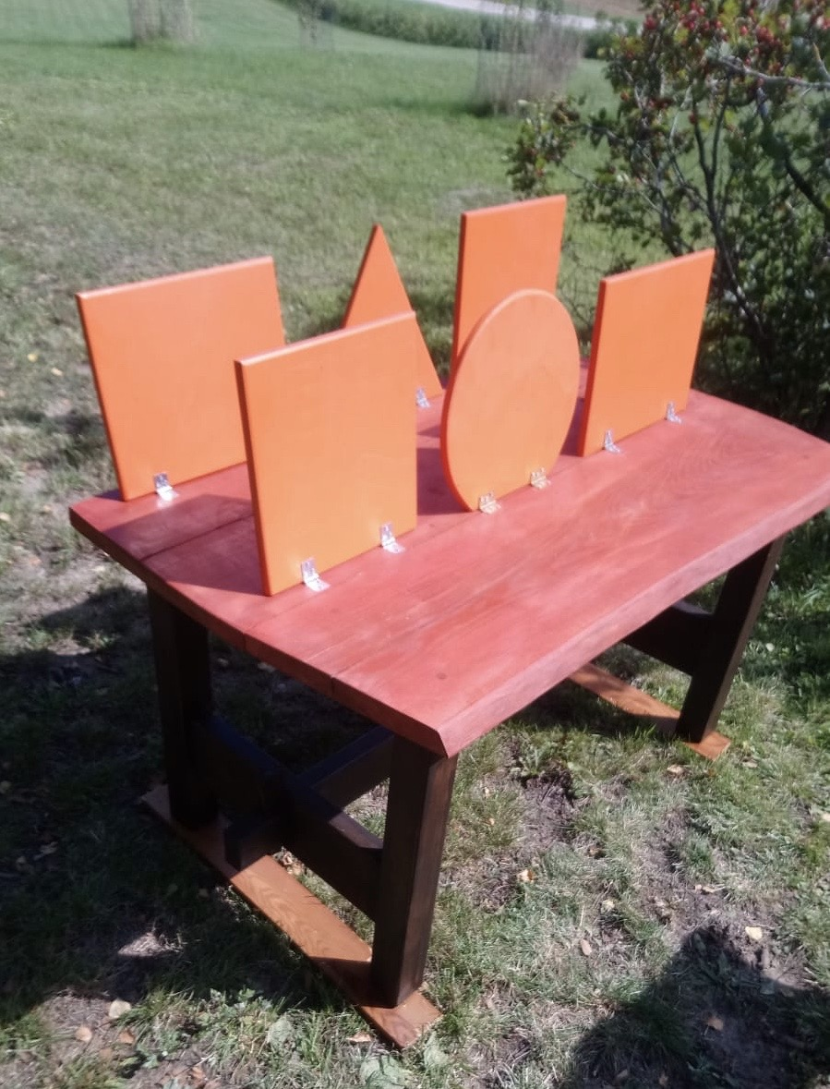
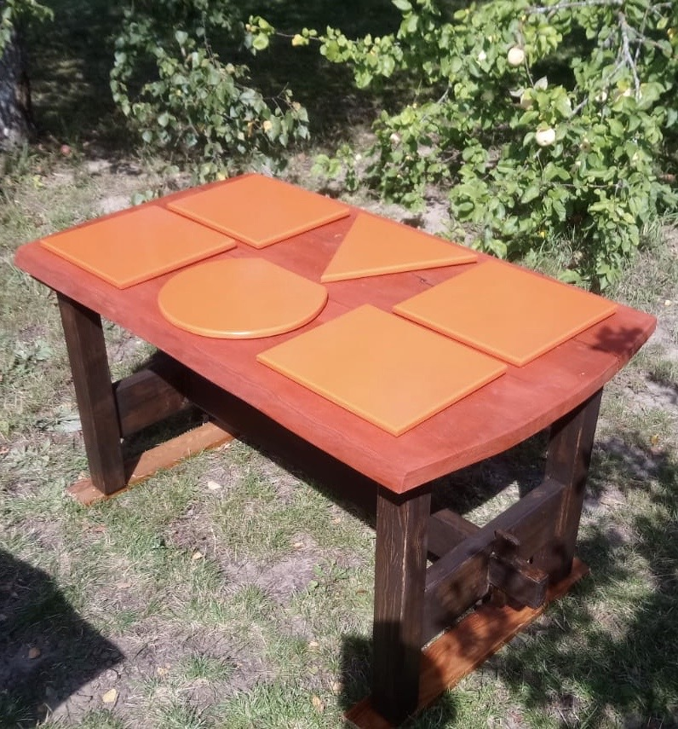
Activities carried out in Period 1
Lead Partner – WP Joint Product Development
4 tactile objects for Rowan
Alley trail in
Kazdanga Castle Park

Slide 8
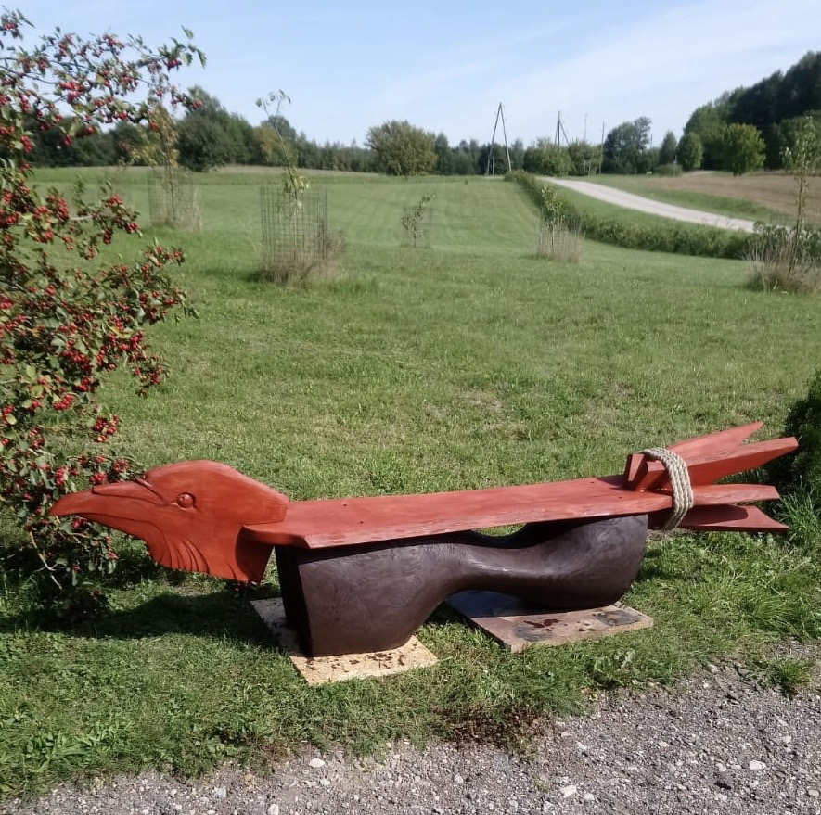
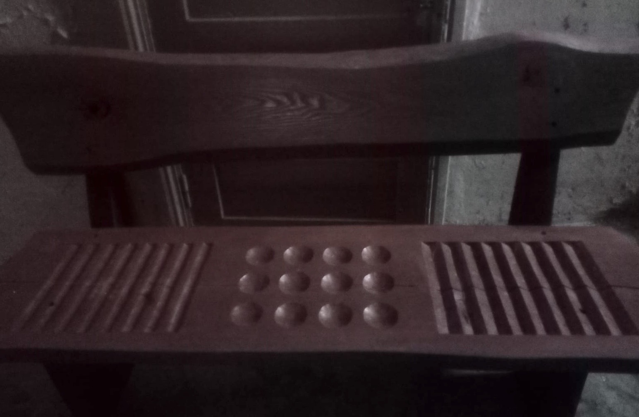
Activities carried out in Period 1
Lead Partner – WP Joint Product Development
4 tactile objects for Rowan Alley trail in
Kazdanga Castle Park

Slide 9
Activities carried out in Period 1
Lead Partner – WP Joint Product Development
Development of Accessibility CL
and Trail Passport

Slide 10
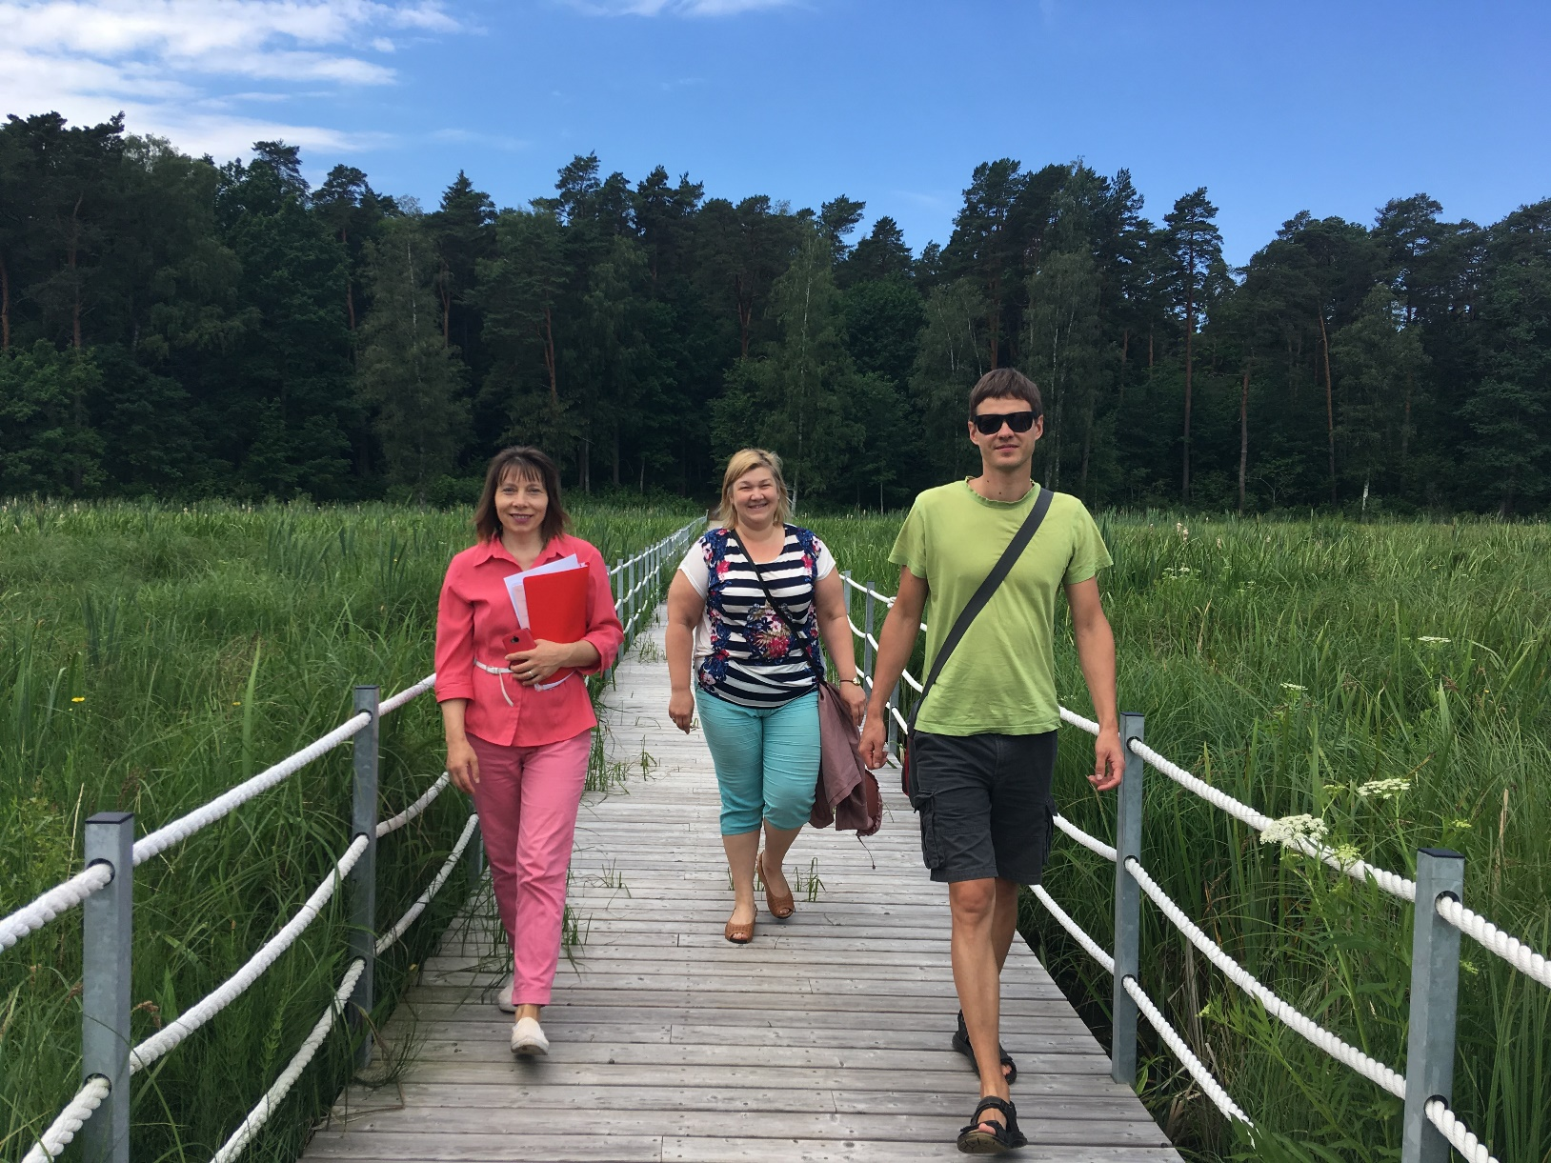
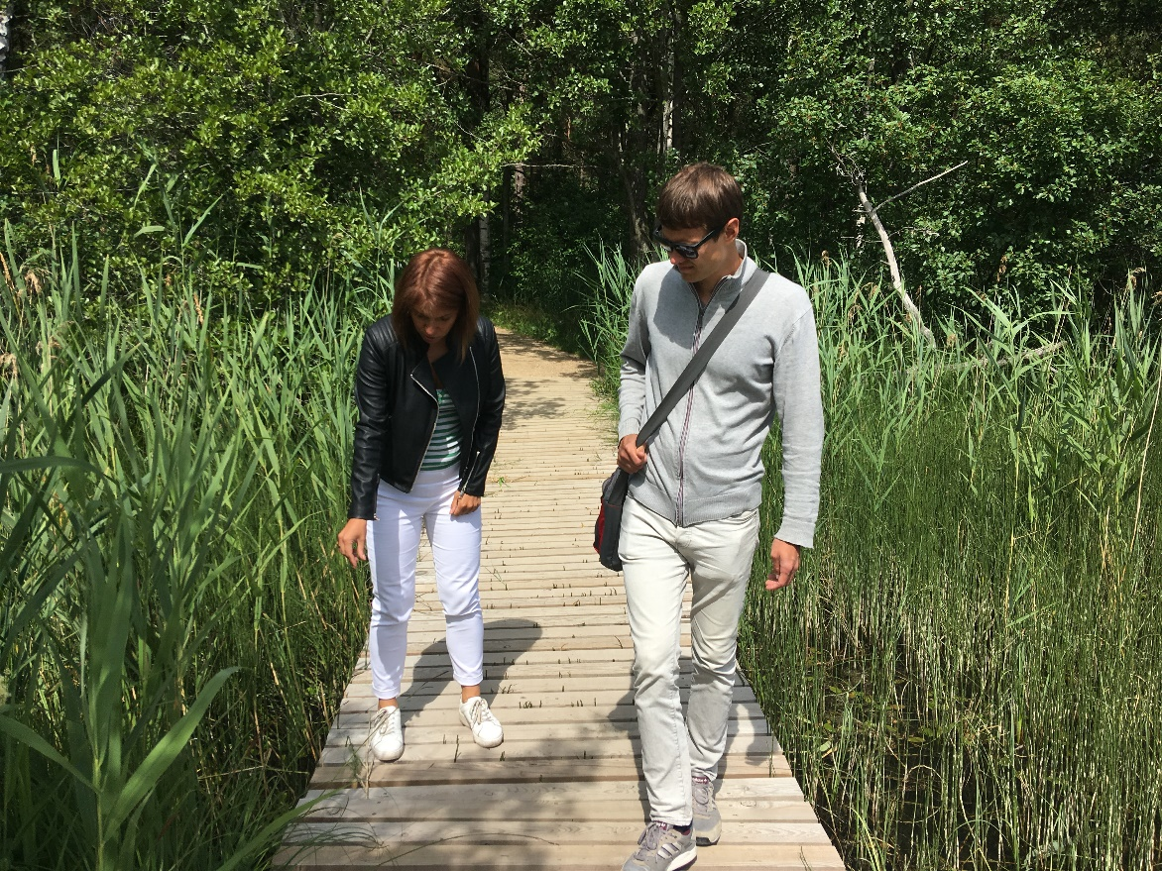
Activities carried out in Period 1
Lead Partner – WP Joint Product Development
On-spot inspection visits at project sites
before construction works

Slide 11
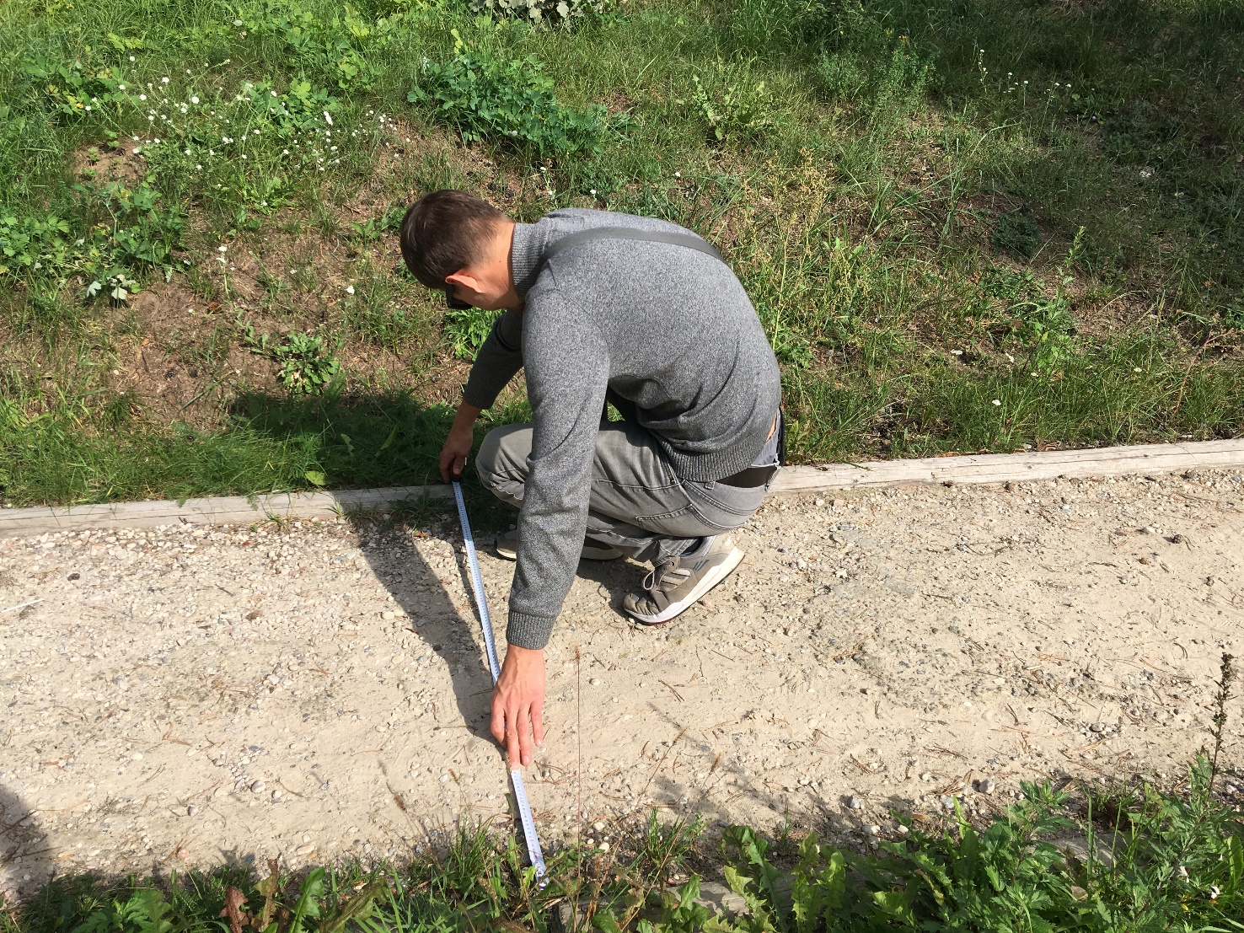
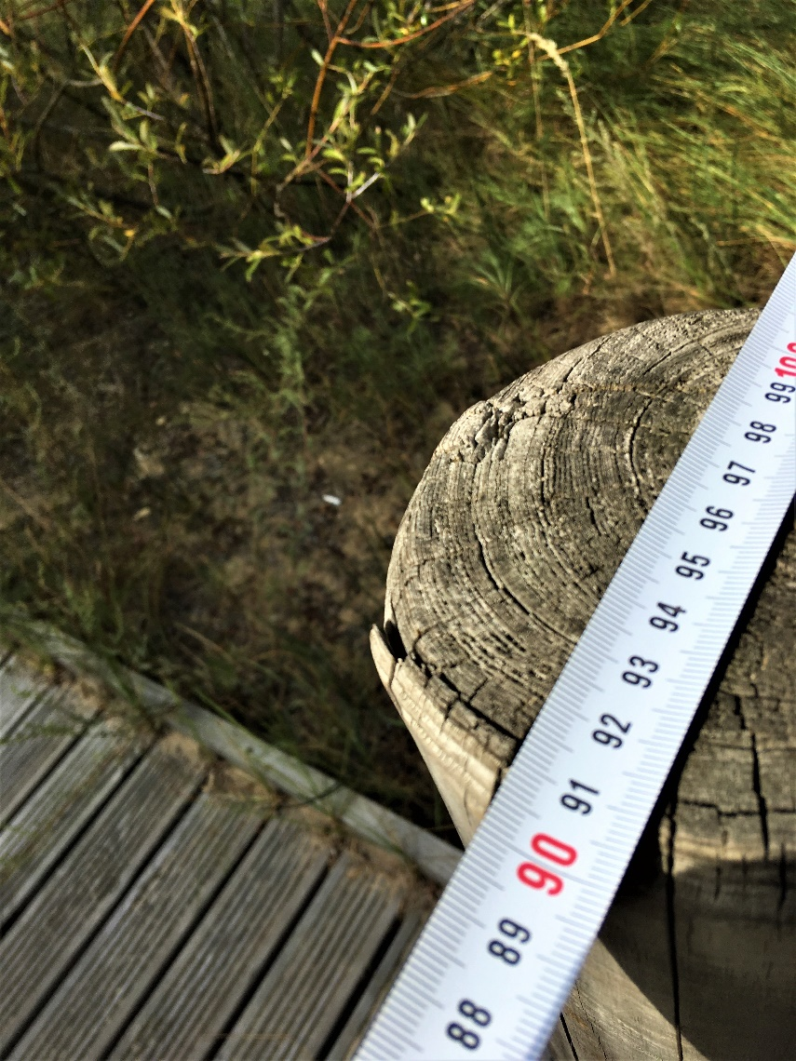
Activities carried out in Period 1
Lead Partner – WP Joint Product Development
On-spot inspection visits at other trails (19 trails inspected)

Slide 12
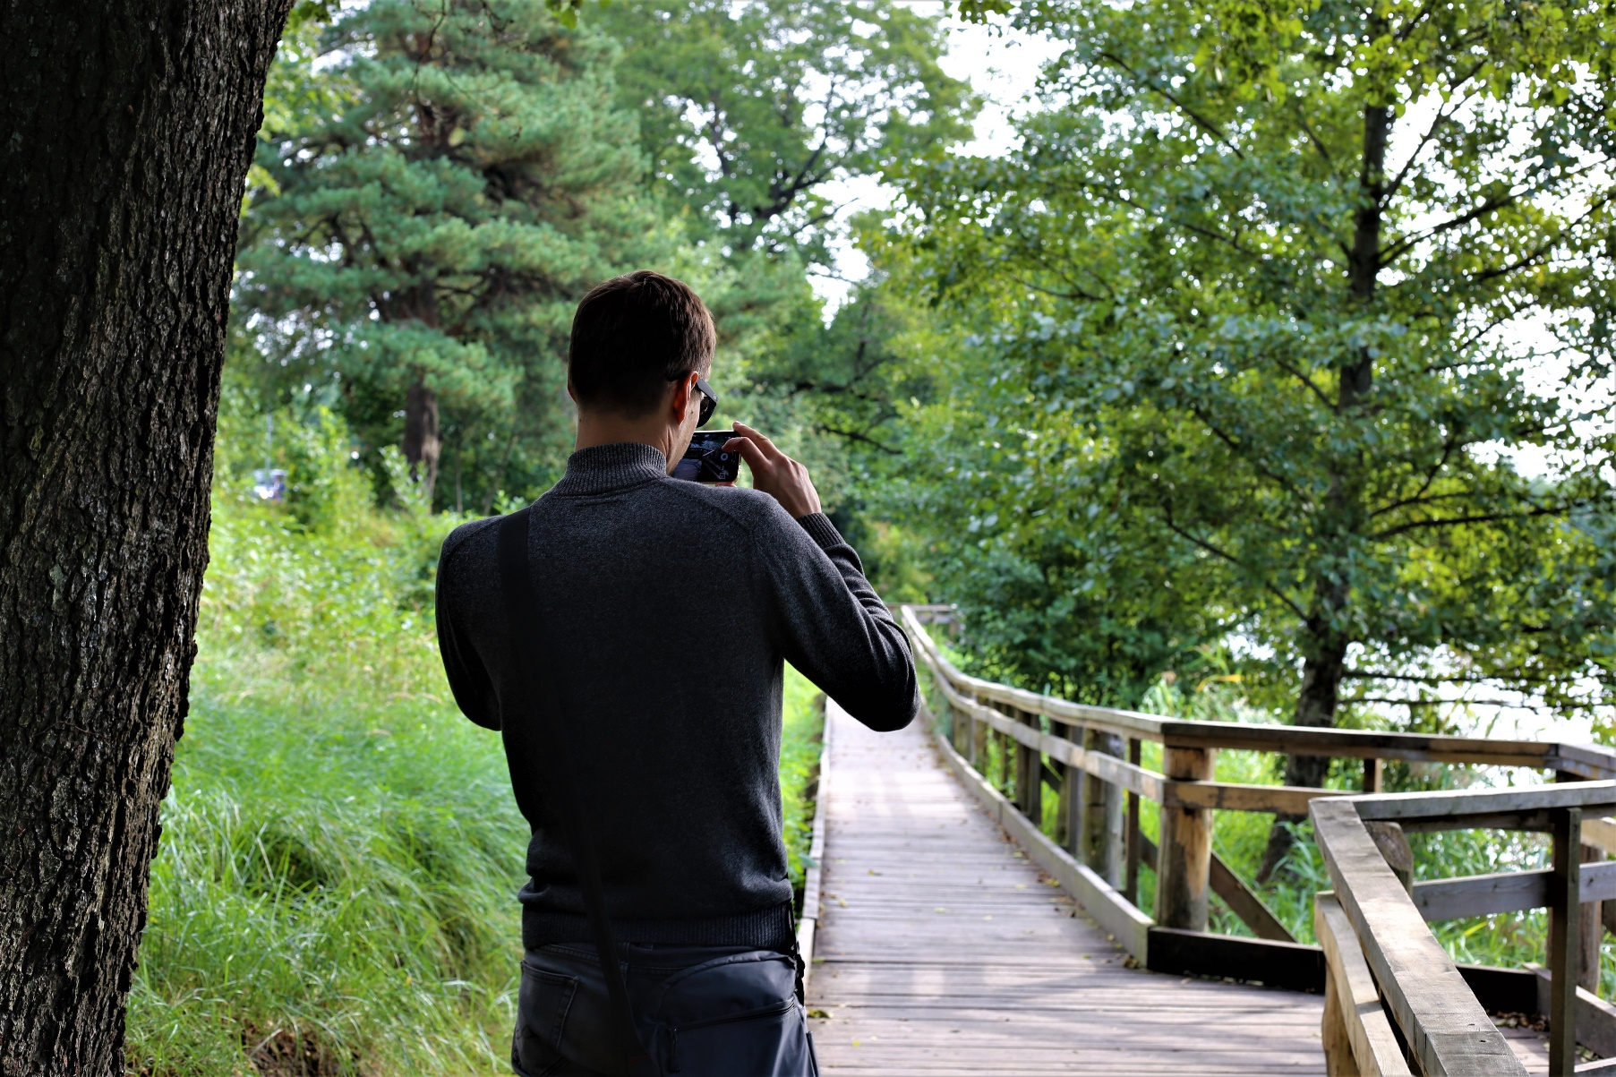
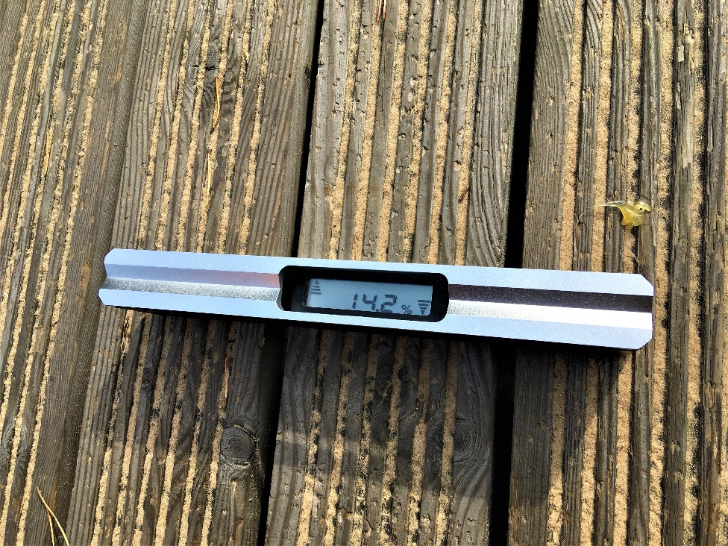
Activities carried out in Period 1
Lead Partner – WP Joint Product Development
On-spot inspection visits at other trails (19 trails inspected)

Slide 13
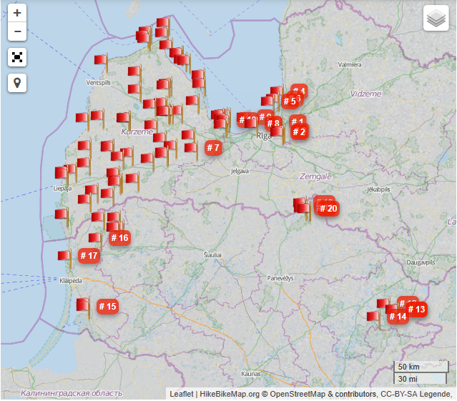

Activities carried out in Period 1
Lead Partner – WP Joint Product Development
On-spot inspection visits at other trails (11 GPX recordings & uploads)

Slide 14
Deliverables started/achieved
Lead Partner
Deliverable | Deliverable title | Target value | Delivery date
M1.1 | Kick-off meeting: Agenda & minutes | 1 | Period 1
I1.1.3 | Ventspils municipality, Lake Būšnieku Trail (dry closet, installation of edges on the wooden boardwalk, benches) | 1 | Period 1 and 2
I1.1.4 | Liepāja, Horse Island Trail (dry closet, trail stretch to it, accessibility improvements at parking lot) | 1 | Period 1 and 2
I1.1.5 | Skrunda municipality, trail along the River Venta (dry closet, trail stretch to it) | 1 | Period 1
T1.1.4 | Development and production of tactile objects for project sites | 7 | Period 1 - 3
T1.3.1 | Accessibility CL for nature sites | 1 | Period 1
T1.4.1 | On-spot inspection visits at project sites | 21 | Period 1 - 4
T1.4.2 | On-spot inspection visits at other natures trails in CB core area | 12 | Period 1 - 3
C1.1.-C1.3 | Poster, web-section, Communication Strategy | 3 | Period 1
C2.1-C2.3 | FB posts (12), web updates (6), article (1) | 19 | Period 1

Slide 15
Activity schedule & delivery dates for Period 2
CB786 Nature access to all
NatAc
The project is co-financed by the Central Baltic Programme 2014–2020 www.centralbaltic.eu

Slide 16
WP Marketing & promotion
Accessibility CL workshops
Thematic workshops
3
LV, EE, FI
Period 2
for municipalities, visitor centres, local operators etc. on developing accessible tourism products, use of self-testing tool, efficient accessibility solutions (total 150 participants)
Latvia – January 2020
Responsible partner: LP, PP2, PP3

Slide 17
Public events&promotion
FAM workshops for messengers
3
LV, EE, FI
Period 2
How to access and spread info on accessible destinations among the target group. Total no of participants - 20.
Responsible partner: LP, PP2, PP3
Preparing for Participation at Europarc Conference 2020
1
In Austria
Period 3
Responsible partner: PP4
workshop on accessibility challenges and achievements by project partners - marketplace?

Slide 18
Public events&promotion
FAM workshops with GER, UK, SE, USA, Asia tour operators
5
09.2019 - 02.2020
Period 2
Responsible partner: PP2
to market the CB core area in LV, EE nad FI as a single accessible nature tourism destination
Developing concept for Accessibility Days
3
LV, EE, FI
Period 3
Responsible partner: LP, PP, PP3
Accessibility Days for families with disabilities to meet and visit the improved project sites. Total no of participants - 90.

Slide 19
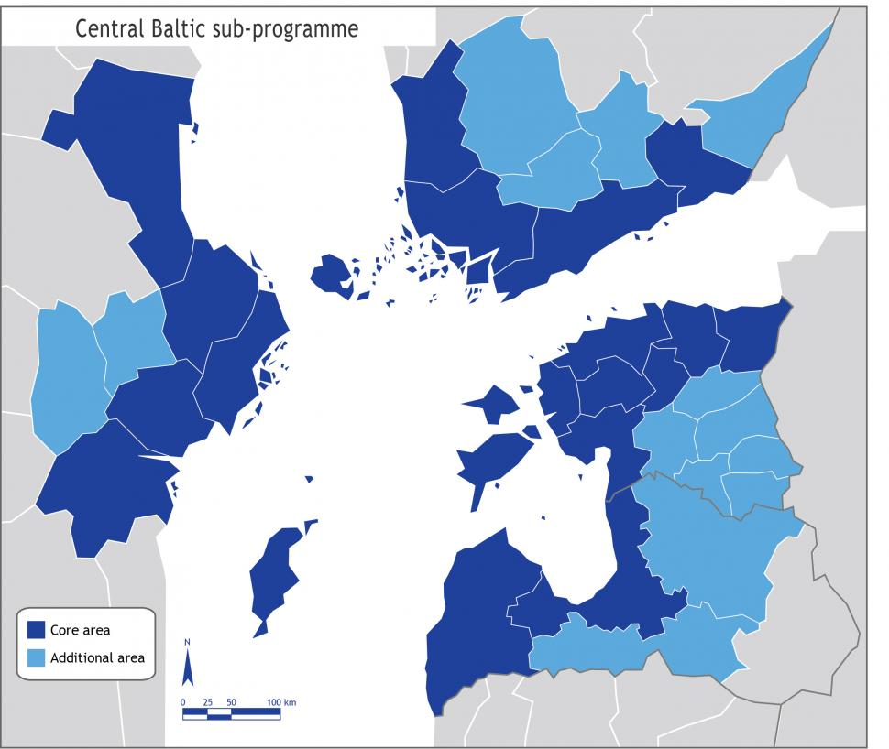
WP Joint product development
On-spot inspection visits
at project sites
48
Period 1: 16
Period 2: 11
Period 3: 11
Period 4: 10
On-spot inspection visits
at other sites
35 round visits
Period 1: 17
Period 3: 18
1) Trail passports
2) Recording GPX
Responsible partner: LP, PP2, PP3

Slide 20
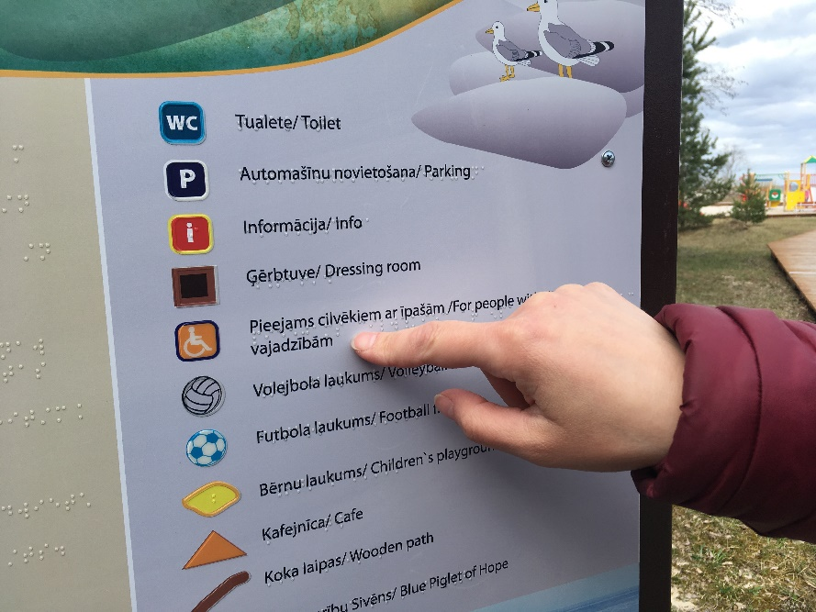
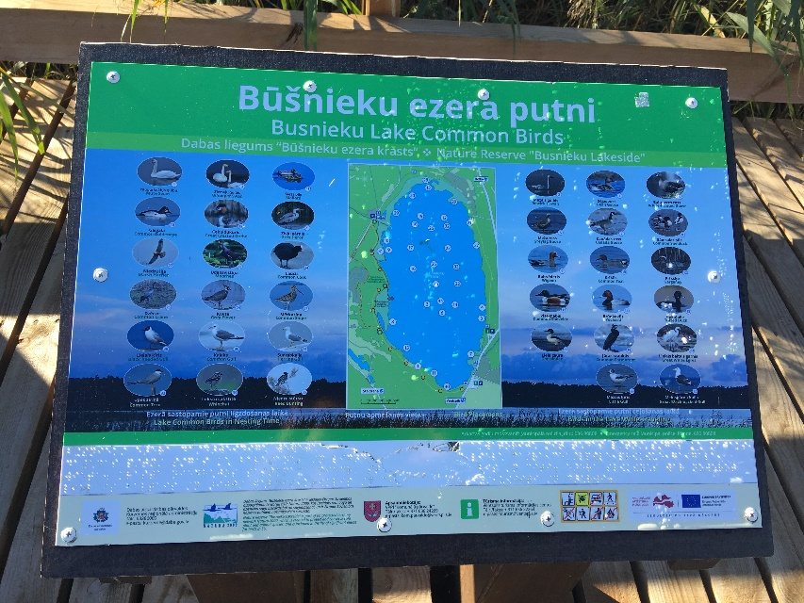
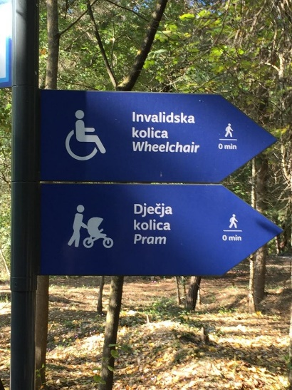
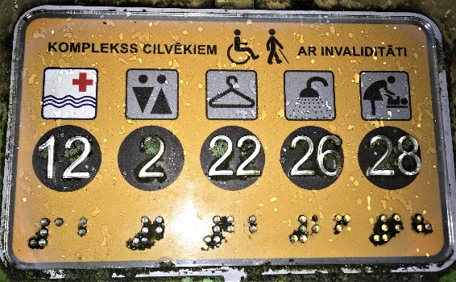





Joint Materials
Signs and info boards
16
Period 3
Responsible partner for development: Metsähallitus
Production: LP, PP2, PP3
Notes:
Developm. and production of unified design on plain texted and visually clear signs and info boards for all project sites. Design adapted for children, foreigners and DP. Reported in Per. 3
Resp. partner for developm.: PP3
Production: LP, PP2, PP3

Slide 21
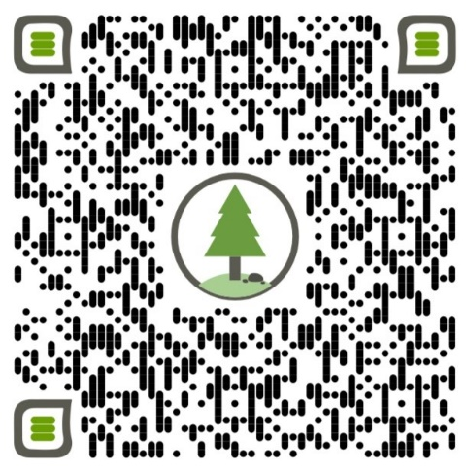
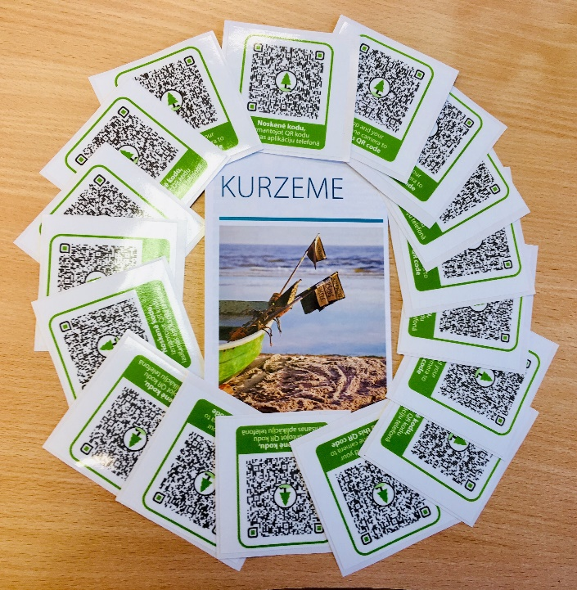
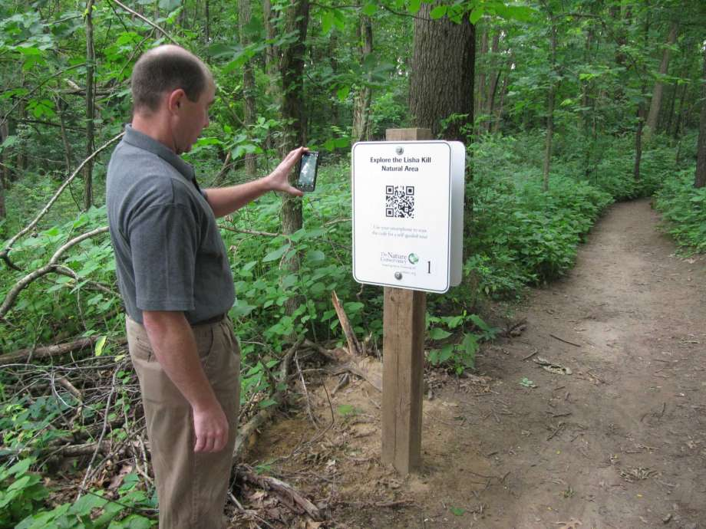
Joint Materials
QR codes with audio and video
16
Period 3
Responsible partners: LP, PP2, PP3
Notes:
Development and production of QR codes with audio (nat. lang. and ENG) and video mat. (incl.sign lang.) for project sites to serve hearing and visually impaired people, no. of project sites with QR codes. Reported in Per. 3
Resp. partners: LP, PP2, PP3

Slide 22
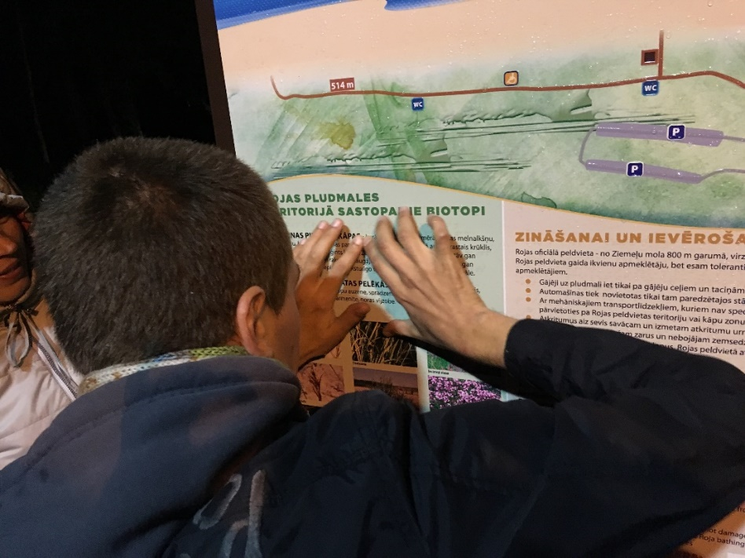
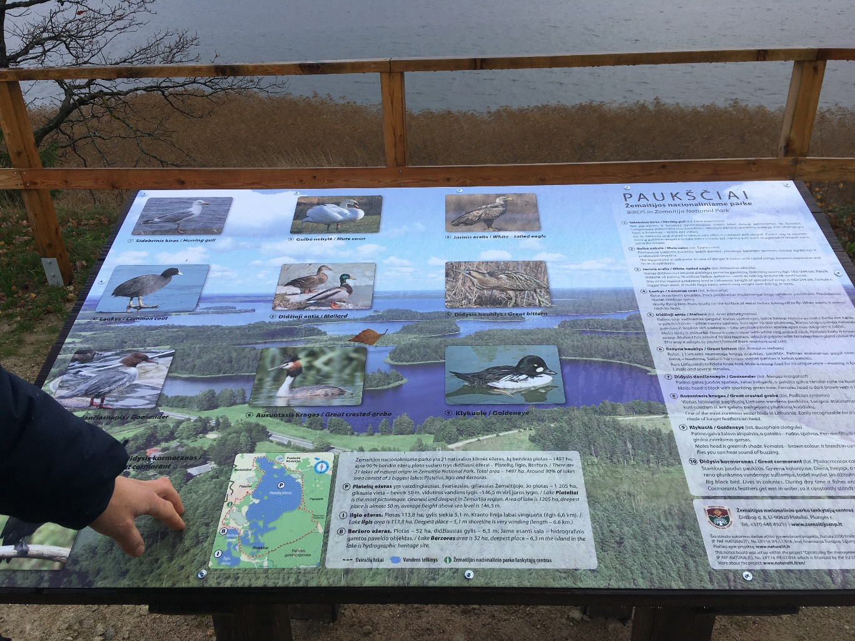
Joint Materials
Tactile & Braille info stands
16
Period 2
Responsible partners: LP, PP2, PP3
Notes:
Development and production of common style tactile and Braille info stands for project sites to serve visually impaired people, no of project sites with tactile and Braille info stands. Reported in Per. 2
Responsible partners: LP, PP2, PP3

Slide 23
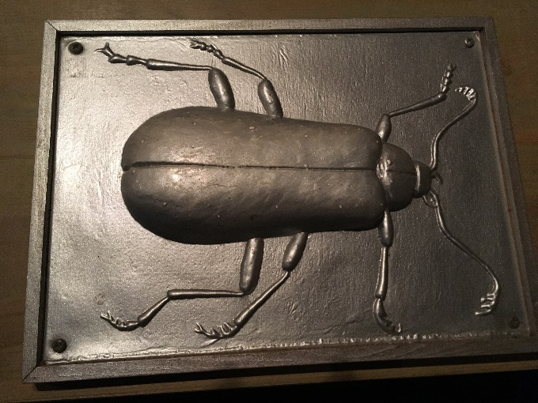
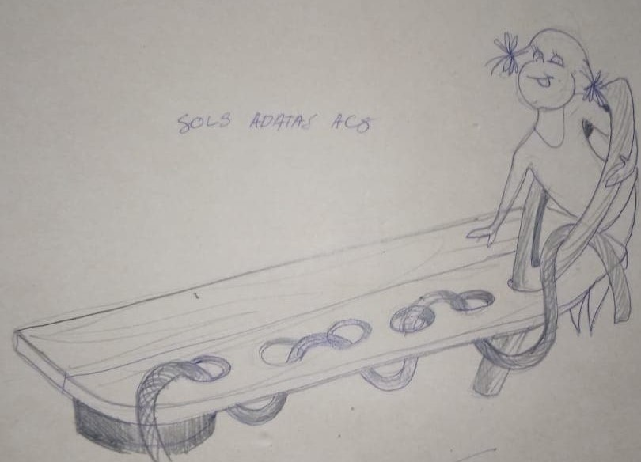
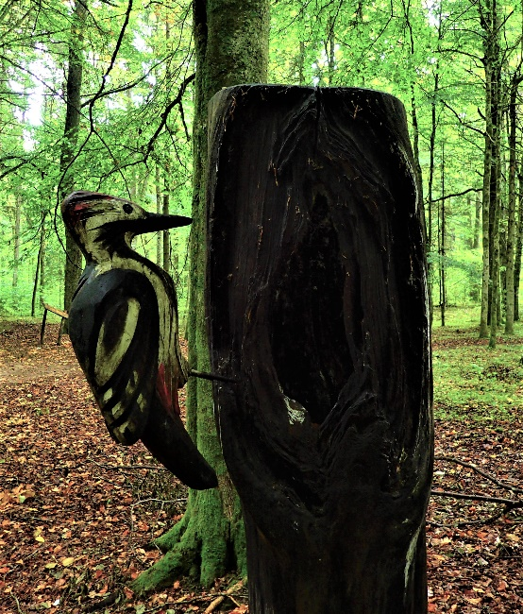
Joint Materials
Tactile objects
16
Period 3
Responsible partners: LP, PP2, PP3
Notes:
Development and production of tactile objects for project sites to serve visually impaired people, no of project sites with tactile objects. Reported in Per. 3
Responsible partners: LP, PP2, PP3

Slide 24
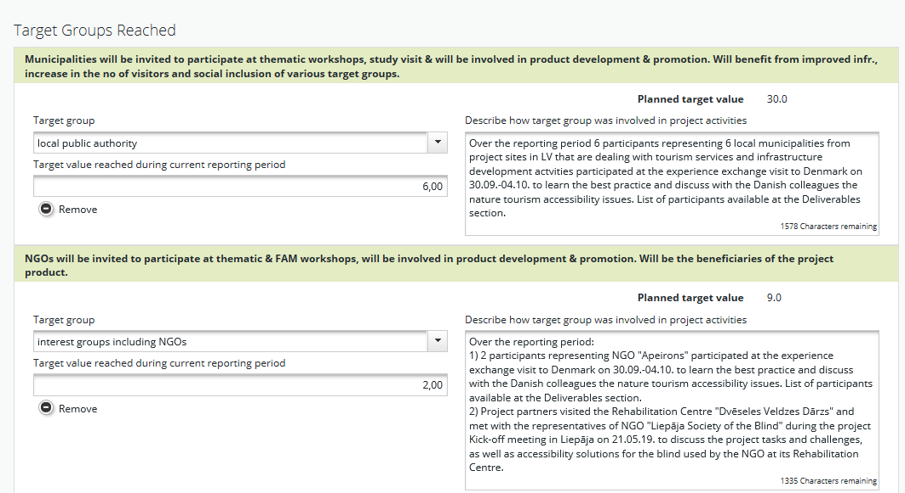
Partner report 1 on eMS

Slide 25
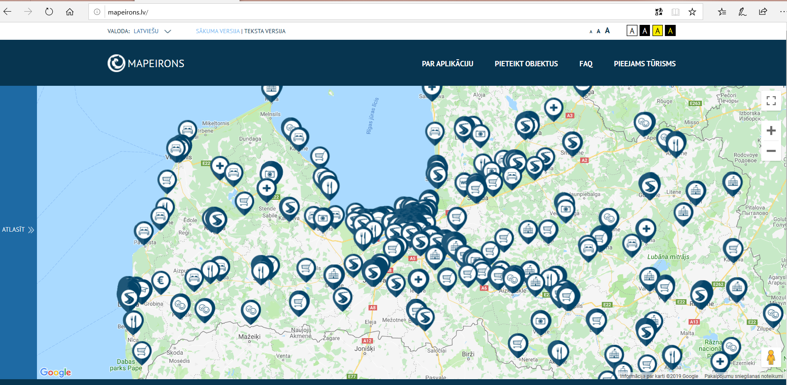
Approach & design of Mapeirons
Mobile-friendly internet platfom
Period 3
Responsible partner: LP

