Slide 1
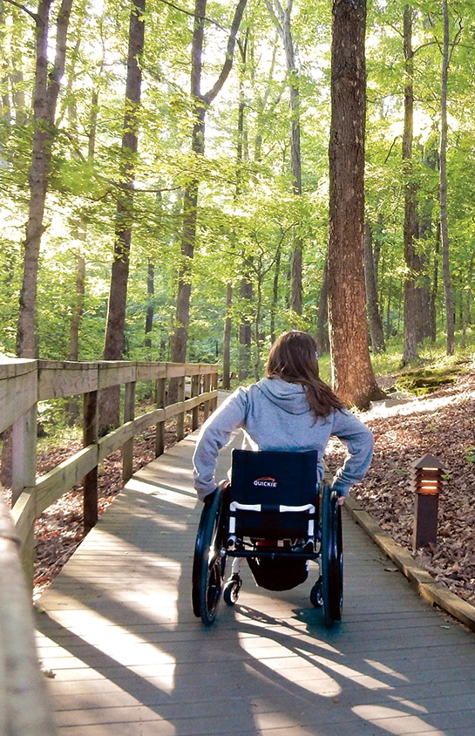
Nature Access to All PP meeting 13.-14.11. 2019 Haapsalu
west-estonia tourism
Anneli Haabu
West-Estonia Tourism

Slide 2
Activities carried out in Period 1
Project manager Anneli, finance manager and 3 regional coordinators were hired, unfortunately 1 position is still vacant.
Steering committee were established – Sille and Helen
Participation in Kick-off meeting
Communication between all PP, PP2 workers, municipalities, stakeholders and NGOs
Expert service from Estonian Chamber of Disabled People – counseling trail passport, accessibility check list, investments
Communication and co-operation has been started with the Northwest Estonian region to identify nature tourism objects in northern Estonia on the way from Haapsalu to Tallinn.

Slide 3
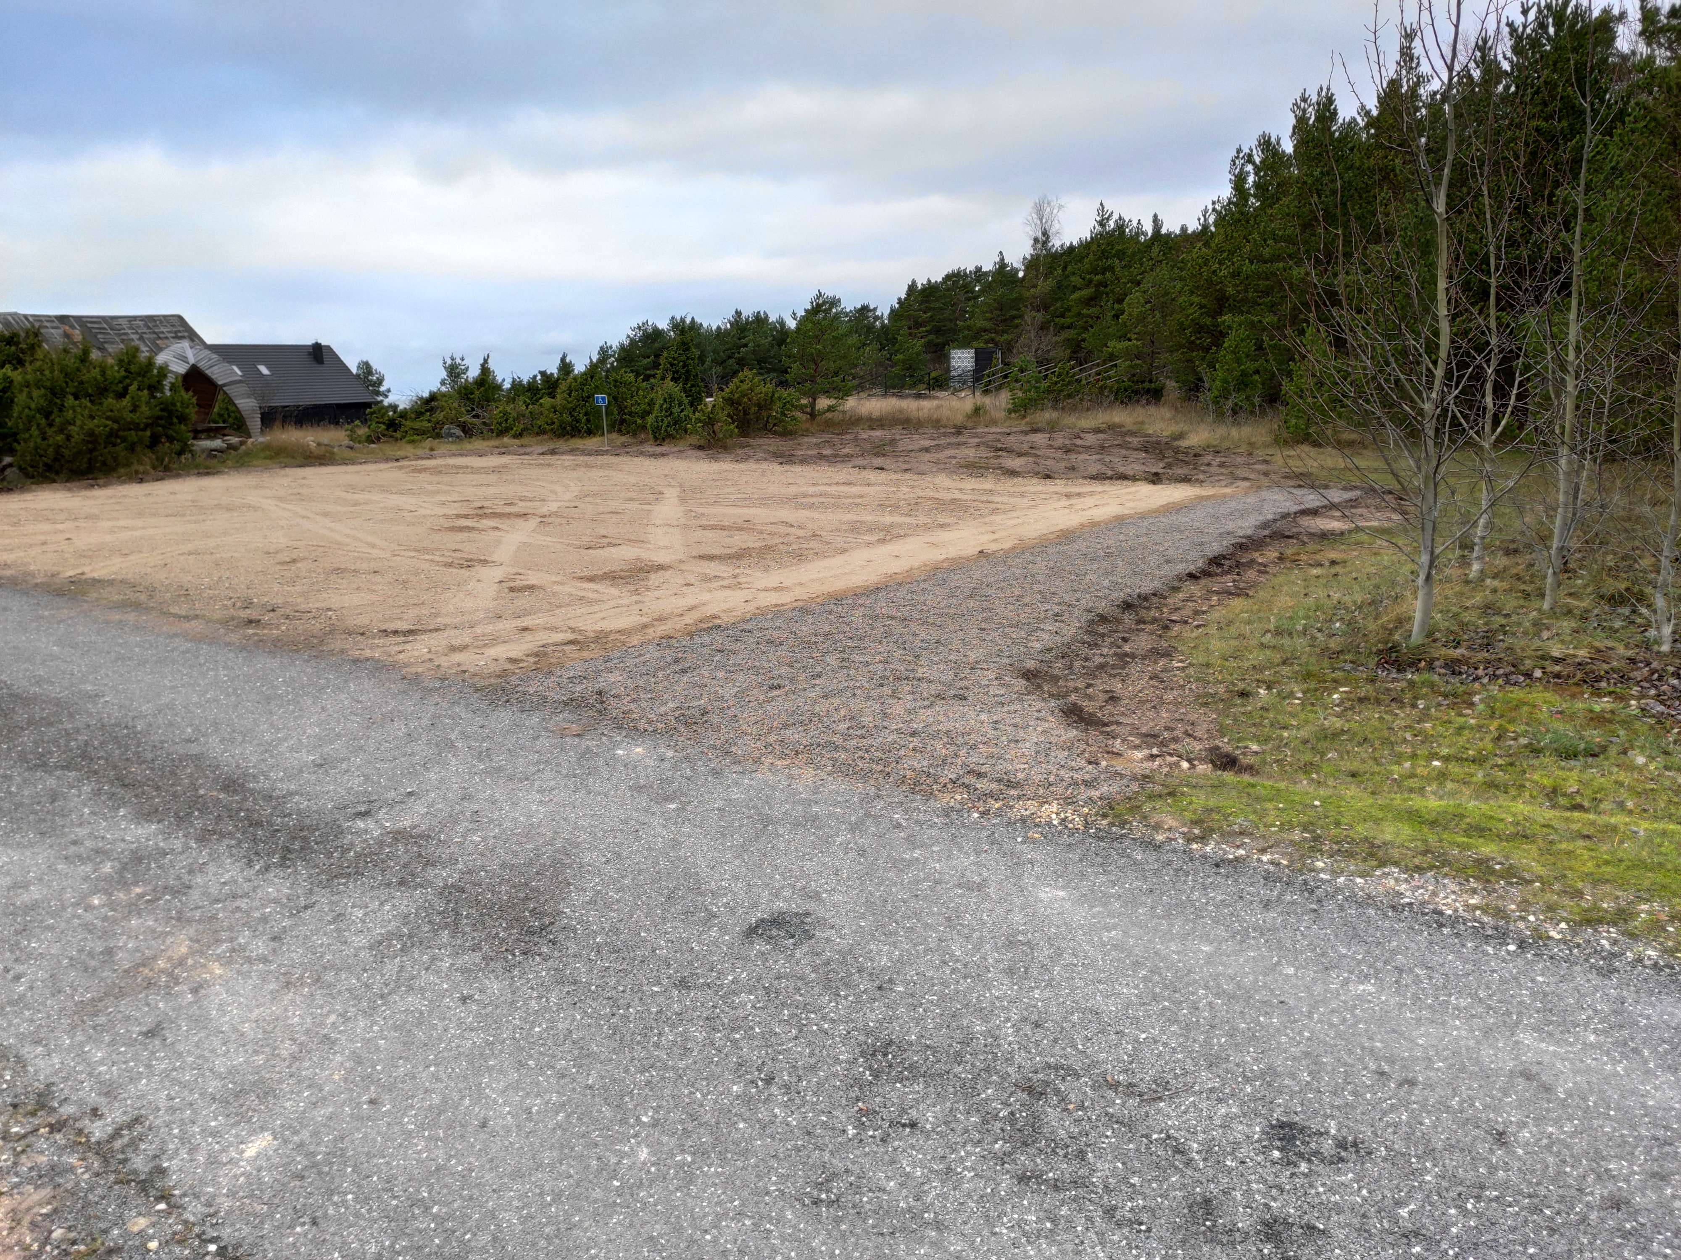
Activities carried out in Period 1. Investments
Haapsalu Paralepa invatoilet - procurement has been carried out and object is under construction and will be completed in April 2019.
Access to Matsi resting area, port and beach (dry-closets, parking spots, tactile path) - parking lot is completed.

Slide 4
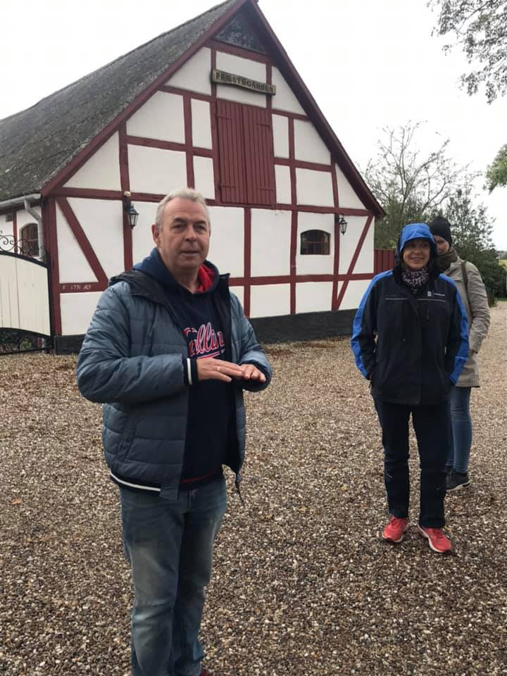
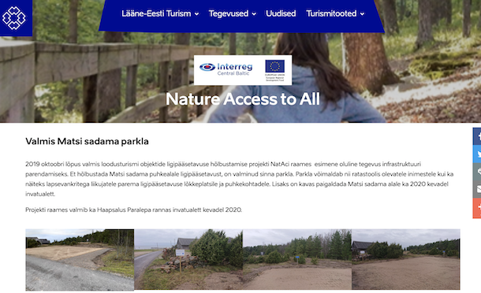
Joint product development
Study trip – 10 persons from West-Estonia were participated
Project sub-page is done
Trail Passport. Accessibilitly check-list.
List of accsessible objects is made

Slide 5
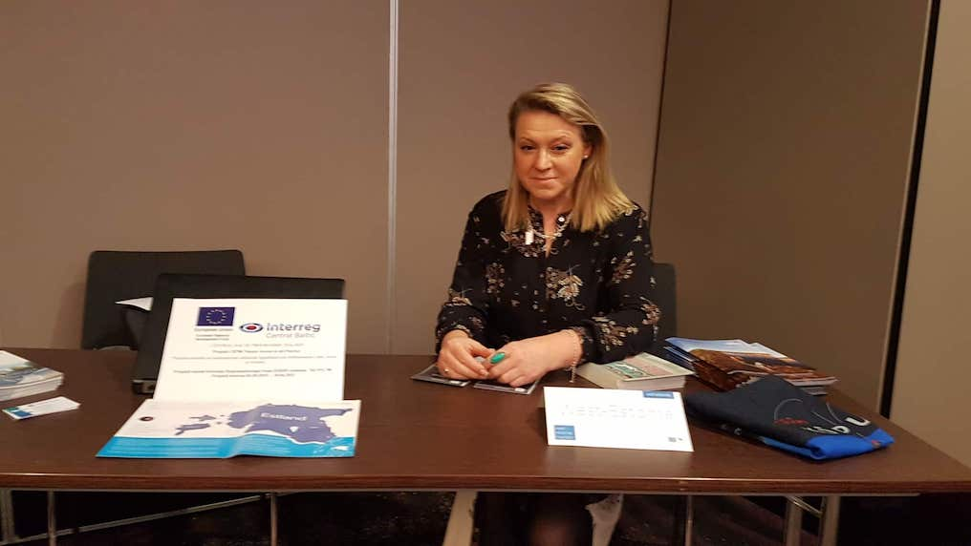
Period 2
PP meeting in Haapsalu in 13-14.11.2019
On-spot visits, inspecting trails for the Travel Guide and Internet Platform.
Köln workshop 12.11.2019, Anne-Ly participated, London workshop in 04.02.2020 ???
thematic workshop for municipalities, visitor centres, local operators etc. is begun. January 2020?

Slide 6
Period 2 investments
Palivere Health Trail (trail, infostands, audio-infostands, signs, benches, waste-bins, closet) and Matsi invatoilet first procurement failed, new technical conditions are under preparation, new procurement December 2019.
Fishing sites in Saaremaa - procurement December 2019.
The construction of the objects should be completed by April 2020

